Slide 1
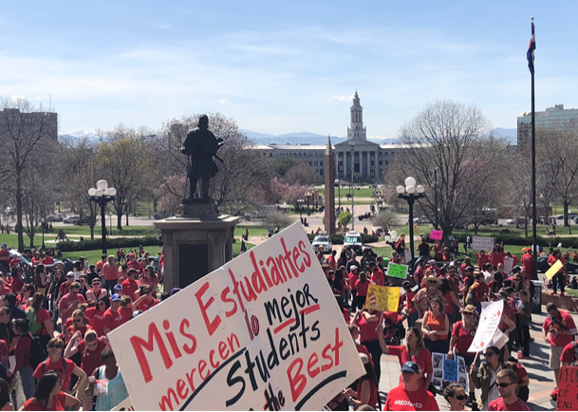
Retirement Security in Uncertain Times
Mary Kusler, Senior Director
Center for Advocacy, NEA

Slide 2
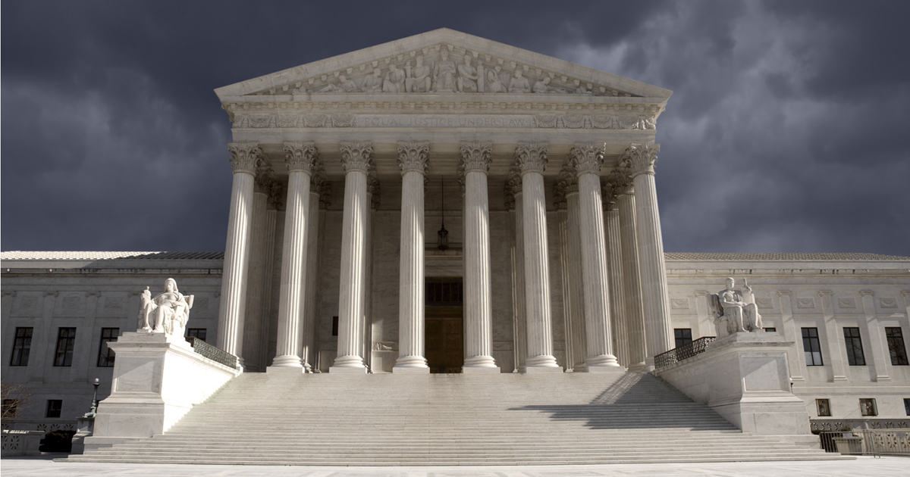
SCOTUS in the Crosshairs
Bigger story then Janus?
Justice Kennedy, 81, retiring
Next justice has the ability to entirely swing the makeup of the court
Messaging on Janus
Corporations and wealthy elites rigging the system against working people
Unions = path to the middle class
Unions are not going away. We will continue to stand up and speak up for students and working families
Notes:
And then there’s Janus v. AFSCME….
Now, you all know we’ve been down this road before. We caught a break on Friedrichs. But lightening is unlikely to strike again in the Supreme Court. We have to prepare.
.

Slide 3
Percent change in total state funding 2008-2015
■ Current funding level below 2008
■ Current funding higher than 2008 level

Slide 4
Wage gap between public school teachers and similar workers 1979–2015
The teacher wage gap grew from -5.5% in 1979 to a record -17% in 2015

Slide 5
Teachers have faced a 9% increase in health insurance premiums

Slide 6
Education support professionals
Analysis:
ESPs working full time make an average of $29,528 annually
28% of ESPs working full time have earnings of more than $35,000 a year
Office and administrative support is the largest category of education support professionals, with 28% of all employees
19% of all ESPs have average earnings of under $15,000 a year

Slide 7
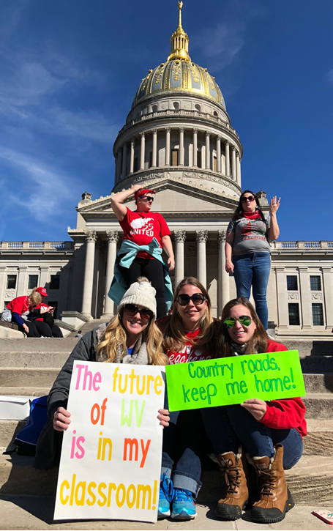
Educator Spring #RedforEd
Decades of cuts to education funding, stagnant and falling teacher salaries, rising healthcare costs
Hundreds of thousands educators have taken to the streets
WV, KY, OK, CO, AZ, NC
Many smaller communities

Slide 8
What have we learned? #RedforEd
Social media is a powerful organizer – it doesn’t care if you are a member or not
Educators can talk in real time and much quicker than the union can talk to them
There is a need for authentic messaging (e.g. Facebook live)
Normal chains of union messaging no longer work.
Need strong educator-to-educator push
Superintendents proved important

Slide 9
Effects of teacher activism
This activism has also caused educators to step up and run for office
In KY, 40 educators have filed to run for office
NEA launched See Educators Run as a way to train and support NEA members running for office
Training in Atlanta trained over 60 current or potential candidates and another training in Chicago at the end of summer

Slide 10
Health care under Trump
Federal Medicaid policy
Eligibility requirements for adults and children vary by state
Under Section 1115 of the Social Security Act, states may apply for Medicaid waivers
These waivers allow states to implement changes to their Medicaid programs, so long as they can show that the changes will reduce costs, be budget neutral or improve quality of care
CHIP funding extension
January & February 2018
Funding for CHIP expired on September 30, 2017, but was reauthorized for six years in January 2018. Three weeks later, it was authorized for an additional four years, through FY 2027
Executive order
April 10, 2018
President Trump signed an executive order calling on several federal agencies, including HHS, to reexamine public assistance programs that do not currently require work for the receipt of benefits or services

Slide 11
Health care under Trump
Federal Medicare spending by category
2006 to 2015
CMS
In an effort to address Medicare prescription drug costs, CMS issued a final rule that will allow members to purchase less expensive biosimilars and generic drugs
CMS Administrator Seema Verma has said the final rule will remove “burdensome regulations” for Medicare Advantage and Part D
The rule will also change the way Medicare covers opioid medications, establishing a ceiling of 90 mg morphine-equivalent units for opioid prescriptions beginning in 2019
The policy will also cap all new opioid prescriptions for short-term acute pain at a week-long supply
$638 billion
14%
7%
$402 billion
11%
17%
14%
5%
15%
11%
22%
31%
16%
27%

Slide 12
GPO & WEP
Government Pension Offset (GPO): Reduces, by two-thirds, Social Security spousal or survivor benefits of people not covered by Social Security themselves
Windfall Elimination Provision (WEP): Reduces, by up to 50%, Social Security benefits of people who work in jobs covered by Social Security and jobs NOT covered by Social Security

Slide 13
Potential Legislation
Social Security Expansion Act (S. 427/H.R. 1114) would, over time, lift the cap on taxed income and boost Social Security benefits
Social Security Fairness Act of 2017 (S. 915/H.R. 1205) would fully repeal both GPO and WEP
Equal Treatment of Public Servants Act (Last Congress - H.R. 711), introduced in the 114th Congress could create new winners and losers

Slide 14
H.R. 711 in Numbers
1.5 million Social Security beneficiaries currently subject to the WEP
15 million retirees now exempt from the WEP would become subject to it
7.5 million would receive lower Social Security benefits than under current law
7.5 million would receive the same or slightly lower Social Security benefits than under current law
8 million people who are now exempt from the WEP with 30+ years of Social Security-covered earnings would become subject to it
Notes:
700,000 current retirees could be charged with an overpayment averaging roughly $8,000. In addition, their future monthly benefits could be reduced by $8,000, on average, over the next 10 years and additional amounts thereafter. (These are people whose Social Security benefits should be reduced under current law, but are not because the SSA does not know that they are receiving a public pension.)
Recovery of overpayments could be waived if (1) the beneficiary was without fault in causing it and (2) the recovery would “defeat the purpose of Title II” (generally, this means that the beneficiary can’t afford to pay it back) or recovery would be “against equity and good conscience” (generally, this means that the overpaid person has changed his or her position for the worse or relinquished a valuBenefits would rise (84 percent)—on average, by $77 per month.
Benefits would fall for 250,000 (16 percent)—on average, by $13 per month
7.5 million would receive lower Social Security benefits than under current law—on average, $46 per month less
7.5 million would receive the same or slightly lower Social Security benefits than under current law—on average, $3 per month less
Of the 8 million people who are now exempt from the WEP with 30+ years of Social Security-covered earnings would become subject to it (75 percent in this category have 4 or fewer years of non-covered earnings)

Slide 15
Reboot of H.R. 711
Ways and Means Chairman Brady (R-TX) and Ranking Member Neal (D-MA) holding stakeholder meetings to revive H.R. 711
Revised version would make changes that would take effect in 2025
After 2025, the WEP goes away and new formula would be used
In 2020, current retirees would get rebate of an additional $100 per month; their spouses would get an additional $50 per month
Cost expected to be between $10 billion and $50 billion
Notes:
Designed to give beneficiaries time to plan
Prior to 2025, the WEP would remain as is;
New proportional formula is the same as Public Service Fairness Formula
(both are indexed and include a COLA)
Requires SSA to include non-covered earnings on statements
Study to determine if data exchange between SSA and pension systems is possible
New proposed bill still creates winners and losers as some beneficiaries would indeed have lower earnings under the new system; full repeal of WEP would cost $40 billion and be paid for by expansion to everyone with non-covered earnings

Slide 16
2018 Social Security Trustees’ Report
The 2018 Social Security Trustees’ Report came out in June
Report projects Social Security’s reserve to be roughly $2.89 trillion
Social Security is fully funded for the next 16 years
93% funded for the next 25 years
87% funded over the next 50 years
84% funded over the next 75 years
With modest legislative increases in revenue, Social Security will be able to pay all scheduled benefits for the foreseeable future
Notes:
Showed Social Security is fully affordable, now and in the future
Reveals that the question of whether to expand or cut Social Security is a matter of values
Social Security system has allowed generations of working Americans to earn critical wage insurance protections for themselves and their families, with incredible success
Social Security is conservatively managed (administrative expenses are less than one penny of every dollar spent) and prudently administered
Without a single penny of additional revenue, Social Security will have sufficient income and assets to pay all administrative costs and benefits for about 15 years, three-quarters of all benefits and all benefits and administrative costs thereafter

Slide 17
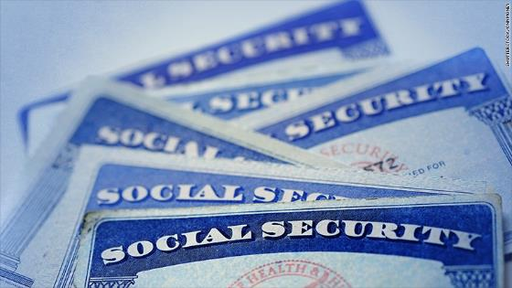
Social Security Field Offices Closures
SSA has closed or is in the process of closing field offices across the country
Bad time to close field offices given the number of people receiving Social Security benefits is rising
NEA is working with allies to stem the tide of offices being closed
Notes:
Offices closed in Arlington, Virginia, Chicago, Illinois; Baltimore, Maryland, and Milwaukee, Wisconsin
We do not know if additional offices are scheduled for closure
As baby boomers age and in-person visits to field offices have only increased, SSA should be opening more offices rather than making it harder for Americans to access their hard-earned benefits.

Slide 18
Social Security: Potential Changes
Raise full retirement age (now 66 and 4 months, gradually rises to 67)
Recalculate COLAs
Lift payroll cap earnings over $128,700 not taxed
Reduce benefits for high earners
Make Social Security mandatory for new hires
House Republican FY 2019 Budget Resolution cuts $4 billion from Social Security disability benefits

Slide 19
2018 Medicare Trustees’ Report
Fund that pays hospital bills for Medicare’s 60 million beneficiaries will fall short in 2026
Weak projections are a result of lower-than-expected 2017 income in the Medicare fund and higher-than-predicted spending
Notes:
This is three years earlier than last year’s projection
Medicare fund gets most of its revenue from Medicare taxes deducted from workers’ paychecks

Slide 20
Proposed Cuts to Medicare
The Tax Cuts and Jobs Act that passed at the end of 2017 added $1.9 trillion to deficit
To help offset deficit, Republicans are once again proposing massive spending cuts
The FY 2019 Republican Budget Resolution proposes a $537 billion cut to Medicare
Creates higher out-of-pocket costs for seniors

Slide 21
More Proposed Medicare Cuts
Proposes replacing guaranteed Medicare benefit with a voucher
Cuts an additional $59 billion by requiring beneficiaries in the Part D “donut hole” to pay more
Increases the Medicare eligibility age from 65 to 67

Slide 22
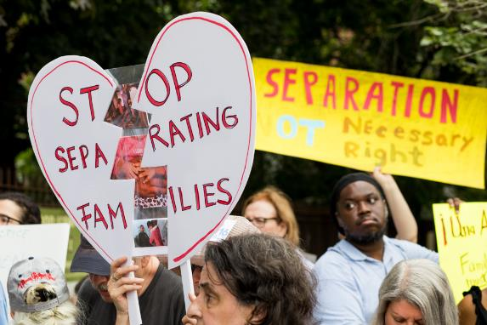
Immigration under Trump
In May 2018, Attorney General Jeff Sessions announced that Immigration and Customs Enforcement (ICE) and the Trump administration would adopt a “zero-tolerance” policy toward anyone caught crossing into the US by Border Patrol
The Department of Homeland Security on Friday confirmed that about 2,000 children were separated from their parents at the border during a six-week period this spring
The New York Times reported that some immigrant parents are being deported without being able to recover their children first
Trump reversed his family separation policy without a set way to reunify families that have been already separated.
Attack on the Flores amendment
Join us!
Saturday, June 30th @ 2pm
Convention Center Entrance
Wear White

Slide 23
The Day has Come and Gone…
Approximate active DACA recipients whose registration expired between 9/5/2017 and 3/5/2018
Ending DACA jeopardizes future of 800,000 aspiring Americans
DACA recipients include many students and educators worried about what the future holds
The March 5 deadline (Trump’s self- imposed deadline) has passed, leaving thousands of Dreamers in limbo
Court rulings have left the path forward unclear for new applicants
Details
Trump has advised the Department of Homeland Security that DACA recipients are not enforcement priorities unless they are criminals, are involved in criminal activity, or are members of a gang

Slide 24
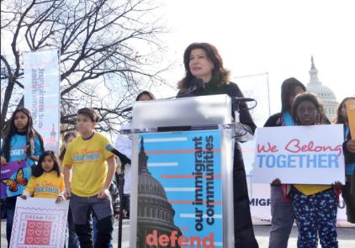
So what is next?
The administration continues to propose hostile policies of walls, family separation, deportation and turning away refugees. Both the House and the Senate defeated.
Pressure is building among republicans to do something on immigration reform. Moderate republicans led on a procedural move that would have forced a vote on a number of proposals including the Dream Act. Short 2 votes to move forward.
Bipartisan Dream Act of 2017 (S. 1615/H.R. 3440)
Immediate action to address current crisis — for example, Dreamer fix combined with reasonable border security measures

Slide 25
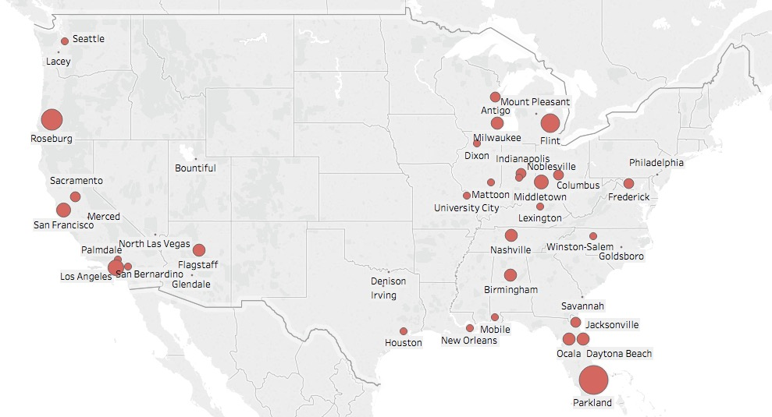
School shootings so far in 2018
Size represents the number of people injured

Slide 26
Students Demand Action
They are energized and demanding answers
We cannot wake to another school shooting
Action = electoral change
www.protectourschool.com

Slide 27
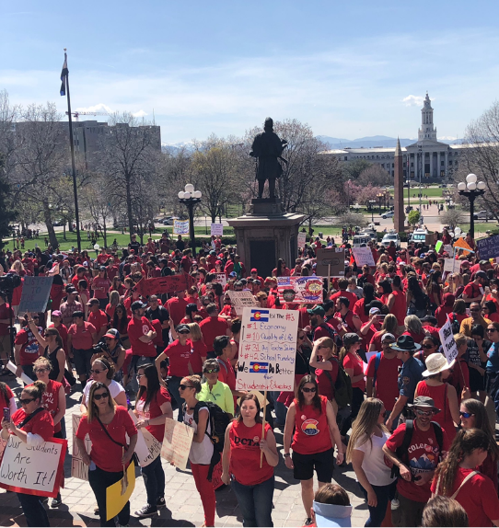
So what now?
Yes, it’s about winning and losing elections and legislative efforts but it is about more than that.
How are we building state, local and member capacity?
How are we linking our efforts back to members and membership?

