Slide 1
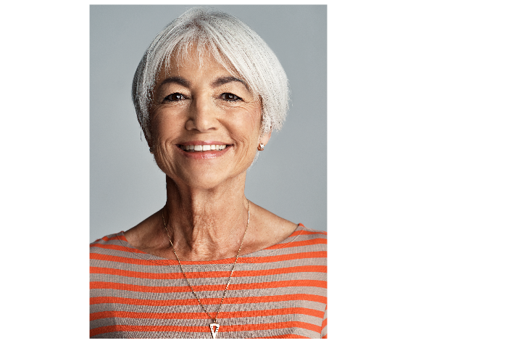

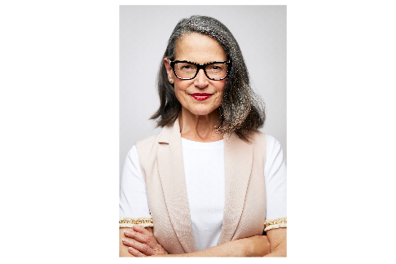
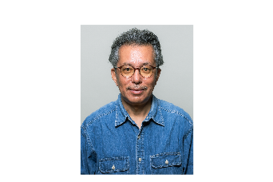

Experience fuels our mission!
Notes:
[Introduce yourself]
You’ve devoted your career to helping students succeed. And along the way, your union has been with you every step. As you plan for your retirement, NEA (state and local) is here to help. And that’s what I want to talk with you about today. NEA-Retired is home to hundreds of thousands of experienced voices who want to stay connected to the profession, their union and each other. At NEA-Retired we like to say, “experience fuels or mission.”

Slide 2
OUR MISSION:
To promote secure retirement with dignity; advance equitable and quality public education; and advocate for human, civil, and economic rights for all.
Notes:
Our mission centers your dedication to public education for all students as well as our commitment to you in your retirement.

Slide 3
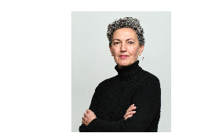
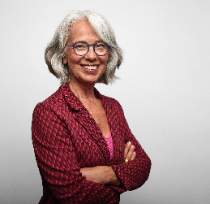

Where the voices
of experience come to:
CONTINUE ADVOCACY ENJOY BENEFITS STAY CONNECTED CONTINUE ADVOCACY ENJOY BENEFITS STAY CONNECTED
CONTINUE ADVOCACY ENJOY BENEFITS STAY CONNECTED
Notes:
Joining NEA-Retired opens the door to a new way of advocating for educators and students, secures the benefits you’ve earned and deserve, and keeps you connected to the profession. So, what does that look like? I’m glad you asked!

Slide 4
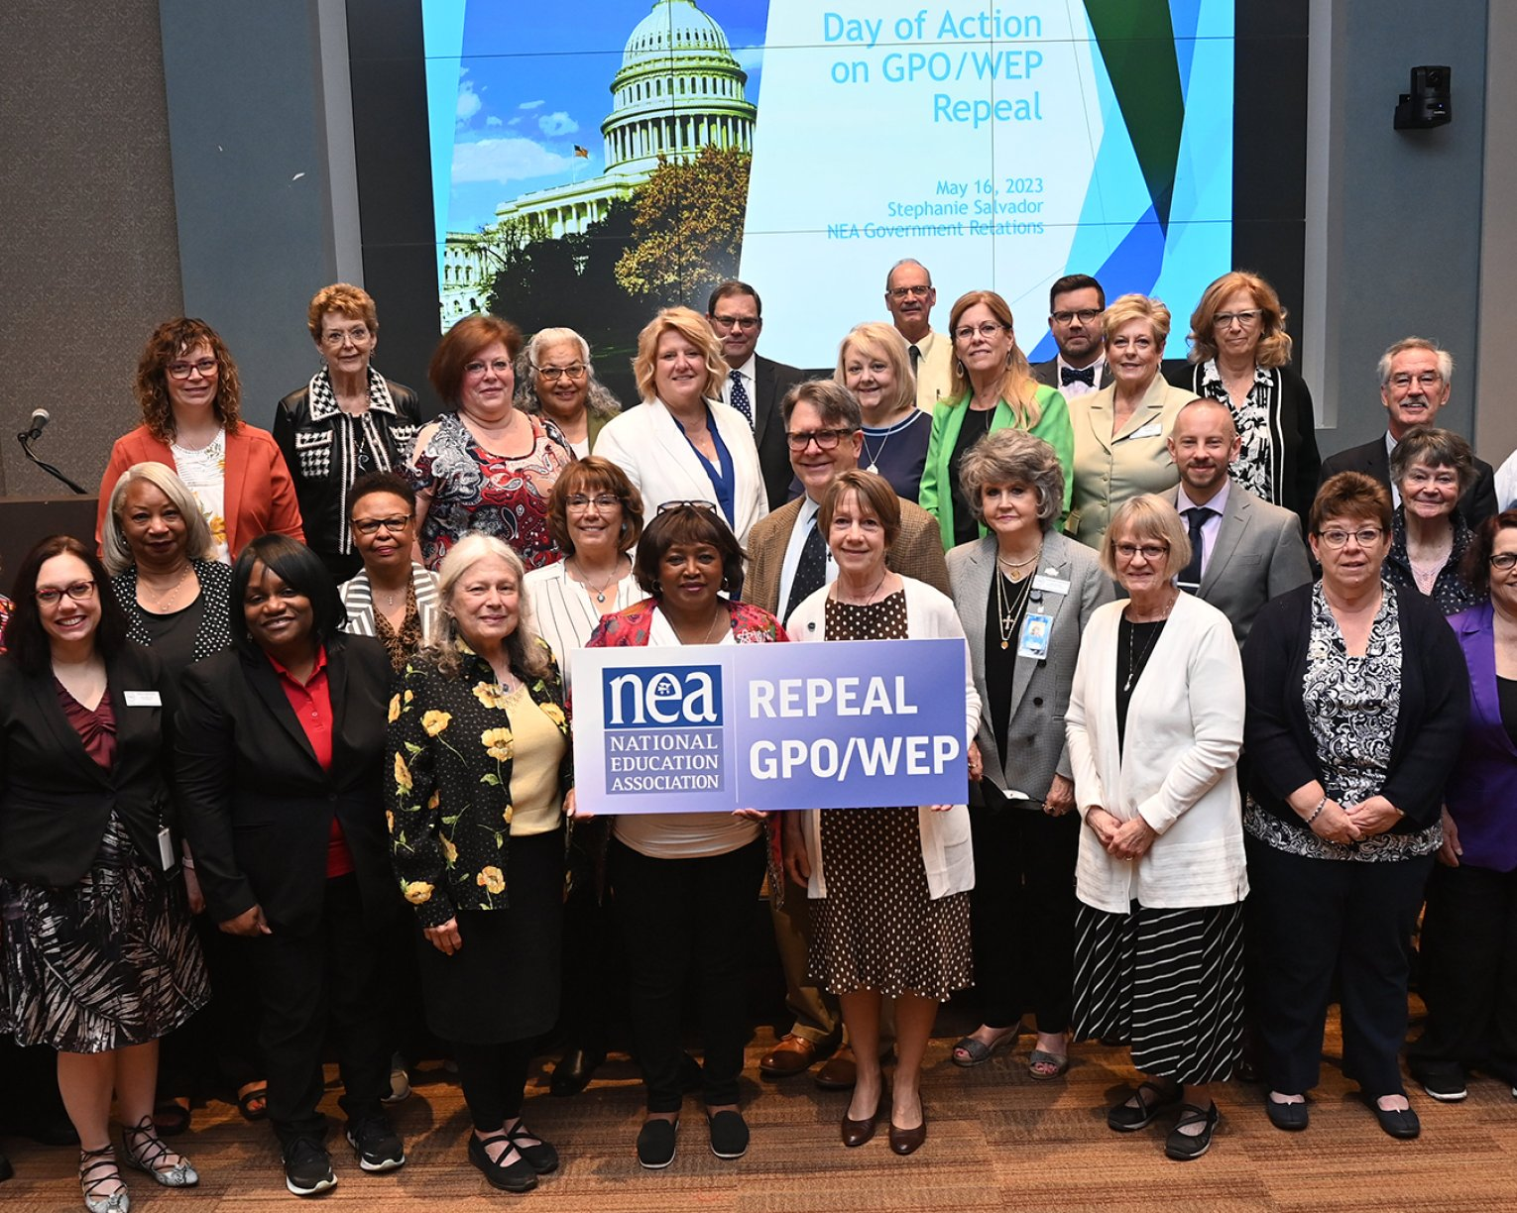
CONTINUE ADVOCACY ENJOY BENEFITS STAY CONNECTED
Our members are leading efforts to:
Safeguard retirement
Repeal the Government Pension Offset
Increase school funding
Protect rights of students, educators and voters
Notes:
At local school boards, state capitols and in the halls of Congress, NEA-Retired members are raising their experienced voices to safeguard and improve retirement pension and health benefits. This includes ongoing and bipartisan efforts to repeal the Government Pension Offset and Windfall Elimination Provision, which has robbed millions of educators of Social Security benefits they have already earned. NEA-Retired members are pushing to increase school funding, protect the rights of students and educators, and dismantle systematic racism they’ve witnessed in their schools and communities for decades. They are walking the lines to support local bargaining efforts. They are showing up in new ways of advocating for a career and a cause they’ve dedicated their life to.

Slide 5


CONTINUE ADVOCACY ENJOY BENEFITS STAY CONNECTED
The buying power of 3 million educators brings you special rates on:
Insurance (including for your pet)
Savings and investment accounts
Loans and mortgages
Purchasing a new car
Vacation for you and the grandkids
Notes:
At NEA [include state and local], we believe a lifetime of devotion to public education deserves a lifetime of benefits. In retirement, your hard-earned money will go further when you continue to take advantage of NEA Member Benefits. There are offerings designed to capitalize on the buying power of 3 million members. There are special rates for insurances (including insurance for your pet), savings and investments, loans and mortgages, as well as all the fun stuff—like buying a new car, taking that bucket list vacation, or surprising the grandkids with a trip to the beach or theme park. When you join NEA-Retired you will keep that purchasing power in your pocket (or pocketbook).

Slide 6
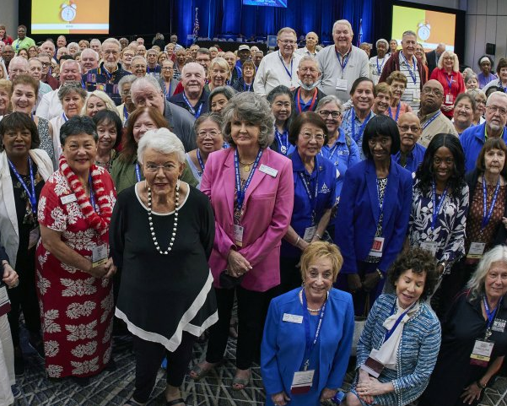
CONTINUE ADVOCACY ENJOY BENEFITS STAY CONNECTED
Stay connected and get involved!
Attend annual conferences
Run for leadership positions
Mentor new educators
Help organize your local union
Apply for scholarships
Notes:
With NEA-Retired, your devotion to the public education will feel right at home. And when you are ready you can be as involved as you want. What many NEA-Retired members will tell you they value most is the opportunity to connect with new retirees in their state and around the country. With NEA-Retired, there is no shortage of ways to get involved and to help make improvements in public education. You can run for a leadership position, make new friends and see some familiar faces at annual conferences, help your local union organize new members, mentor new educators, and much more.

Slide 7

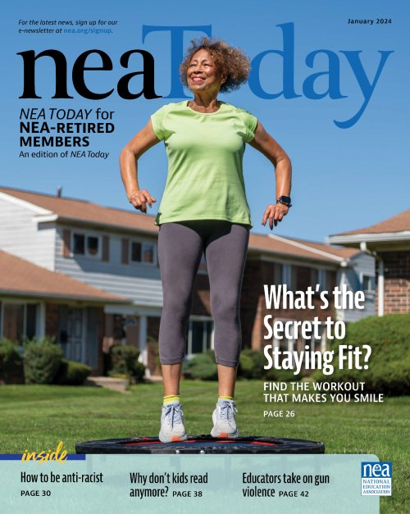
NEWS YOU CAN TRUST
Stay up-to-date on critical issues in education, remain engaged in your profession and maintain access to valuable benefits.
Notes:
NEA-Retired members still want to know what is going on in the profession and what they can do to help. Whether it’s reading the quarterly NEA Today for Retired Members or visiting nea.org/retired, NEA is the news source you can trust to keep you informed about the latest politics, benefits, scholarships and happenings. As a members of NEA-Retired you will stay up-to-date on critical issues in education, remain engaged in your profession, and maintain access to valuable benefits.

Slide 8

SO, YOU’RE “JUST THINKING” ABOUT IT?
That’s great!
We can help with that!
vecteezy.com
Notes:
Deciding when to retire is a very personal and important decision. Whether you’ve already planned your retirement are just beginning to think about it, NEA-Retired is here to help and is ready to welcome you! Signing up for a NEA-Retired Lifetime Membership in advance of retirement plans, whether your retirement plans are set in stone or you’re “just thinking” about it, will ensure a seamless membership transition into your well-deserved retirement. That way there will be no interruption in the member benefits you used as an active member. Signing up for a NEA-Retired Lifetime Membership today is an easy and smart investment in your future.

Slide 9

OUR MEMBERS
ARE EXPERIENCED, DEDICATED AND ENGAGED!
Notes:
Whether you’re already retired or planning your transition from your education career, membership in NEA-Retired can offer you a more fulfilling retirement as you maintain a lifetime commitment as a champion for public education. We invite you to join our roster of experienced, dedicated and engaged members.

Slide 10
State Logo
LEARN MORE
nea.org/retired
JOIN NEA-RETIRED
nea.org/join-NEA-Retired
FOLLOW & LIKE US
facebook.com/NEA-R
LEARN MORE
state
JOIN NEA-RETIRED
state
FOLLOW & LIKE US
state
Join Us!

