Slide 1
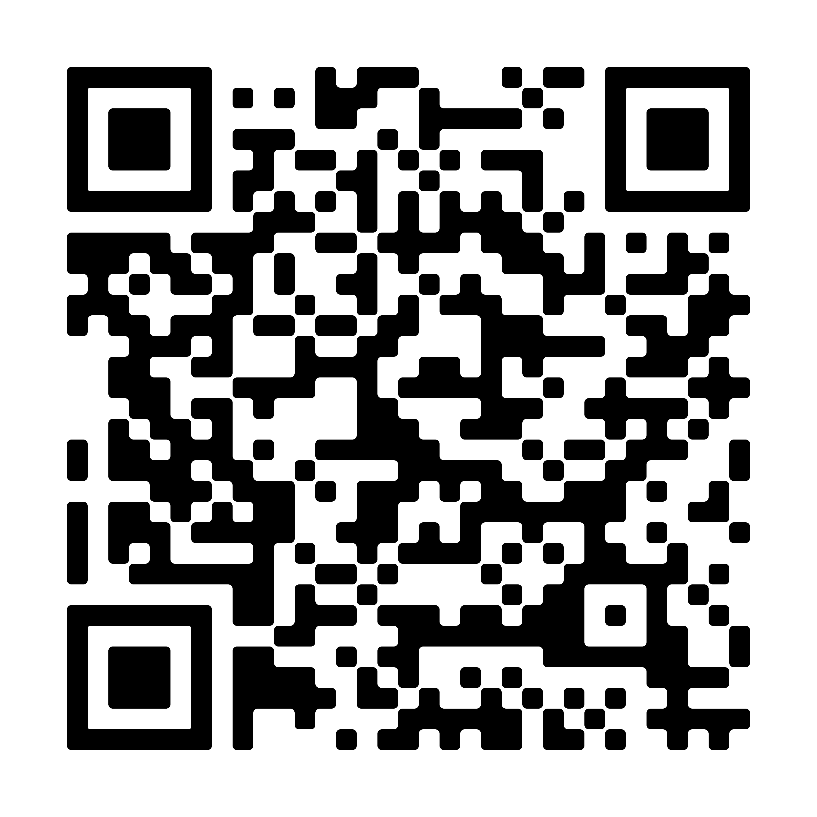
Resources
Guidance includes:
Immigration & Schools 101
Immigration Enforcement at Schools
Safe Advocacy Tips for Educators
Know Your Rights Guides
Higher Ed Guidance
Safe Zones sample policy and FAQs

Slide 2
Additional Immigration Resources
Red Cards: https://www.ilrc.org/red-cards-tarjetas-rojas
Family Preparedness Plan: https://www.ilrc.org/sites/default/files/resources/family_preparedness_plan_v3-20170323.pdf
Education for All Campaign: https://education4all.us/
Plyler and Data Collection: https://www.nilc.org/resources/plyler-and-data-collection

Slide 3
LGBTQ+ Rights & Resources
  Responding to the Gender Identity EO: What Educators Should Know About the Gender Identity Executive Order and LGBTQI+ Rights | NEA
  Responding to the K-12 Schooling EO: Educator Support for Transgender, Nonbinary and Intersex Students: Setting the Record Straight on the K-12 Schooling Executive Order | NEA
  Broader Guidance: What Educators Should Know About LGBTQ+ Rights | NEA

