Slide 1




BRIDGING GENERATIONS
RETIRED + AE
Grace Callen + Peyton Richards

Slide 2
NEA MEMBERS AND EXTERNAL AUDIENCES
This presentation and its contents are confidential and may not be further distributed or passed on to any other person or published or reproduced, in whole or in part, by any medium or in any form for any purpose. Audio/video recording, copying of slides, and the use of AI note-taking tools are prohibited without the written consent. Violation of these terms may result in legal action.

Slide 3



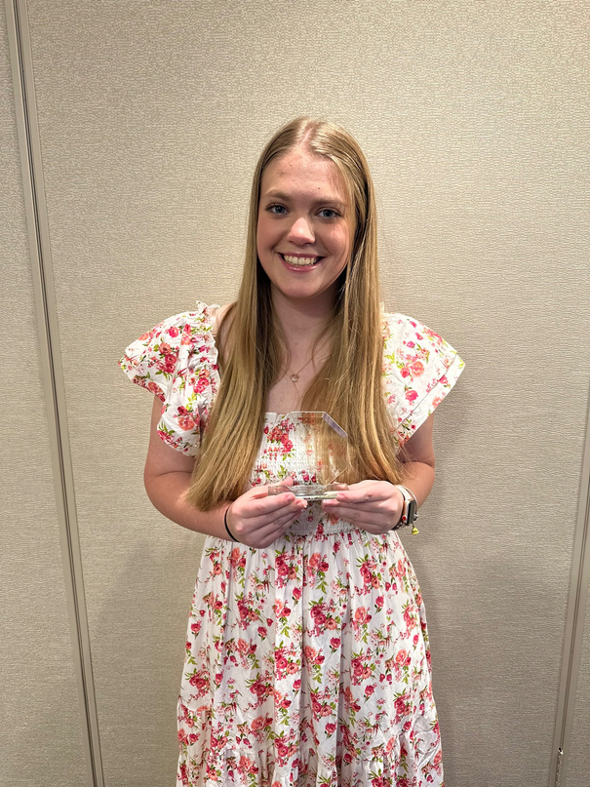
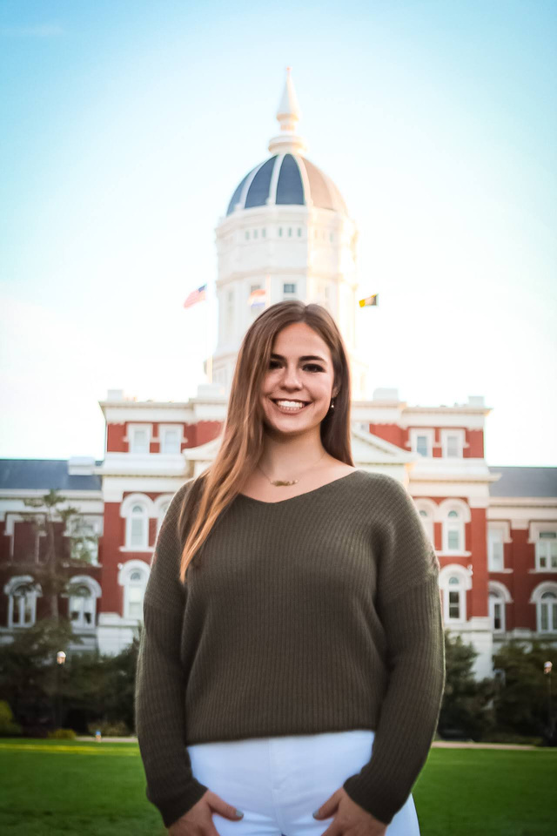

HELLO! WE ARE SO GLAD YOU’RE HERE!
Peyton Richards
Grace Callen
Elementary Ed - Mizzou
MS Science - Mizzou
Notes:
Welcome to our session on 'Bridging Generations: Legislative Advocacy and the Role of Retired Educators in Supporting Aspiring Educators.' We are your presenters, Grace Callen and Peyton Richards, and we are honored to be here today to discuss how we can build strong intergenerational partnerships to advocate for public education.As we look toward the future of education, it is essential to foster connections between those who have spent years in the classroom and those just beginning their careers. Retired educators have a wealth of experience to offer, and aspiring educators bring fresh perspectives and energy to the field. Together, we can advocate for policies that support a stronger, more equitable public education system for all
Peyton: “Let’s take a look at what we’ll be covering today. We’ll start by exploring the current legislative challenges facing public education. Missouri Aspiring Educators (AEs) are leading the charge to address some of these challenges. Then, we’ll talk about the crucial role retired educators play in supporting these efforts, whether it’s through mentorship, advocacy, or grassroots organizing. By the end of the session, we’ll work together to develop action plans that bring these ideas to life.”
Grace: “The goal today is for everyone to leave with actionable strategies. We will give you the tools and insight you need to make a difference in your communities and beyond.”

Slide 4


WHAT’S THE PLAN?
01
02
03
Understand the current legislative challenges that public education faces and how Missouri Aspiring Educators (AEs) are advocating for positive change.
Develop an action plan that includes advocacy steps retired educators and AEs can take together to influence public education policies.
Identify ways in which retired educators can actively support AEs through mentorship, advocacy, and grassroots efforts.

Slide 5


INTRODUCTION
TO THE MISSOURI AE
The MNEA Aspiring Educators Program, part of the National Education Association (NEA), connects over 50,000 future educators nationwide, offering the tools, resources, and support you need to succeed. Members receive access to scholarships, $4 million in professional liability coverage, free legal consultations, and leadership opportunities at local, state, and national levels.
As well as, receive essential resources like the Start Smart handbook, Something Better magazine, and salary benchmarks to compare Missouri school district salaries.
TeachMO offers tools and resources to streamline your journey, from application checklists to a chance at a $1,000 scholarship.
Notes:
- Briefly introduce the AE program/organization.
- Highlight the AEs' commitment to public education.
- Showcase some of the AEs' current legislative advocacy efforts (with brief examples).

Slide 6


WHAT ARE SOME OF
AE’S PRIORITY?
Lobbying & Policy Engagement
Protecting DEI & Student Resources
Addressing the Teacher Pipeline Crisis
Fighting for Fair Compensation & Working Conditions

Slide 7
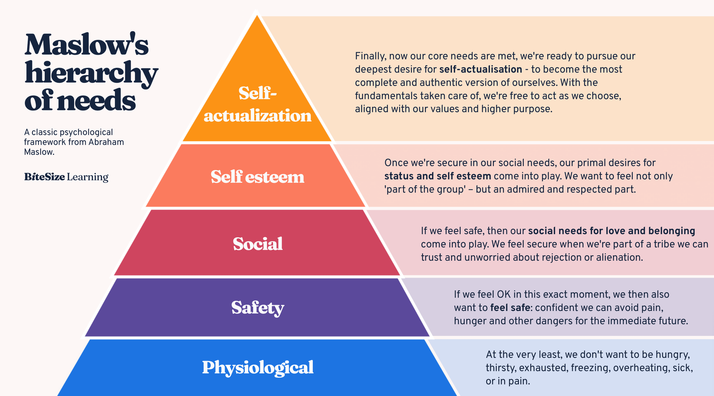
Notes:
Within the AE program, we base our work around the argument of Maslow’s Hierarchy of Needs. Society regularly applies this to both students and teachers, so in what world does it make sense to exile the in-between demographic from application of the exact same concept?

Slide 8
PAID STUDENT TEACHING
FACTS
Michigan - $4,800/sem, $9,600/year
Colorado - $11,000/sem, $22,000/year
Maryland - $20,000/year
Kentucky - $5,000/sem
North Kansas City - $1,000/month
STL Public Schools - $132/day & 100% medical, dental and vision
MSU - Pathways for Paraprofessionals program

Slide 9

TEACHER SHORTAGES
National Statistics
  Current national teacher shortage: Approximately 300,000 teachers were needed for the 2021-2022 school year in the U.S. (Source: Learning Policy Institute).
  Teacher attrition rates: Nearly 50% of teachers leave the profession within the first 5 years (Source: National Center for Education Statistics).
  Missouri is facing significant teacher shortages, particularly in special education, math, and science (Source: Missouri DESE).

Slide 10
TEACHER SALARY
National Statistics
National Average: The average salary for public school teachers in the U.S. is around $58,000 (Source: National Center for Education Statistics).
    The average salary for Missouri teachers is approximately $50,000, which is below the national average (Source: Missouri DESE).

Slide 11
EDUCATION FUNDING
DISPARITIES
  National Funding Gap: The U.S. public school system faces a $23 billion annual funding gap between wealthy and low-income districts (Source: EdBuild).
  Impact on Students: Schools in low-income areas often have less access to advanced courses and fewer educational resources (Source: The Education Trust).

Slide 12
STUDENT DEMOGRAPHICS
  National Overview:
    Over 50% of U.S. public school students are from minority groups (Source: National Center for Education Statistics).
    The U.S. has about 8 million English Language Learners (ELLs) in K-12 schools (Source: National Education Association).
  Missouri-specific:
    40% of Missouri's K-12 students are students of color, with an increasing diversity in urban areas (Source: Missouri DESE).

Slide 13
EQUITY IN EDUCATION
  Achievement Gaps: Students from low-income backgrounds perform significantly lower than their peers from wealthier families in areas such as standardized testing and graduation rates (Source: The Education Trust).
  Funding Inequities: Disparities in school funding contribute to the achievement gap, where wealthier districts can spend up to twice as much per student as poorer districts (Source: EdBuild).

Slide 14
IMPACT OF TEACHER RETENTION
  Teacher Retention Rates: In districts with high teacher turnover, students experience lower academic achievement, especially in underserved areas (Source: Learning Policy Institute).
  Retention Strategies: States like Michigan and Colorado have implemented retention strategies like paid student teaching programs to address shortages and improve retention (Source: State Legislative Websites).

Slide 15
ASPIRING EDUCATORS
  Teacher Preparation Programs: The availability of resources for aspiring teachers, like those found in TeachMO and Missouri NEA, plays a role in addressing teacher shortages by offering career development and certification support (Source: TeachMO, Missouri NEA).

Slide 16
KEY CHALLENGES FOR MISSOURI ASPIRING EDUCATORS (AES):
Funding Gaps & Salary Disparities
  Missouri ranks among the lowest in starting teacher salaries, making recruitment and retention difficult.
  Rural and urban districts struggle with underfunding, leading to resource disparities.
Legislative Resistance to Public Education Support
  Missouri lawmakers often prioritize tax cuts over increasing education funding.
  Proposals for voucher programs and charter school expansion threaten public school resources.
Barriers to DEI & Equity Initiatives
  Recent legislation has sought to limit discussions on race, gender, and systemic inequities in teacher preparation programs.
  DEI programs at Missouri colleges have faced funding cuts and policy restrictions, impacting aspiring educators' access to training.

Slide 17

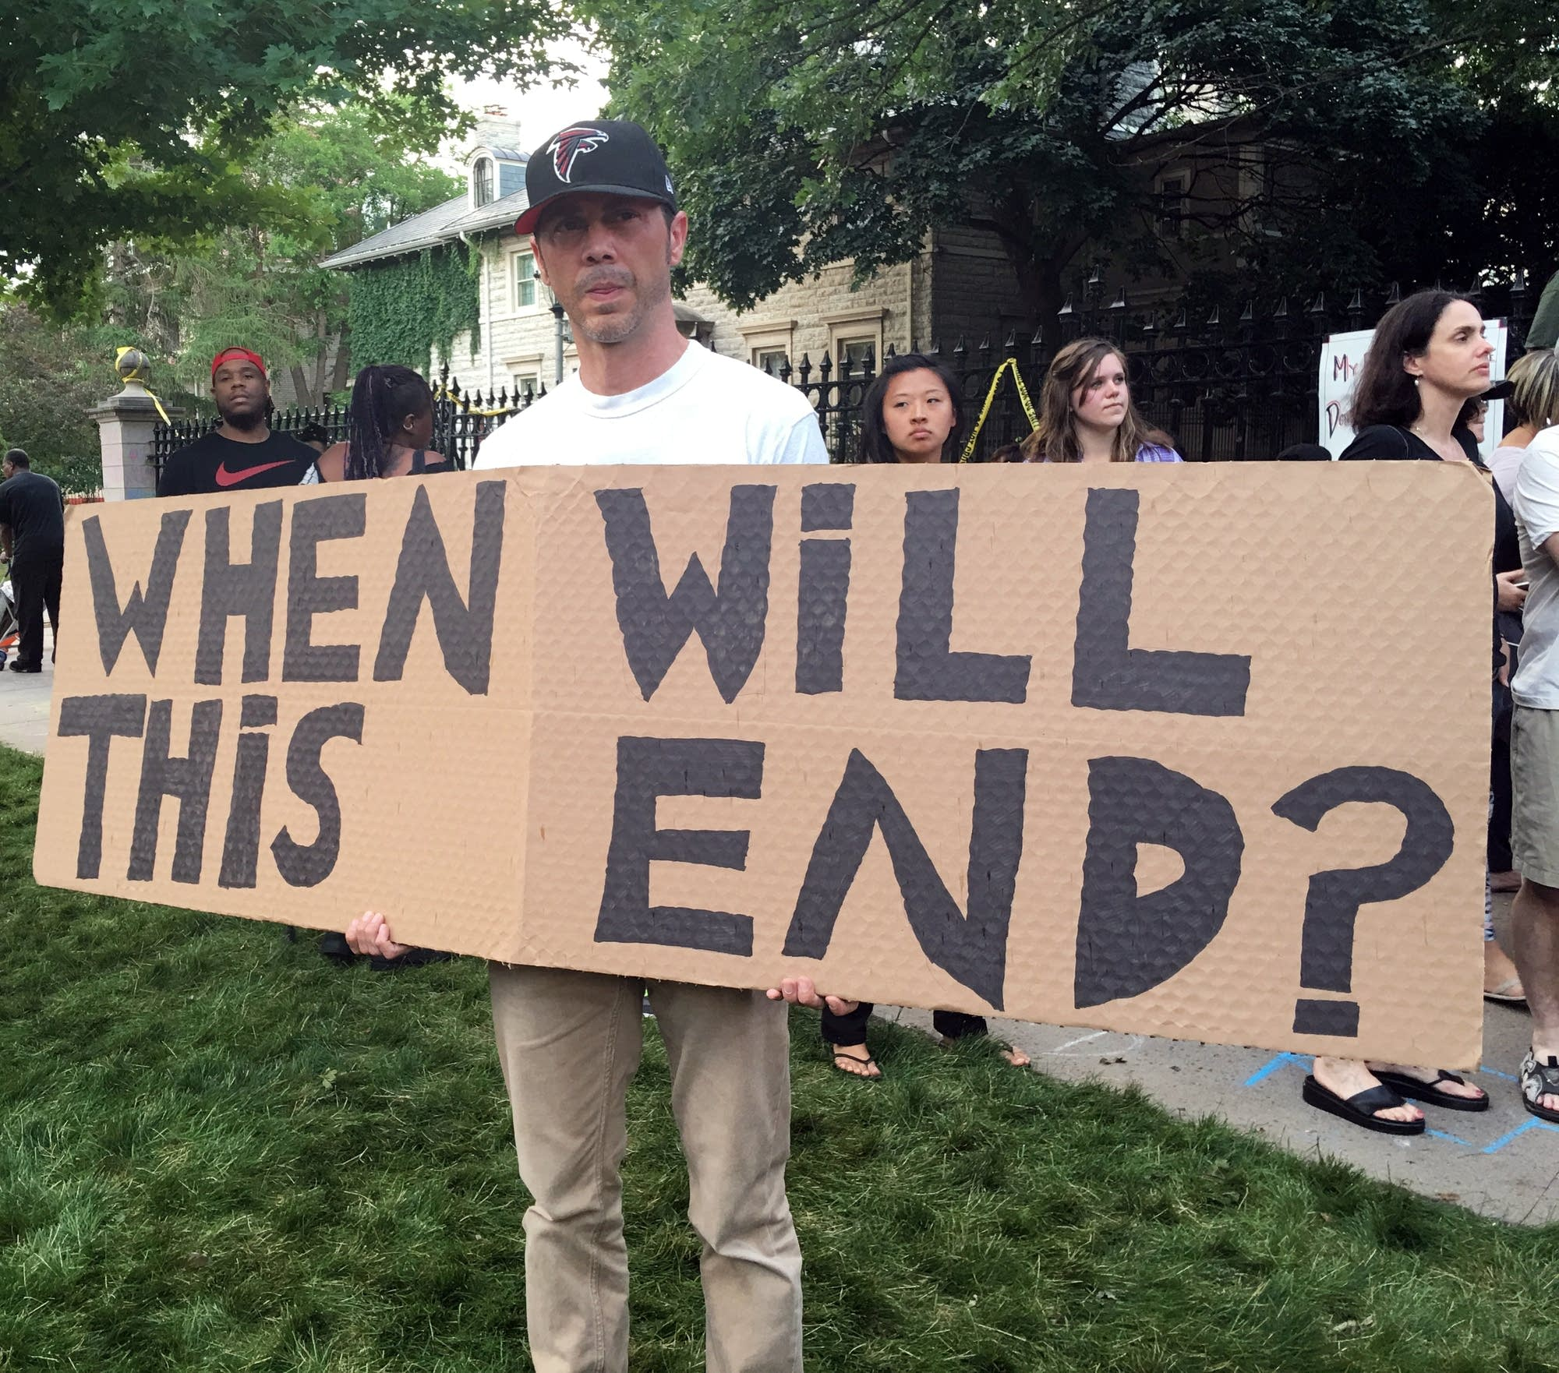
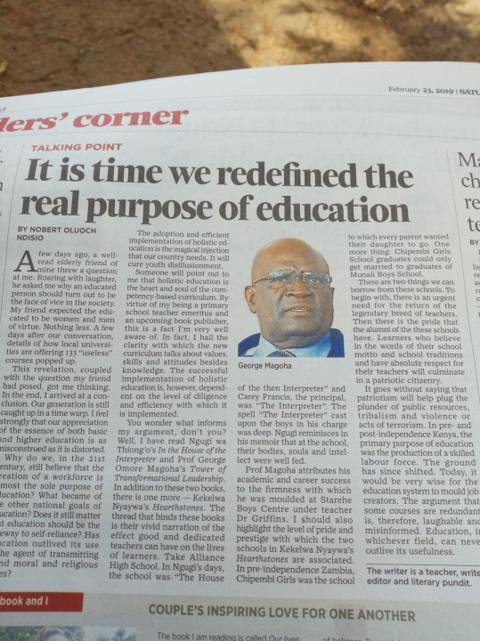
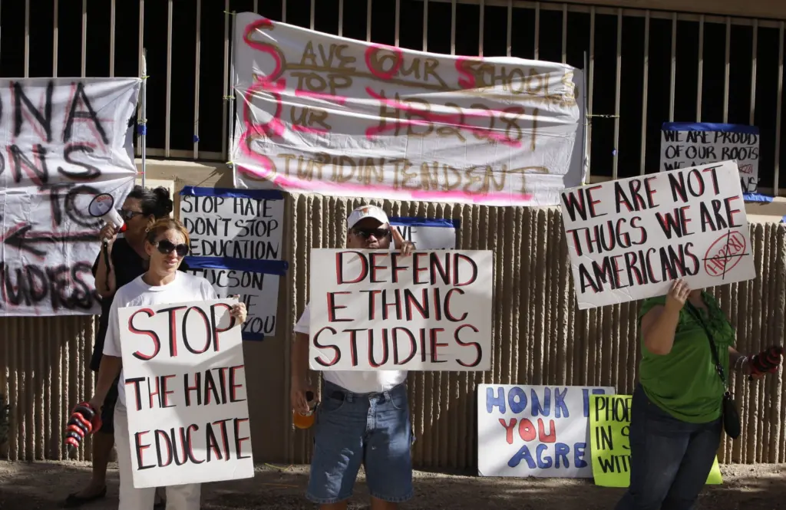
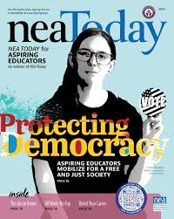
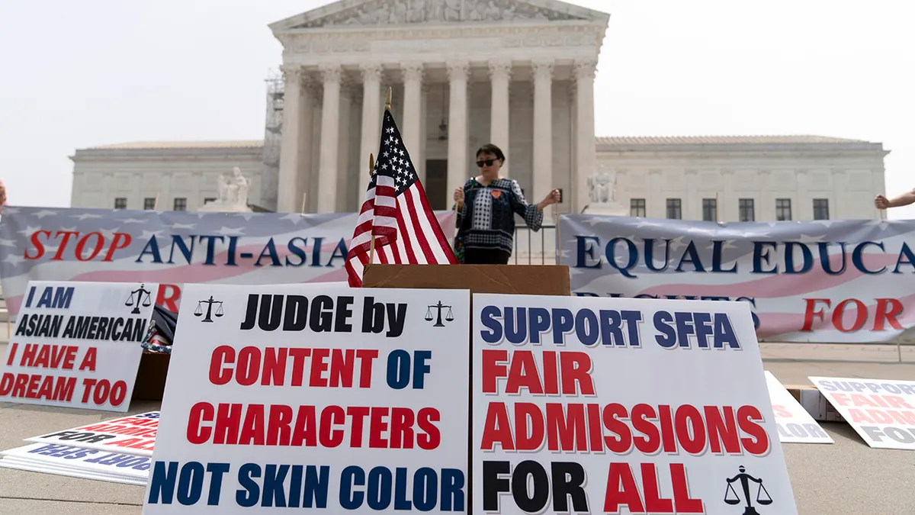
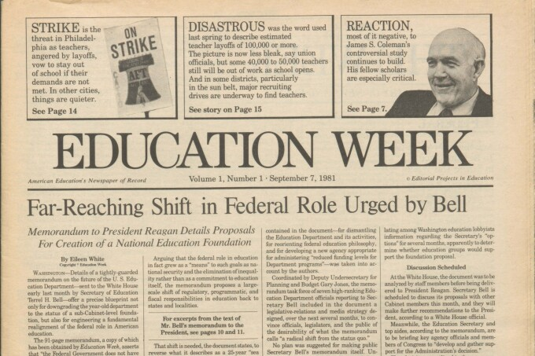
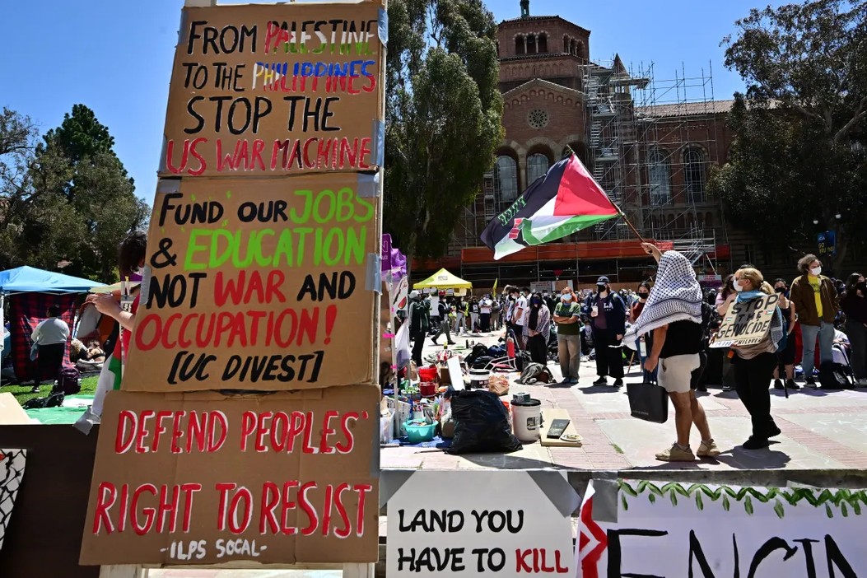

WHAT ARE THE CURRENT LEGISLATIVE CHALLENGES THAT PUBLIC EDUCATION FACES
Notes:
Present key legislative challenges impacting public education in Missouri (using data/statistics where possible).
Focus on 2-3 key issues for deeper dive in breakouts.
Mention any current legislative opportunities/bills being considered.

Slide 18
NEA MEMBERS AND EXTERNAL AUDIENCES
This presentation and its contents are confidential and may not be further distributed or passed on to any other person or published or reproduced, in whole or in part, by any medium or in any form for any purpose. Audio/video recording, copying of slides, and the use of AI note-taking tools are prohibited without the written consent. Violation of these terms may result in legal action.

Slide 19





WHY DOES ADVOCACY WORK?
Research
Analysis
Communicate
Design
Implementaion
Notes:
Public education is facing numerous challenges, including funding cuts, privatization efforts, and teacher shortages. Advocacy is key to ensuring that our schools remain strong and equitable. Retired educators bring invaluable experience and connections, while aspiring educators bring fresh energy and commitment. Together, we can form a powerful advocacy force. Showcase specific examples of how Missouri AEs are engaging in legislative advocacy.
Share success stories or impactful actions.
Emphasize the importance of their voice.

Slide 20
OPPORTUNITIES FOR ADVOCACY:
✅ Building Coalitions with Retired Educators & Allies to push for increased funding and support for AEs.
✅ State-Level Engagement: Participating in MNEA lobbying efforts to challenge harmful legislation.
✅ Grassroots Organizing: Engaging communities to highlight the importance of public education funding and policy reforms.
Notes:
Public education is facing numerous challenges, including funding cuts, privatization efforts, and teacher shortages. Advocacy is key to ensuring that our schools remain strong and equitable. Retired educators bring invaluable experience and connections, while aspiring educators bring fresh energy and commitment. Together, we can form a powerful advocacy force. Showcase specific examples of how Missouri AEs are engaging in legislative advocacy.
Share success stories or impactful actions.
Emphasize the importance of their voice.

Slide 21
Higher Education Policy Shifts Impacting AEs:
DEI (Diversity, Equity, and Inclusion) Restrictions
  Missouri lawmakers have introduced bills to limit DEI programs and restrict training on diversity issues in teacher preparation.
  Potential consequences: Less cultural competency training, and fewer support resources for underrepresented educators.
Pell Grant Changes & Financial Aid Challenges
  Pell Grant eligibility and funding have fluctuated, making it harder for low-income education students to afford tuition.
  Some legislative proposals seek to limit access to federal financial aid based on program type or institution.
Student Loan Forgiveness Uncertainty
  Changes to Public Service Loan Forgiveness (PSLF) requirements and federal loan policies create confusion for future teachers.
  Missouri AEs may face longer repayment periods if forgiveness programs are scaled back.
Teacher Preparation Barriers
  Unpaid student teaching makes it financially difficult for students to complete their training.
  Certification requirements are becoming more complex, with increased testing costs and additional coursework burdens.
Notes:
Public education is facing numerous challenges, including funding cuts, privatization efforts, and teacher shortages. Advocacy is key to ensuring that our schools remain strong and equitable. Retired educators bring invaluable experience and connections, while aspiring educators bring fresh energy and commitment. Together, we can form a powerful advocacy force. Showcase specific examples of how Missouri AEs are engaging in legislative advocacy.
Share success stories or impactful actions.
Emphasize the importance of their voice.

Slide 22
PASSING THE TORCH
Call to Action:
🎓 Support Legislation for Paid Student Teaching to reduce financial barriers.
🎓 Advocate for Pell Grant Expansions & Loan Forgiveness Protections.
🎓 Push Back Against DEI Rollbacks to ensure culturally competent teacher training remains intact.
  What advocacy efforts have proven to be most effective in supporting aspiring educators (AEs)?
  What obstacles have you encountered in advocating for AEs, and how have you overcome them?
  How can intergenerational mentorship enhance and strengthen advocacy efforts for AEs?
Notes:
Acknowledge the valuable experience and knowledge of retired educators.
Highlight the unique contributions they can make to advocacy efforts.
Emphasize the importance of mentorship and guidance.

Slide 23
HOW MISSOURI COMPARES:
STATE-LEVEL DIFFERENCES IN TEACHER SUPPORT
Some states (e.g., Colorado, Maryland, and Michigan) offer paid student teaching programs, while Missouri does not.
Teacher salaries and benefits vary widely—Missouri teachers earn below the national average, making recruitment harder.
Some states have stronger retention incentives, such as loan forgiveness for educators in high-need subjects (Missouri has limited options).
Notes:
Acknowledge the valuable experience and knowledge of retired educators.
Highlight the unique contributions they can make to advocacy efforts.
Emphasize the importance of mentorship and guidance.

Slide 24

RETIRED EDUCATORS SUPPORTING AES
Mentorship
Advocacy
Grassroots
Sharing experience, offering guidance, providing emotional support.
Writing letters, contacting legislators, attending school board meetings.
Organizing community events, raising awareness, building public support.
Notes:
Pose key questions to the panel of just AE's and use the audience to get the insight of retired educators related to:
Current legislative challenges
Successful advocacy strategies
Mentorship opportunities
Intergenerational collaboration

Slide 25
RETIRED EDUCATORS SUPPORTING AES
👥 Mentorship & Career Guidance
  Retired educators can offer 1-on-1 mentorship to AEs navigating student teaching, certification, and job placement.
  Share experiences about working in Missouri’s education system and offer career advice.
📢 Legislative Advocacy & Lobbying
  Attend MNEA lobbying days to advocate for teacher-friendly policies.
  Write letters and make calls to challenge harmful education policies.
  Promote state and federal student loan forgiveness initiatives for future teachers.
🏫 Grassroots Organizing & Community Outreach
  Partner with universities to host workshops and panels on advocacy and teacher preparation.
  Organize public awareness campaigns on the impact of underfunding in Missouri schools.
Notes:
Pose key questions to the panel of just AE's and use the audience to get the insight of retired educators related to:
Current legislative challenges
Successful advocacy strategies
Mentorship opportunities
Intergenerational collaboration

Slide 26
LET’S GET TALKING
  How can retired educators serve as mentors to aspiring educators (AEs), and what are some effective mentorship strategies they can implement?
  In what ways can retired educators contribute to lobbying efforts for policies that support AEs, and what specific actions can they take (e.g., letter-writing, meetings with legislators)?
  How can retired educators play a role in community organizing to support AEs, and what actionable steps can they take to engage the community (e.g., outreach, organizing events)?

Slide 27
BREAK OUT SESSION!
CHARTING THE COURSE
Notes:
Welcome to our session on 'Bridging Generations: Legislative Advocacy and the Role of Retired Educators in Supporting Aspiring Educators.' We are your presenters, Grace Callen and Peyton Richards, and we are honored to be here today to discuss how we can build strong intergenerational partnerships to advocate for public education.As we look toward the future of education, it is essential to foster connections between those who have spent years in the classroom and those just beginning their careers. Retired educators have a wealth of experience to offer, and aspiring educators bring fresh perspectives and energy to the field. Together, we can advocate for policies that support a stronger, more equitable public education system for all. Divide into small groups (AEs and Retired Educators together).
Focus on 2-3 specific legislative issues (from Slide 4).
Brainstorm actionable ways retired educators can support AEs in these areas (mentorship, lobbying, community organizing).
Use flip charts to record ideas.

Slide 28
CHARTING THE COURSE
For this next portion, we will break into small groups, each group will focus on a specific legislative issue, such as teacher shortages or funding cuts. Your goal is to brainstorm actionable ways that retired educators can support AEs—whether through mentorship, lobbying, or community organizing. When come back together and share our findings. Each group will have 2-3 minutes to present their key ideas. As you listen, think about which strategies you might apply in your own advocacy efforts.
Notes:
Groups share key ideas from the breakout sessions.
Develop a collaborative action plan with concrete steps.
Focus on local and state level action.
Introduce the shared online document/form.

Slide 29
RESOURCES &
NEXT STEPS
• Handouts: Legislative advocacy guides, Missouri AEs’ policy priorities
• Sign-Up for Advocacy Alerts & Mentorship Opportunities
• Join Local & State Advocacy Networks
👉 Retired educators are essential allies in AE advocacy! Your experience and influence can help shape policies, mentor future teachers, and strengthen grassroots efforts.
Notes:
Summarize the key takeaways from the session.
Provide specific action steps participants can take (contacting legislators, joining coalitions, mentoring AEs).
Promote NEA Retired resources and opportunities.
Include contact information for Missouri AEs and relevant organizations. Open the floor for questions and discussion.
Provide information on how to stay connected and involved.
Thank participants for their engagement. Express gratitude to participants.
Provide contact information for presenters.
Include links to relevant resources (NEA Retired, Missouri NEA, Missouri AEs).

Slide 30
NEA MEMBERS AND EXTERNAL AUDIENCES
This presentation and its contents are confidential and may not be further distributed or passed on to any other person or published or reproduced, in whole or in part, by any medium or in any form for any purpose. Audio/video recording, copying of slides, and the use of AI note-taking tools are prohibited without the written consent. Violation of these terms may result in legal action.

