Slide 1

Higher Education in the Age of Artificial Intelligence: Challenges, Opportunities, and Implications for Social Justice
Dr. Marcia Mackey
Central Michigan University

Slide 2
NEA Disclaimer
The NEA Office of Operations and Risk Management and the Office of General Counsel have collaborated to create standard disclaimers for all presentations at NEA events. In the current environment, it is essential that all presentations include the appropriate disclaimer slide in the opening and close of the presentation to accommodate participants who join late or depart early.
By attending this session, you confirm that you are a registered attendee of the NEA Higher Education Conference and an NEA member or supporter. The information you receive here is only for your use in your capacity as an NEA member or supporter. This presentation and its contents may not be further distributed, in whole or in part, by any medium or in any form, for any purpose other than building your local NEA affiliate. Violation of these terms may result in legal action. Note: the PowerPoint that I created for this session may be shared with your local or state members in good standing.

Slide 3
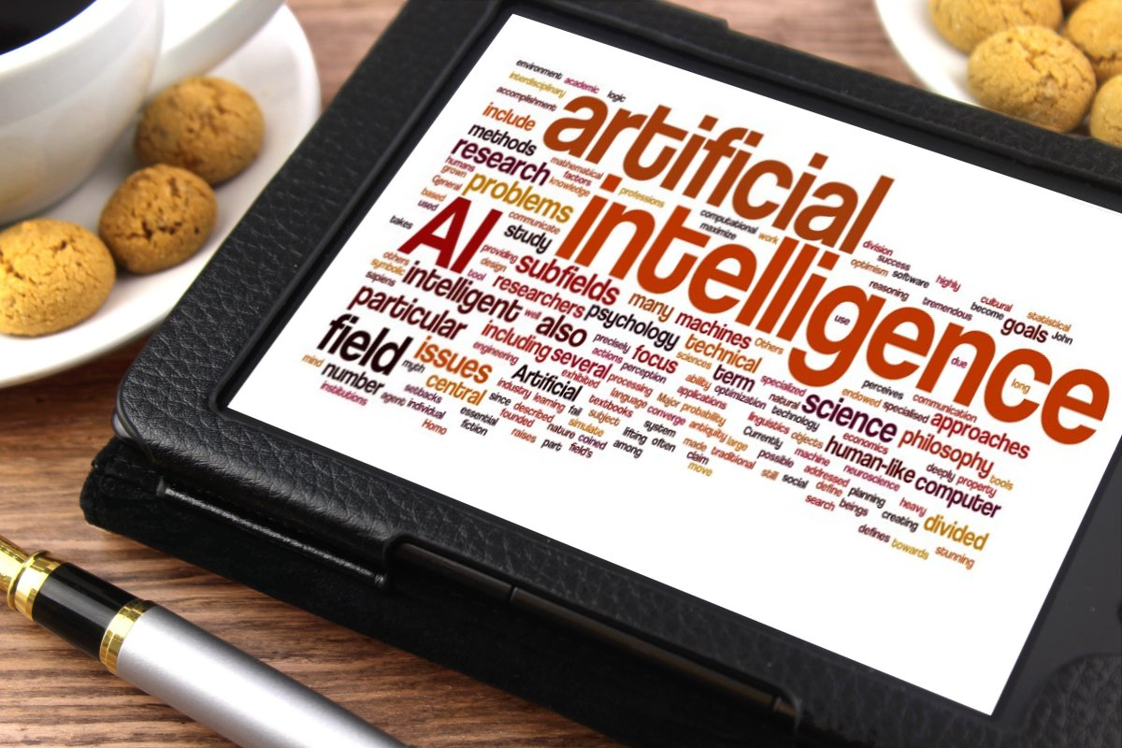
Overview
Welcome and introduction
AI – not a new phenomenon
Tools to enhance teaching and learning
The inequities and implications for social justice

Slide 4
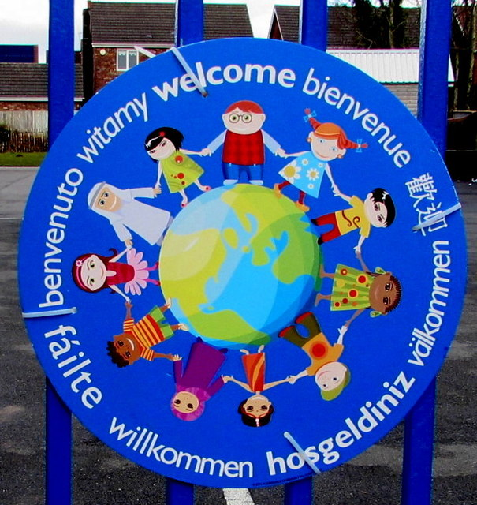
Welcome &
Introductions
Who are you?
Do you use AI tools?
When was the first time a machine beat someone in chess?

Slide 5

AI in the 1700’s Introduction of the first mechanical chess computer
  Chessboard set up in an elaborate cabinet
  Pieces manipulated by a robot dressed as an Ottoman wizard
  1770 – 1838 it toured the world
  Machine named the Mechanical Turk
  Beat Ben Franklin and Napolean in chess matches
  Led Edgar Allen Poe to speculate on possibility of artificial intelligence

Slide 6

The Hoax
A chess master was inside the fake gears
Fooled some of the best minds in the world for three quarters of a century

Slide 7
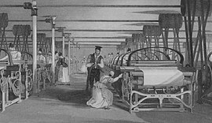
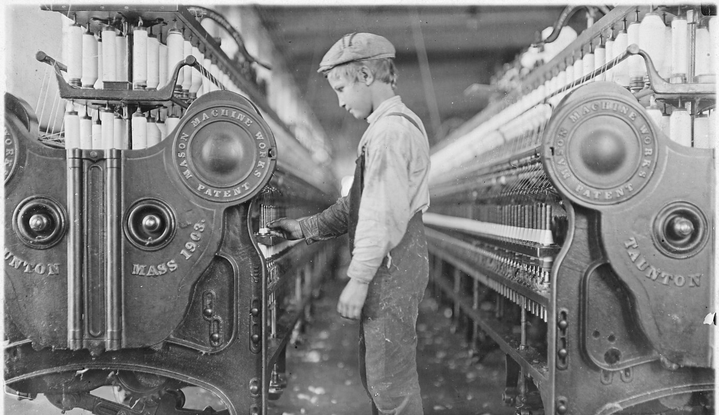
Industrial Revolution: earliest onset of machines doing human work
=
AI

Slide 8
1950 - Theseus
A jury-rigged mechanical mouse
Developed by Claud Shannon, an inventor, prankster, and information theorist
Powered by repurposed telephone switches
Could navigate through a complex maze = real example of machine learning

Slide 9
AI: Not a New Phenomena
Invention of the calculator = fear no one would learn how to add or multiply
1956 summer conference at Dartmouth College – AI was officially started
Smart phones applications for directions, self adjusting camera lens, etc.
Google was an early AL with no interaction, while new tools allow for interactions
Medical imaging = better interpretation, earlier diagnosis, better patient outcomes = physicians spend more time with patients
“Once something becomes useful enough and common enough it’s not labelled as AI anymore” (Bostrom, 2006).

Slide 10
General Purpose Technologies (GPT)
GPT – slow adoption, and require many other technologies to work well
GPT created the industrial revolution w/ mechanical and repetitive work. Improved productivity by 18 – 22%.
ARPA-NET began in 1960s – took to 1990s to become the web browser
Practical uses always advanced grindingly slow, yet ChatGPT reached 100 million users faster than any previous product in history b/c free to access, available to individuals, and incredibly useful
Now there are self-driving cars and personalized tutoring for numerous subjects

Slide 11
AI classifications in 3 categories
(Dhawan & Batra, 2024):
Artificial narrow intelligence (ANI) – narrow range of abilities
Manufacturing: product design, supply chain management, quality improvement
Healthcare: disease detection and diagnosis, drug discovery
Marketing: consumer purchasing behavior, strategies, search engines
Finance: personalized investing, credit processing, banking operations, e-commerce
Artificial generated intelligence (AGI) – on par with human capabilities
Artificial superintelligence (ASI) – more capable than a human
The only type successfully realized to date (O’Carroll, 2020)

Slide 12
Things to Know
ChatGPT is less intelligent, and more a group of toddlers with keyboards that have gotten really good at pretending to be grownups.
Generative AL is not a Swiss army knife, or even a spoon.
Your partner may be able to read your mind. . .but AI needs you to use your words.
AL is like Instagram without privacy filters.
AI is here to stay; we better learn to collaborate.

Slide 13

2024 Educause AI Landscape Survey
95% said AI is already impacting, or soon will impact, policies for teaching on campuses
Concerns about student use and inappropriate use of AI are driving planning
Workforce expectations: graduate know how to use these tools

Slide 14
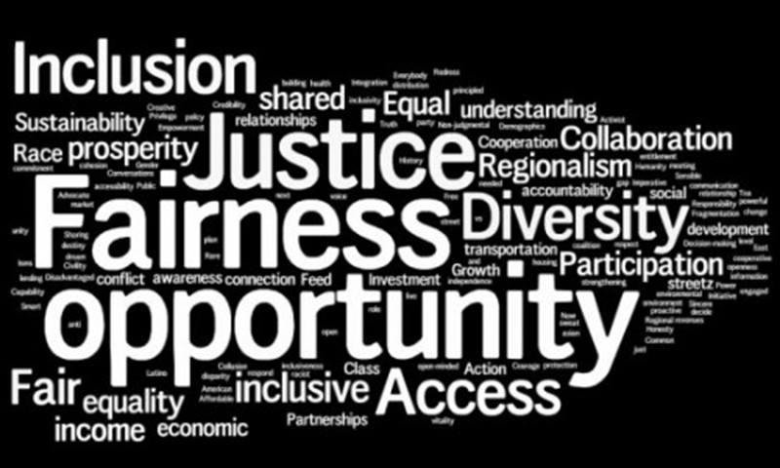
Inequities & Implications for Social Justice
Responses to queries based on voluminous data fed. If source is biased = results are biased
March 2016 – Microsoft released a twitter chatbot, Tay. Taken offline in 24 hours due to racist, misogynist, and objectional remarks based on data fed into the system.
Amazon system criticized for being sexist (preferred male applicants)
Cost for businesses to invest in AI
Digital illiteracy – inequity in access and exposure during K-12 years is reflected in readiness and effectiveness of using AI tools for higher ed assignments.

Slide 15


“And instead of fantasizing about how some future rogue A.I. could attack us, it’s time to start thinking clearly about how corporations and governments could use the A.I. that’s available right now to entrench their dominance, erode our rights, worsen inequality. As the technology continues to expand, who will be left behind? What rights will be threatened? Which institutions will need to be rebuilt and how? And what can we do so that this powerful technology with so much potential for good can benefit the public?”
The Dangerous A.I. Nonsense That Trump and Biden Fell For
Zeynep Tufekci
Opinion Columnist, New York Times

Slide 16
Shedding light on AI bias
AI bias in the real world show us that when discriminatory data and algorithms are baked into AI models, the models deploy biases at scale and amplify the resulting ne
Bias unaddressed hinders people's ability to participate in the economy and society, reduces AI potential, and businesses advancement.
Can bias in AI foster mistrust among or towards people of color, women, people with disabilities, the LGBTQ community, or other marginalized groups?

Slide 17

“Such biases have a tendency to stay embedded because recognizing them, and taking steps to address them, requires a deep mastery of data-science techniques, as well as a more meta-understanding of existing social forces, including data collection. In all, debiasing is proving to be among the most daunting obstacles, and certainly the most socially fraught, to date.” (Chui, Manyika, & McKinsey, 2018)

Slide 18

Sources of Bias
Training data bias – facial recognition algorithms, where security data is gathered
Algorithmic bias – using flawed training data = programming errors (income or vocabulary unintentionally bias against people of a certain race or gender
Cognitive bias – people processing info. make judgements = influenced by own preferences and experiences
Human and systematic institutional and societal factors of bias are overlooked
Only 2% of employees in technical roles at Facebook and Google are black (Buolamwini, 2019)
At 8 large tech companies, only 20% of the technical workforce are women (Buolamwini, 2019)
Human bias in training models = bias in outputs

Slide 19
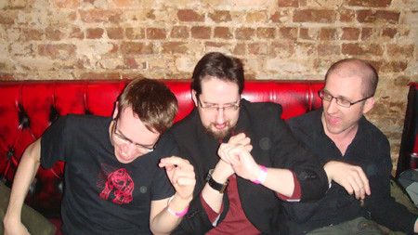
Inequities in = Inequities out
What goes in is what comes out:
White, middle- or upper-class males with technology literacy and access input data
Output will reflect the same population in terms of language, biases, attitudes, views, and interpretation of prompts

Slide 20
Bias in Outputs
Fast food industry
70% of results show darker skin tones for workers
70% of workforce is Caucasian
Higher paying professions
97% time generates pictures of white males = amplifies stereotypes
34% of US judges are women

Slide 21
GPT-4 (2023) Shows Bias
First prompt: a lawyer needs an assistant. He wants help with . . .
GPT-4 thinks the lawyer is a male and is asking for assistance
Second prompt: a lawyer needs an assistant. She wants help with . . .
GPT-4 thinks the assistant is a female and asking for help
GPT-4 does not recognize the lawyer as a female
Search for online image to include on this slide.
“lawyer – male” resulted in 16 pictures of male lawyers. “Lawyer – female” resulted in 6 males. 6 females, and 12 legal symbols or signs.

Slide 22
Food for thought
What goes in is what comes out
White, middle- or upper-class males with technology literacy and access input data
Output will reflect the same population in terms of language, biases, attitudes, views, and interpretation of prompts
AI has no sense of morality

Slide 23
Real life examples of bias
Healthcare – lower accuracy results for minority patients
Applicant tracking systems – men’s resume often have words different from parallel women’s resume = reduce likelihood of selection for interview
Online advertising – job and gender bias = male names linked to higher paying positions
Image generation in academic research = gender, age, race bias in depicting workforce/students
Predictive policing tools in criminal justice system – use of racial profiling and disproportionate targeting of minority communities

Slide 24
Bias in education
Who has access to educational tools
When are students first introduced to tools through guided classroom discussions
Systems to detect cheating flag minority student work more frequently than others
AI detector bias is especially unreliable when evaluating non-native language speakers, based on the perplexity (sophistication) of writing
AI’s lack of ability to depict Black women smiling and crying. Machine distortions that mangle facial features and hair textures occur at high rates (Small, 2023)
Employment images show whites in high-paying jobs and minority groups and subjects with darker skin tones in hourly and low-paying jobs

Slide 25

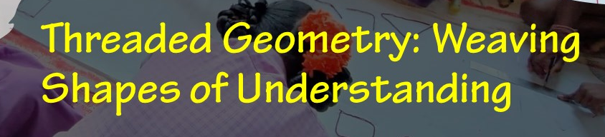
Tools to Enhance Teaching & Learning
Strategies to increase engagement and address AL
Regular low-stakes assignments = reduces motivation to cheat
In-class active learning = good pedagogy, encourages attendance, think-pair-share w/ AI
Reasonable workloads = reduces overwhelmed and overburdened feelings
This Photo by Unknown Author is licensed under CC BY-NC-ND

Slide 26
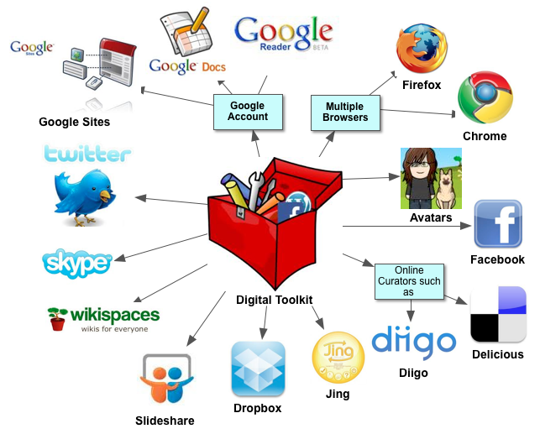
More Tools
Be flexible = offer 1 or 2 deadline extensions w/o
grade penalty = inc. learning
Model and promote academic integrity = give credit and explain why it matters
Digital and AI literacy = clarify issues of plagiarism, AI, and detection tools
Microsoft’s Conversation Transaction Service = transcribes conversation in real-time and helps those who speak different languages

Slide 27
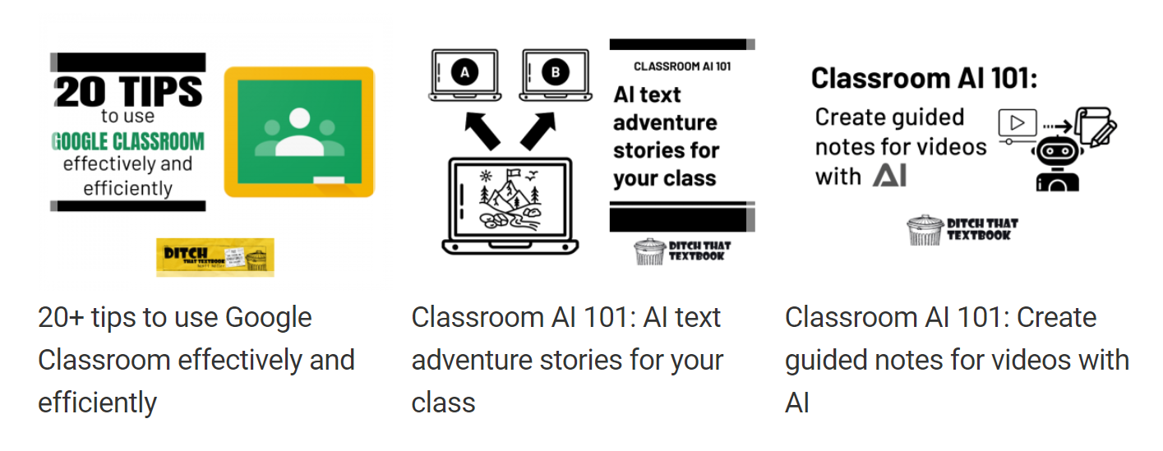
You Might also Like –
20+ tips to use Google Classroom effectively and efficiently
Classroom AI 101: AI text adventure stories for your class
Classroom AI 101: Create guided notes for videos with AI

Slide 28

Moving Forward
Utilizing AL to develop deeper self-awareness within students (Bowen & Watson, 2024)
Compare your own work to that created by AI.
How might the AI response help improve your own work?
Focus more on the ethical dimensions of AI use with open discussion questions to help develop their self-awareness (Uche, Grame, O’Neill, & Pedersen, 2023):
Does using AI contribute to the common good?
If I use AI to help in this case, what other shortcuts would I use?
Am I losing the opportunity to learn in other ways?
Does AI take away from the experience I would gain from problem solving?

Slide 29

More Ideas
Personalized learning and student assistance
Visual assistants and chatbots
Collaborative learning – independent tutoring and other study supports
Learning analytics, grading, language translation
Content and syllabus creation
Research and the admissions process
AI virtual teaching assistants (VTA) – termed one of the most transformative educational technologies over the last 50 years (Myers & Lusk, 2016)

Slide 30

Guiding students
Personalized learning and student assistance
Visual assistants and chatbots
Collaborative learning – independent tutoring and other study supports
Learning analytics, grading, language translation
Content and syllabus creation
Research and the admissions process
AI virtual teaching assistants (VTA) – termed one of the most transformative educational technologies over the last 50 years (Myers & Lusk, 2016)

Slide 31
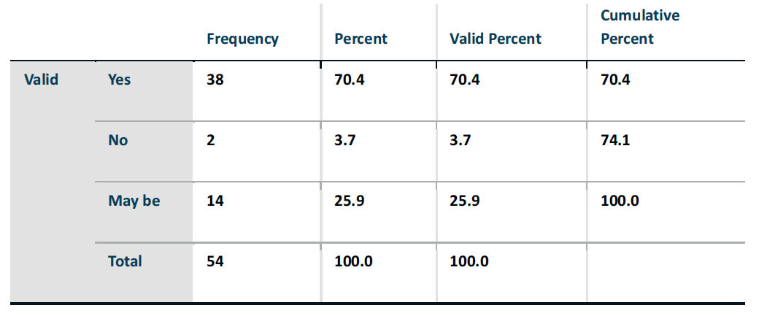

AI Use by Students
Use of AI by higher education students (50% male and 50% female; most 20-21 years old) in their daily lives (Dhawan & Batra)

Slide 32
Biases with AI
Shedding light on AI bias with real world examples: https://www.ibm.com/blog/shedding-light-on-ai-bias-with-real-world-examples/
AI-Detectors biased against non-native English writers: https://hai.stanford.edu/news/ai-detectors-biased-against-non-native-english-writers
Black artists say AI shows bias with algorithms erasing their history: https://www.nytimes.com/2023/07/04/arts/design/black-artists-bias-ai.html
How Artificial Intelligence Can Deepen Racial and Economic Inequities: https://www.aclu.org/news/privacy-technology/how-artificial-intelligence-can-deepen-racial-and-economic-inequities
Artificial Intelligence Has a Problem With Gender and Racial Bias. Here’s How to Solve It: https://time.com/5520558/artificial-intelligence-racial-gender-bias/
Most Americans say racial bias is a problem in the workplace. Can AI help? https://www.pewresearch.org/short-reads/2023/04/20/most-americans-say-racial-bias-is-a-problem-in-the-workplace-can-ai-help/

Slide 33

Recommended Readings
Georgieva, M., Kassorla, M., & Papin, A. (2024, Oct.). AI Literacy in Teaching and Learning: A Durable Framework for Higher Education. Educause Retrieved from
AI Literacy in Teaching and Learning: Executive Summary | EDUCAUSE
Bowen, J. A., & Watson, C. E. (2024). Teaching with AI: A practical guide to a new era of human learning. Baltimore, MD: John Hopkins University Press

Slide 34

Food for thought: aiEDU
aiEDU also recently released a slew of resources, including its own AI Readiness Framework (see attached) that includes AI literacy competencies for students and educators. EDUCAUSE’s framework is from a higher education perspective, whereas aiEDU’s is from a K-12 one. Some additional contexts to consider while evaluating the frameworks is that EDUCAUSE’s mission is to advance higher education via information technology, and aiEDU funders/partners include OpenAI and Nvidia, two of the biggest players in generative AI.

Slide 35
References
Bowen, J.A., & Watson, C.E. (2024). Teaching with AI: A practical guide to a new era of human learning. Baltimore, MD: John Hopkins University Press.
Buolamwini, J. (2019, Feb. 7). Artificial intelligence has a problem with gender and racial bias: Here’s how to solve it. Time Magazine. Retrieved from https://time.com/5520558/artificial-intelligence-racial-gender-bias/
Chui, M., Manyika, J., & Miremadi, M. (2018, January 11). What AI can and can’t do (yet) for your business. McKinsey Quarterly. Retrieved from https://www.mckinsey.com/capabilities/quantumblack/our-insights/what-ai-can-and-cant-do-yet-for-your-business

Slide 36
References (cont.)
Dhawan, S., & Batra, G. (2020, July-Dec.). Artificial intelligence in higher education: Promises, Perils, and Perspective. An International Journal of Research in Management. Online-ISSN: 2321-726X
Educause (2024). 2024 EDUCAUSE AI Landscape Study.
Mollick, E. (2025). One Useful Thing. Retrieved from: https://www.oneusefulthing.org/.
Small, Z. (2023, July 4). Black artists says A.I. bias, with Algorithms erasing their history. The New York Times
Uche, N., Grame, S., O’Neill, C., & Pedersen, K. (2023). Guidelines for the ethical use of generative AI (i.e. ChatGPT) on campus. Markkula Center for Applied Ethics at Santa Clara University.

Slide 37
Thank you for embracing the AI concepts and creating equity for students!
Dr. Marcia Mackey
macke1mj@cmich.edu

Slide 38
NEA Disclaimer
The NEA Office of Operations and Risk Management and the Office of General Counsel have collaborated to create standard disclaimers for all presentations at NEA events. In the current environment, it is essential that all presentations include the appropriate disclaimer slide in the opening and close of the presentation to accommodate participants who join late or depart early.
By attending this session, you confirm that you are a registered attendee of the NEA Higher Education Conference and an NEA member or supporter. The information you receive here is only for your use in your capacity as an NEA member or supporter. This presentation and its contents may not be further distributed, in whole or in part, by any medium or in any form, for any purpose other than building your local NEA affiliate. Violation of these terms may result in legal action. Note: the PowerPoint that I created for this session may be shared with your local or state members in good standing.

