Slide 1
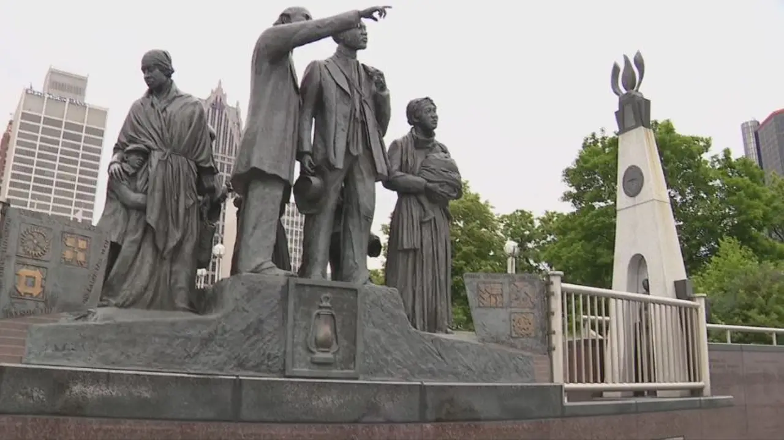
City of Opportunity: Detroit in Civil Rights & Labor History
NEA-Retired Conference
March 9 – 11, 2025
Detroit, Michigan

Slide 2
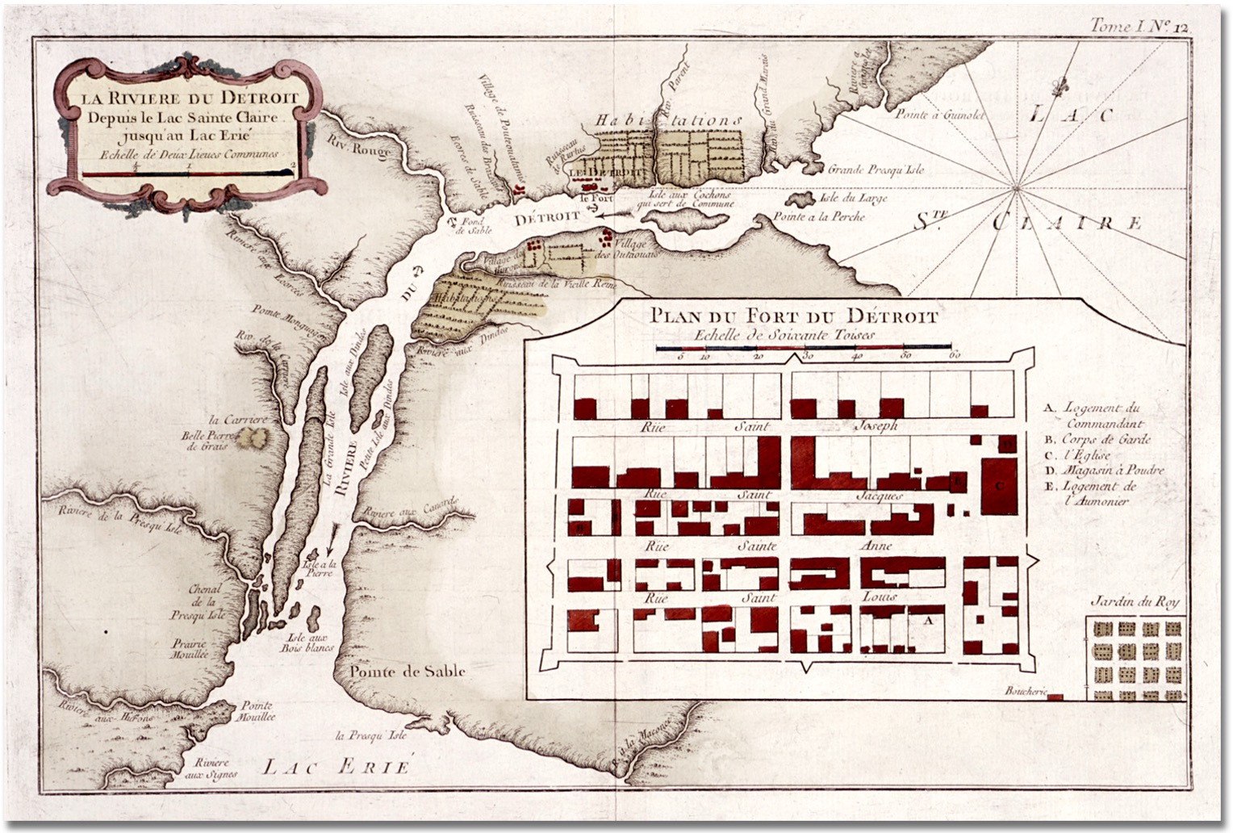

Slide 3
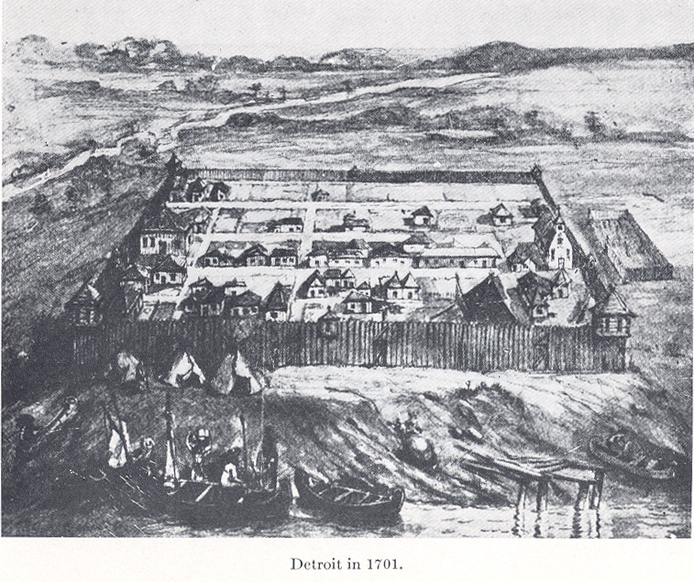
Fort Pontchartrain du Detroit, 1710

Slide 4
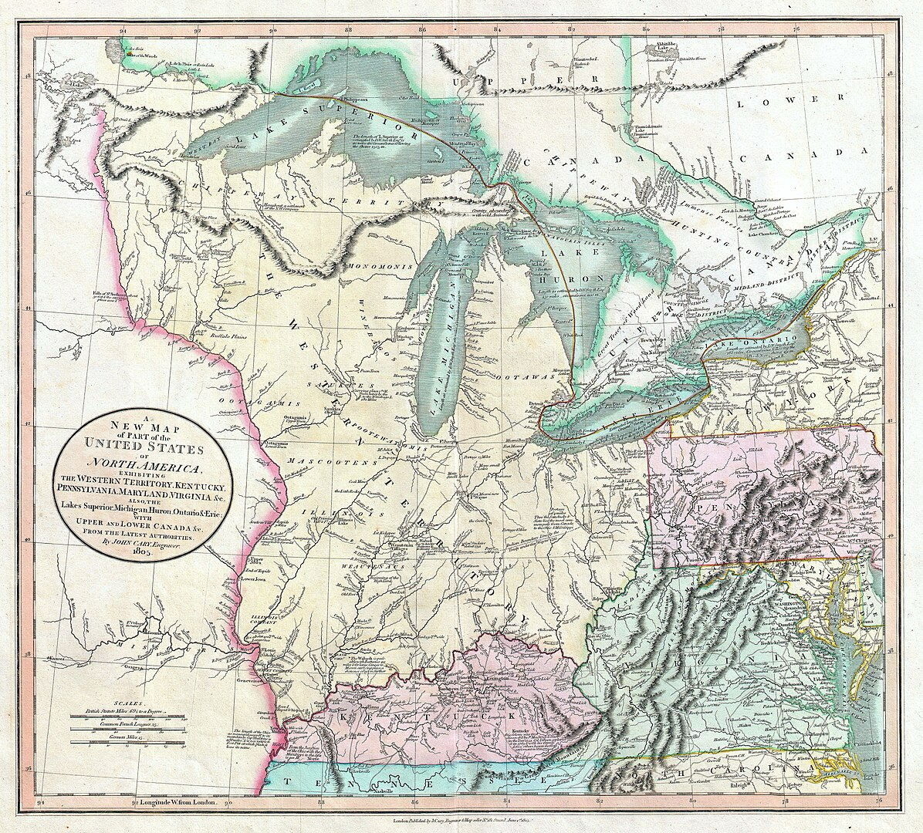
Northwest Territory

Slide 5
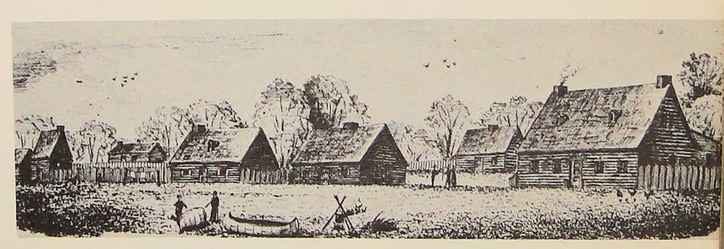
Detroit Farms, late 1700s

Slide 6
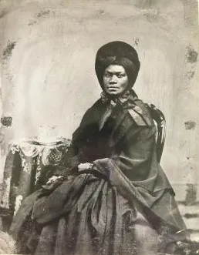
Lisette
Denison

Slide 7
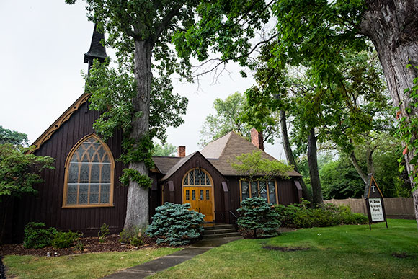
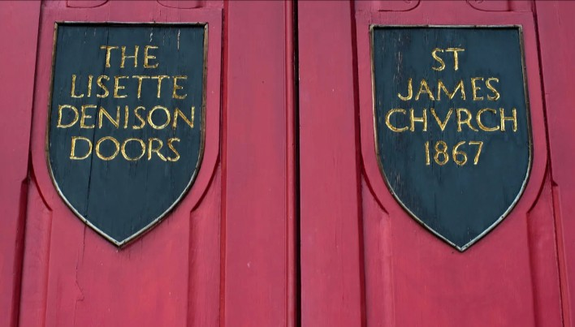

Slide 8
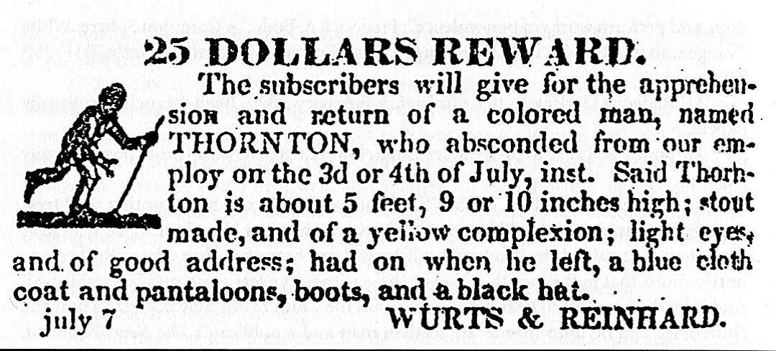
The Blackburn Affair

Slide 9
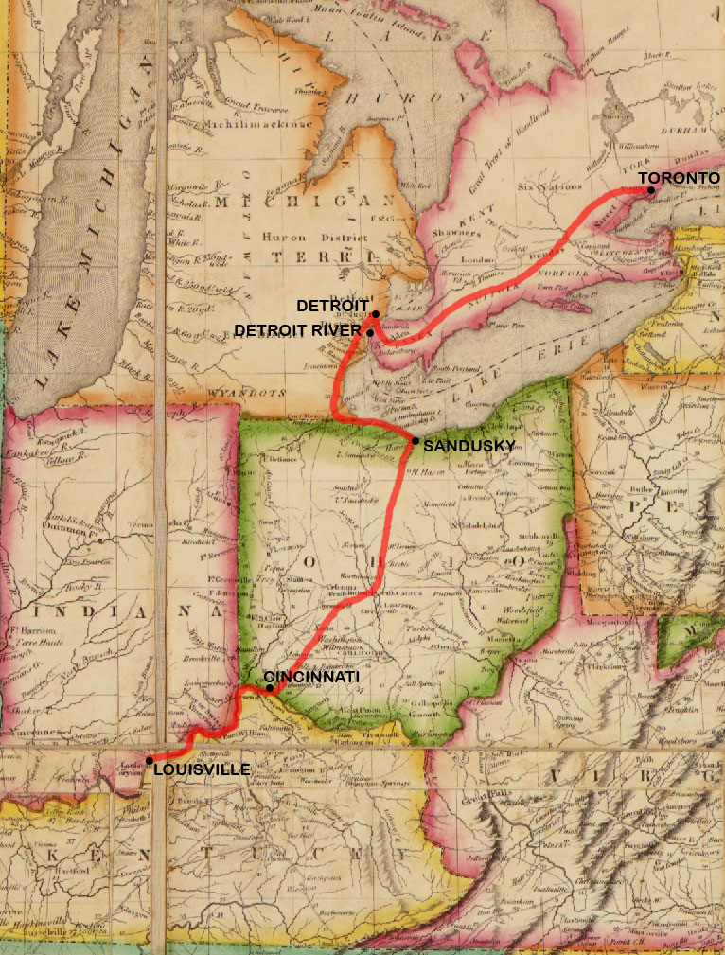

Slide 10
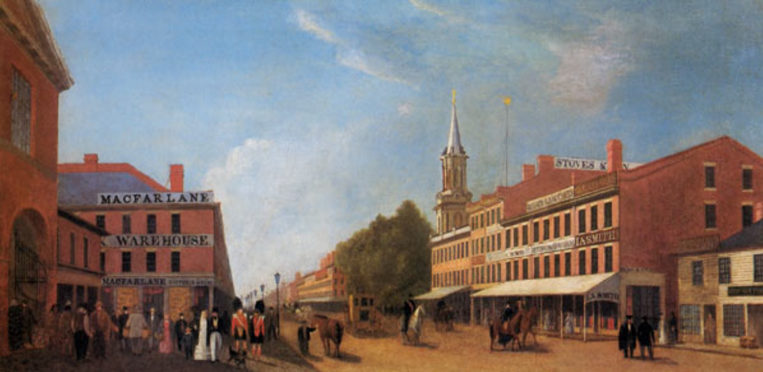
John Gillespie, View of King Street, Toronto, 1844

Slide 11
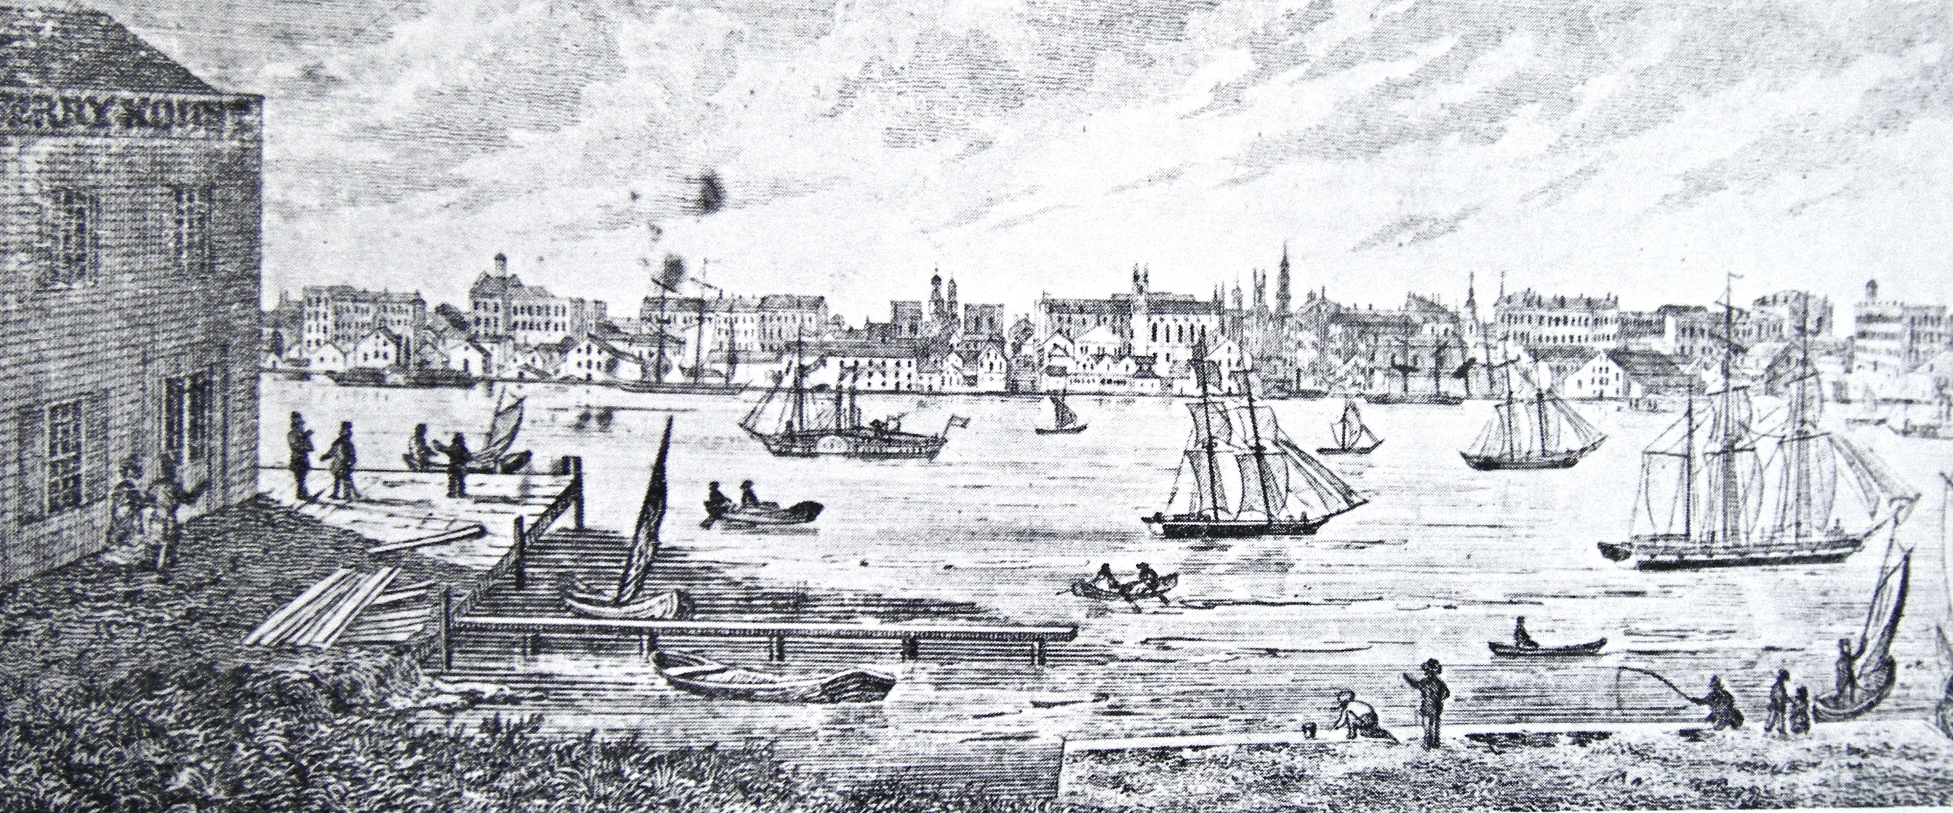
View of Detroit from Windsor, 1850

Slide 12
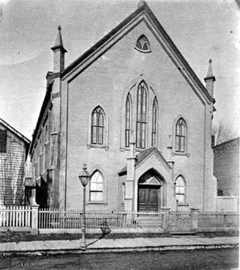

Slide 13
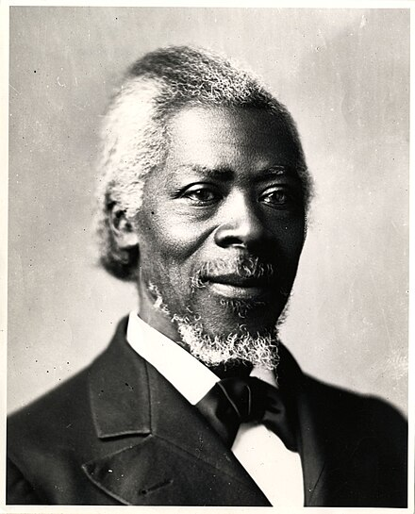
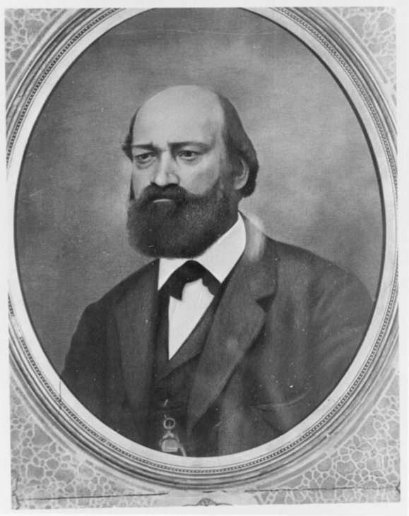
William Lambert
George DeBaptiste

Slide 14
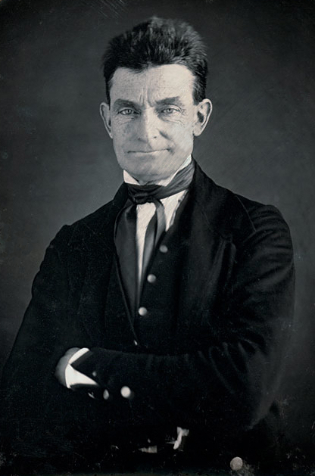
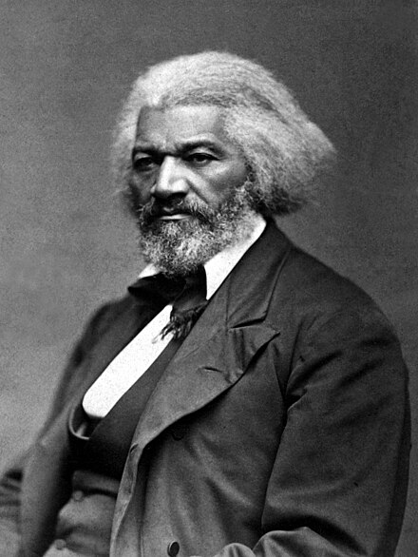
John Brown
Frederick Douglass

Slide 15
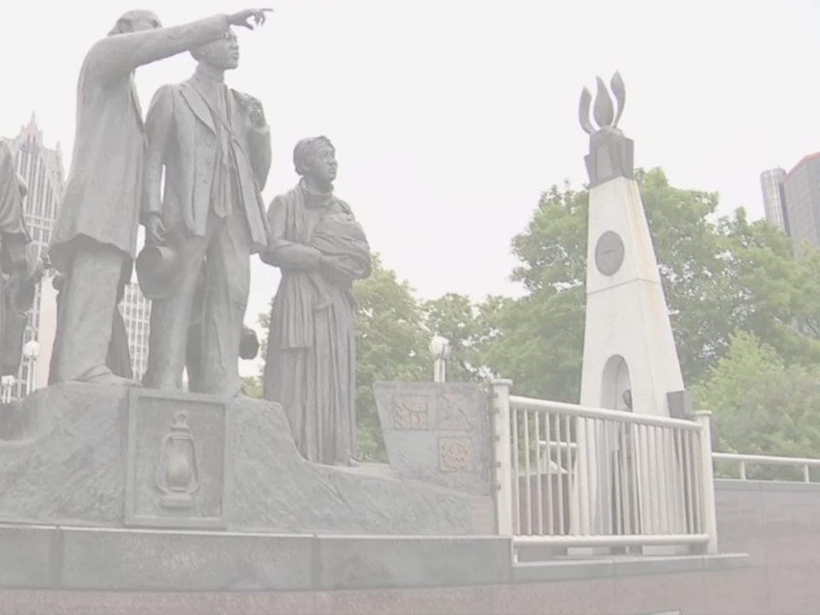
Breakout Session

Slide 16
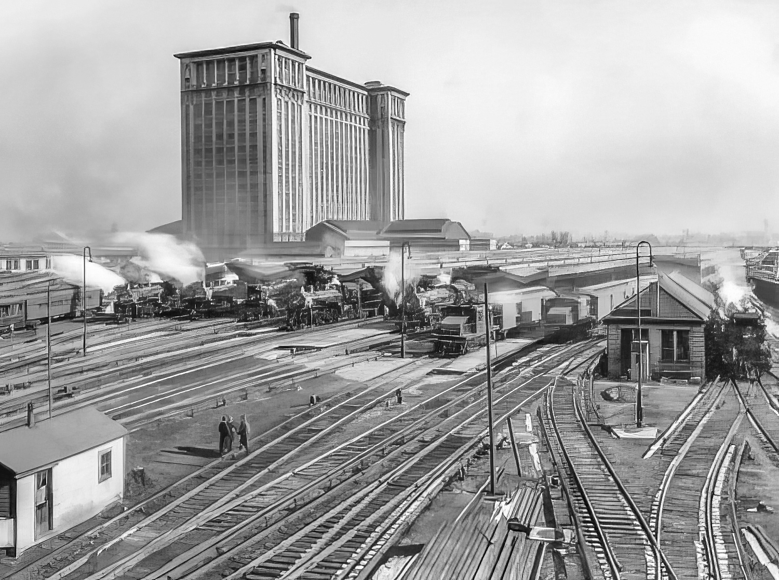
Michigan Central Station

Slide 17
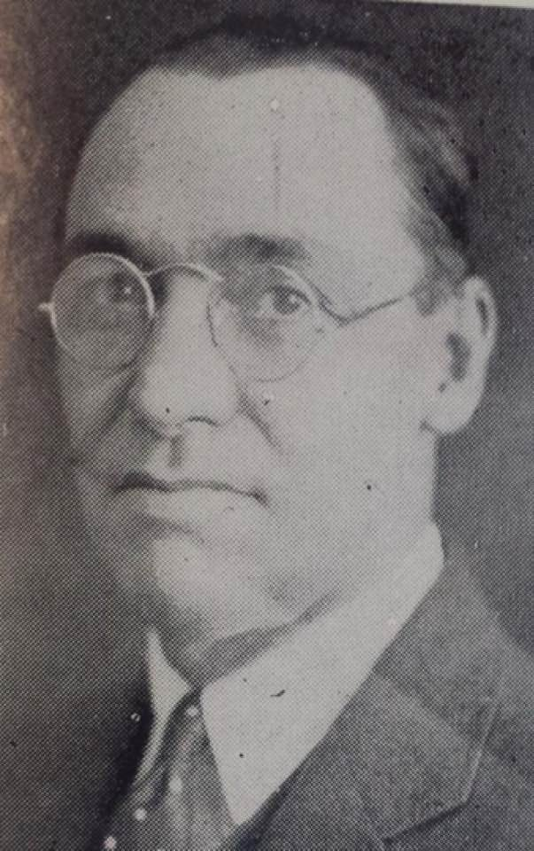
Rev Robert
Bradby

Slide 18
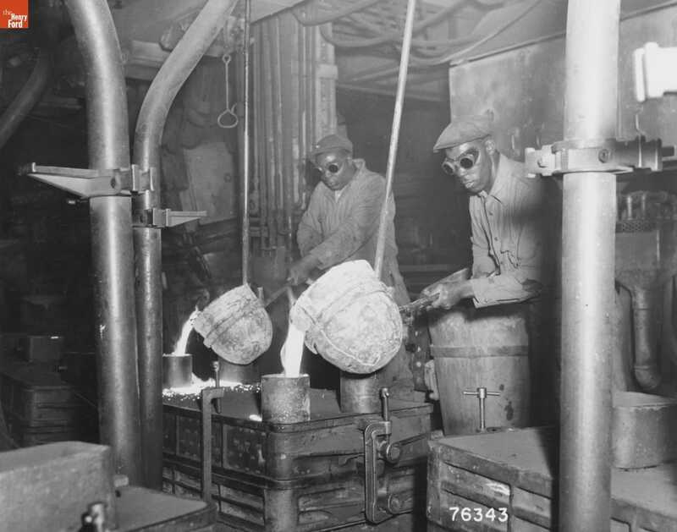
Auto Plant Foundry Workers, 1920s

Slide 19
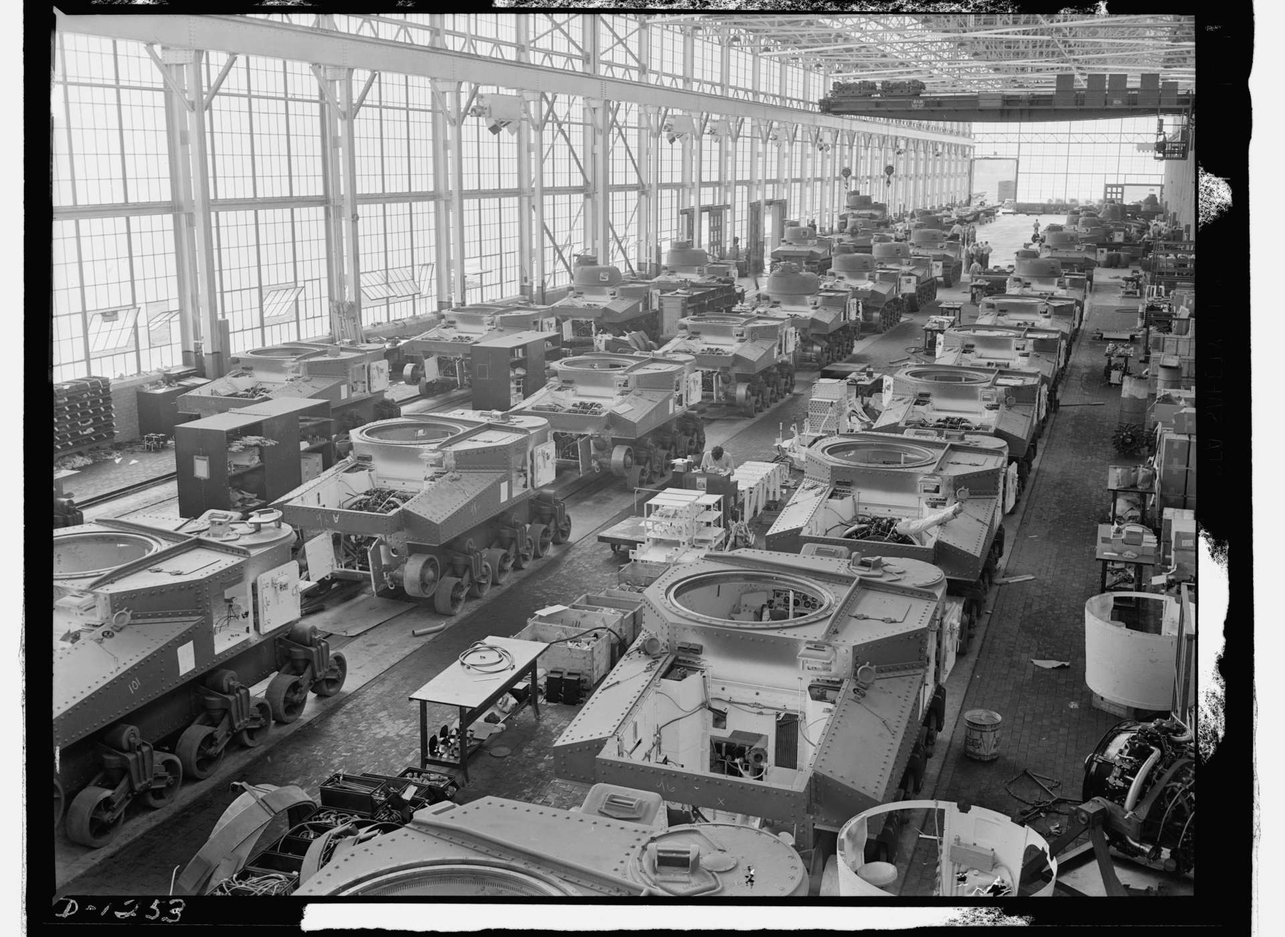
Detroit, Arsenal of Democracy

Slide 20
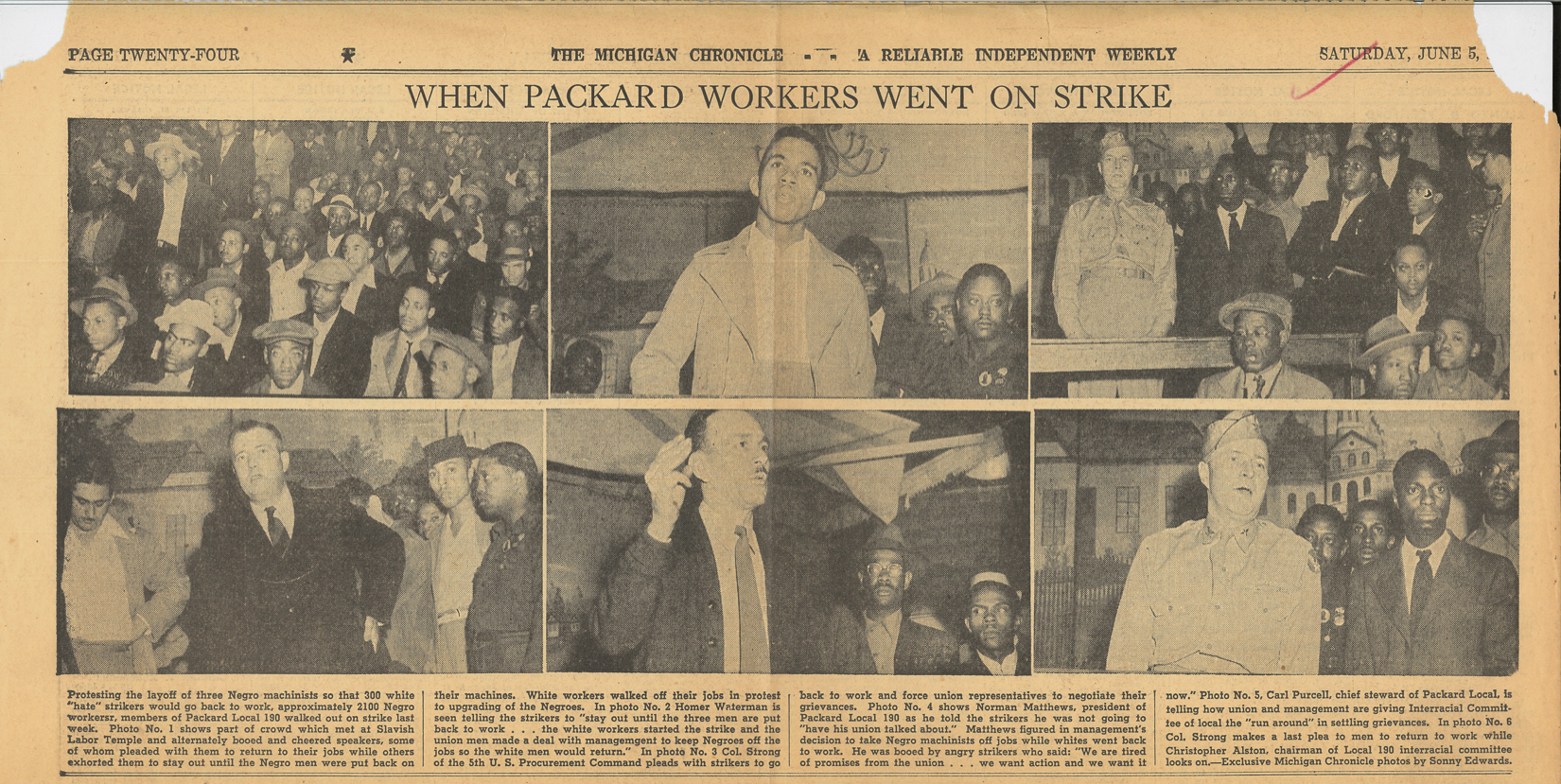
Packard Hate Strike

Slide 21
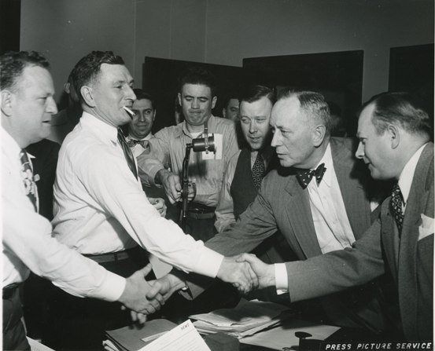
Walter Reuther (2nd from right), Treaty of Detroit, 1950

Slide 22
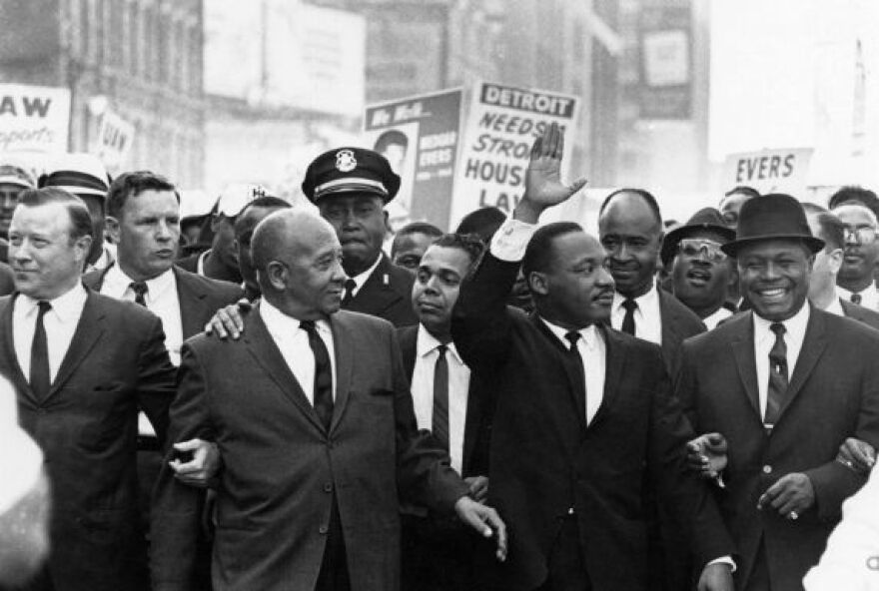
1963 Detroit Walk to Freedom, Walter Reuther (left) Martin Luther King (2nd Right)

Slide 23
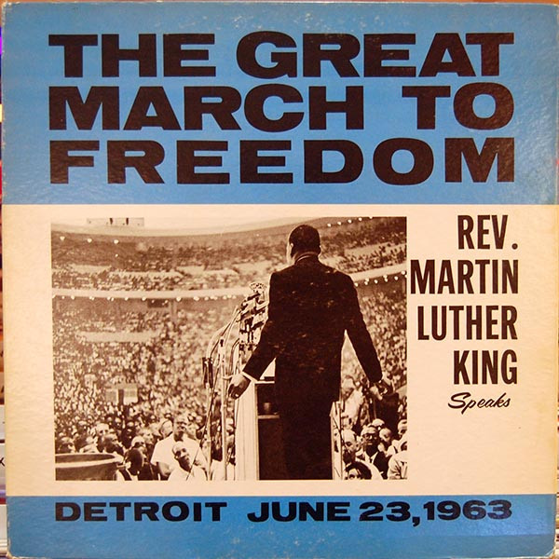

Slide 25
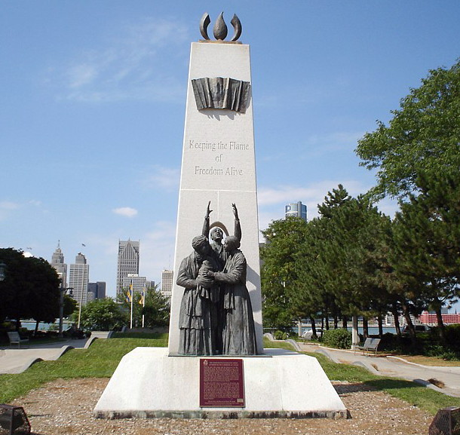

Slide 26
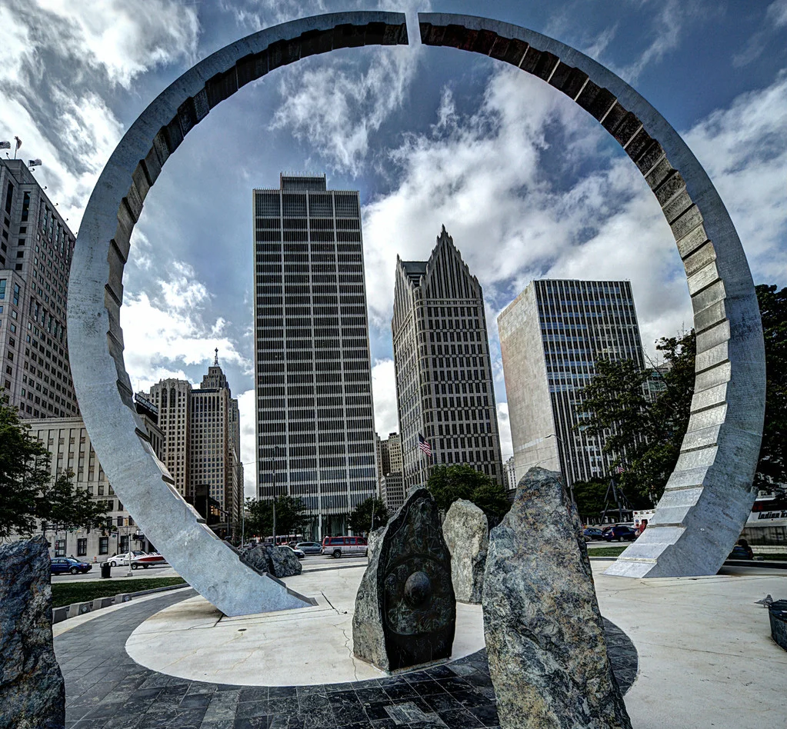

Slide 27
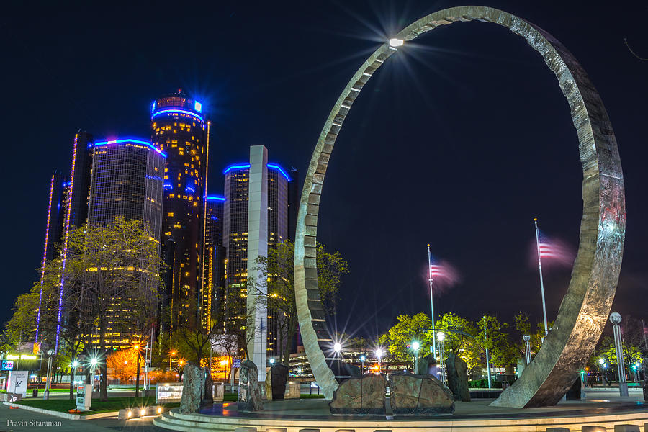

Slide 28
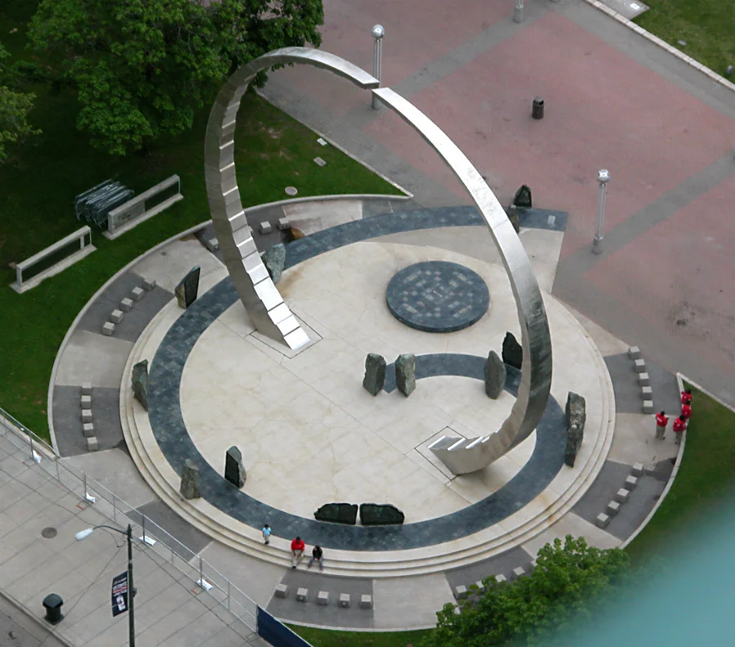

Slide 29
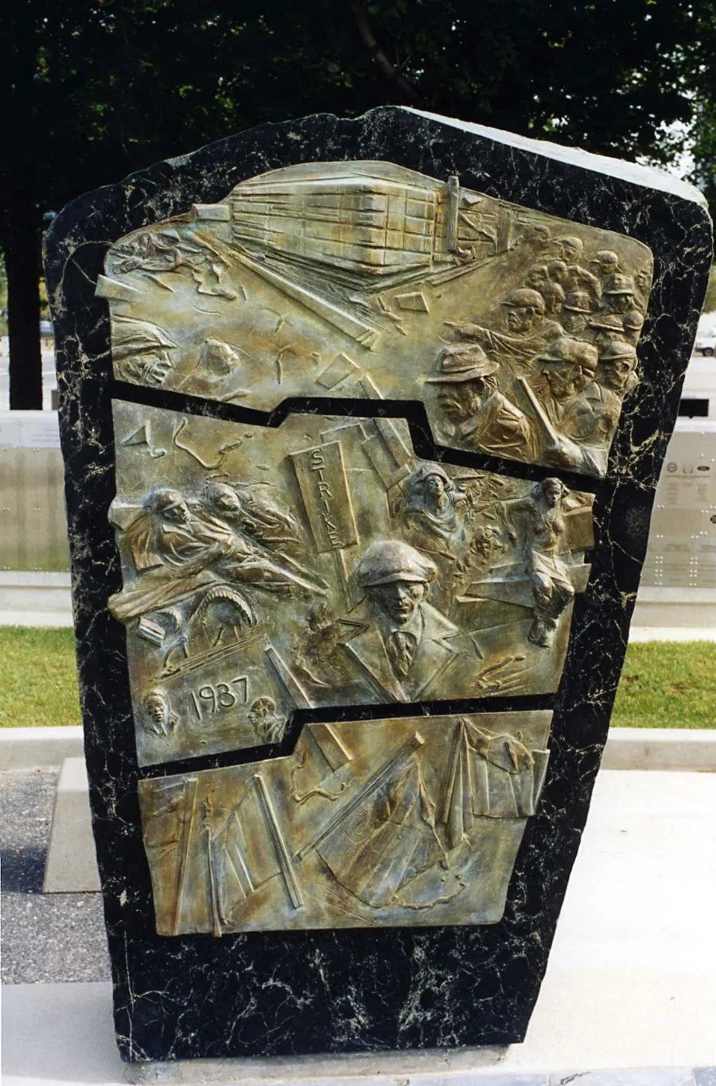

Slide 30
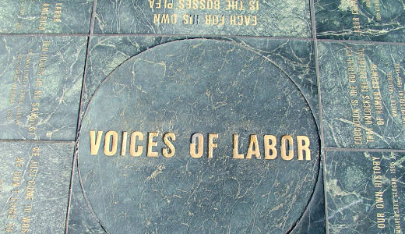

Slide 31
Discussion

