Slide 1
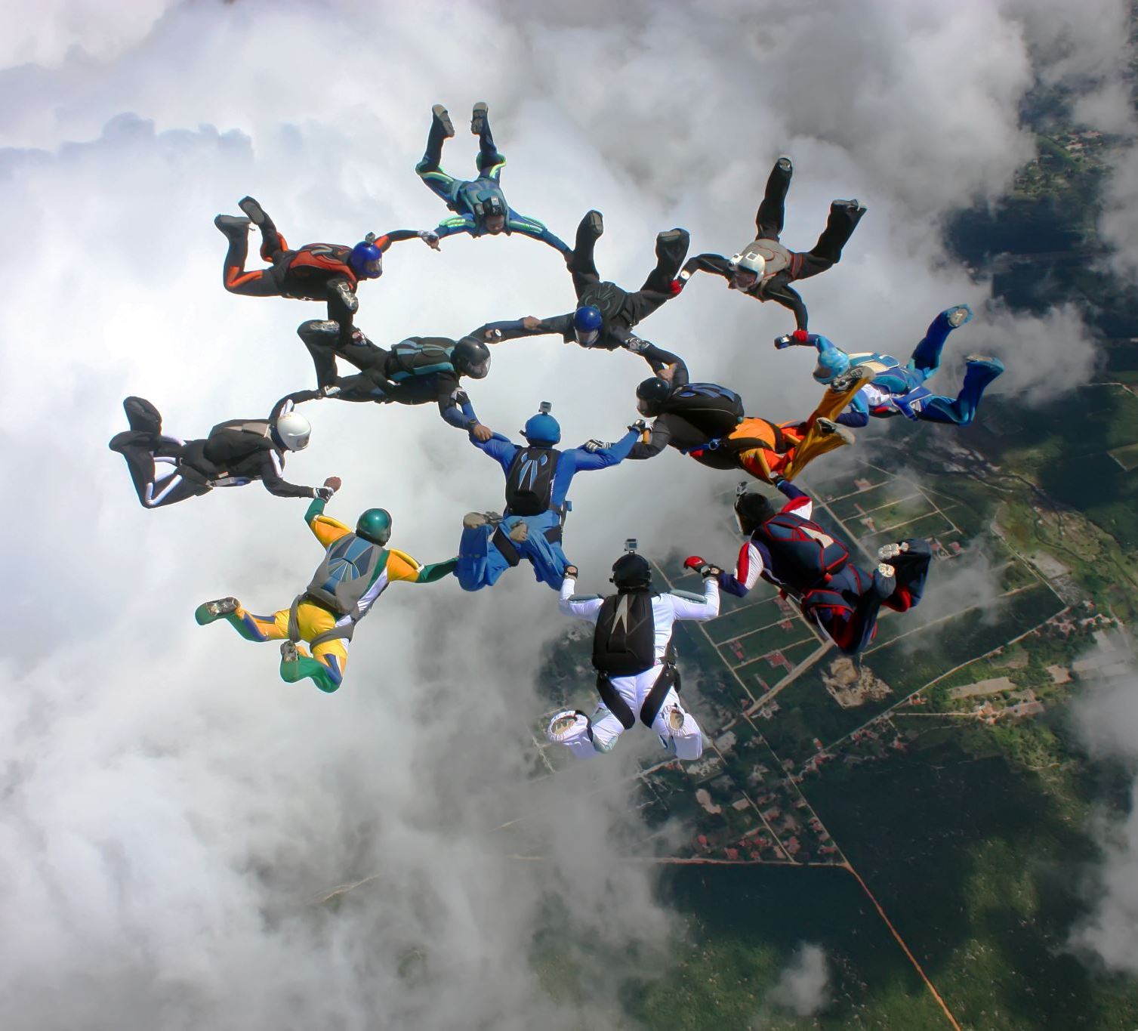
Leading a Meeting: Getting the Basics of Parliamentary Procedure

Slide 2
John Heineman NEA360 or ringojohn@aol.com
This presentation is based on Robert’s Rules of Order, newly revised, 12th edition .
Your individual bylaws or standing rules may say something different that what I say.

Slide 3
Why Parliamentary Procedure?
To facilitate the transaction of business
Creates an official record of what happened
To ensure that all members have equal rights, privileges, and obligations
Ensure the majority has the right to decide, but the minority has rights which must be protected as well

Slide 4
Some Basic Principles
A quorum must be present for the group to act.
As defined by the by-laws
If not, then majority of membership
Only one question should be considered at any given time.
No member should speak until recognized by the chair.
The chair should maintain strict impartiality during discussion.
Chair can vote if it will affect the outcome(Break at tie or create a tie)

Slide 5
Have an Agenda!
Call to order
Attendance/Roll call
Reading and Approval of minutes
Reports of Officers, Boards, and Standing Committees
Report from Special Committees
Special Orders
Unfinished Business
New Business
Announcements
Adjournment

Slide 6
Getting a Main Motion on the Floor
Member rises and addresses the Chair.
“Mr./Madam President or Chairperson.”
Chair recognizes the member.
Member states:
“I move that _______ (states motion).”
Second to motion (not necessary to stand or be recognized).

Slide 7
Main Motion Continued
Chair states motion:
“It has been moved by (name) and seconded that _________.”
Discussion:
If debatable, every member has right to debate
Proposer of motion has first right of debate
Chair refrains from debate while presiding
Must be related (germane) only to motion
The Chair says:
“If there is no further discussion, the motion is _______(restate motion).”

Slide 8
Finishing the Main Motion
Vote:
The Chair says, “All those in favor of ______(the motion is stated) say ‘aye.’ Those opposed say ‘no.’
If motion requires 2/3 vote, ask for rising or by show of hands.
Should always ask for those opposed.
Result of the vote is stated by chair.
“The motion is adopted and…” or “the motion is lost.”
If counted vote, give number on both sides

Slide 9
Let’s Practice!
I move we donate $250 to the NSEA Children’s Fund.

Slide 10
Motion to Amend
Methods of Amending
Insert (inside the motion)
Add (at the end)
Strike out
Strike out and insert
Substitute (a paragraph)
Amendment can be amended

Slide 11
Let’s try one….
Chair: “It has been moved and seconded that the NSEA spend $6000.00 to remodel
the president’s office. Mr. Big Bucks you may speak to your motion.” Second
Mr. Big Bucks speaks…
Someone rises and says…”I Move to amend the by…” Needs a second
Insert (inside the motion)
Add (at the end)
Strike out
Strike out and insert
Substitute (a paragraph)

Slide 12
Stating the amendment.
Insert (inside the motion)
Add (at the end)
Strike out
Strike out and insert
Substitute (a paragraph)
“It has been moved and seconded to amend the main motion by…”
”If the amendment is adopted, the motion will read…”
“We are now debating the amendment to the main motion by..
Repeating the amendment several times will keep everyone well informed on what is being debated.

Slide 13
Commit or Refer to a Committee
Allows for additional information or study of issue before voting
Motion to Refer should include to which committee
Who will appoint and number if it is a new committee
Usually defines time for committee to report

Slide 14
Previous Question or Call the Question
Actual motion is “Call the Previous Question”
Must be recognized by chair to make motion, cannot be just shouted out
Is a vote to stop debate
Requires a 2/3 vote to pass
If receives 2/3 vote, motion passes and debate is stopped, and a vote is taken
If does not receive 2/3 vote, motion fails, and debate continues

Slide 15
Postpone a Main Motion
Postpone Indefinitely - Kill
Postpone until a certain time – Delay
Lay on the table - Something has come up

Slide 16
Point of Order
Used to correct a mistake in procedure
Can interrupt a speaker
Doesn’t require a second
Is not debatable
Chair rules
Must be raised at time of mistake before action has been taken

Slide 17
Move Without Objection
When there seems to be no objection
“If there are no objection” or “Without objection”
“Is there an objection?”
“I object”
Treat like a motion if someone objects

Slide 18
Let’s Debate
That the NSEA…
Donate $1000 to the John Heineman for Pres. Fund
Move its headquarters to Grand Island
Delegate Assembly be held every other year
Make your own motion

Slide 19
Questions and Scenarios from your experience
This is your opportunity to ask a parliamentarian!!!

Slide 20
Always happy to help!
John Heineman
NEA360 or ringojohn@aol.com

