Slide 2
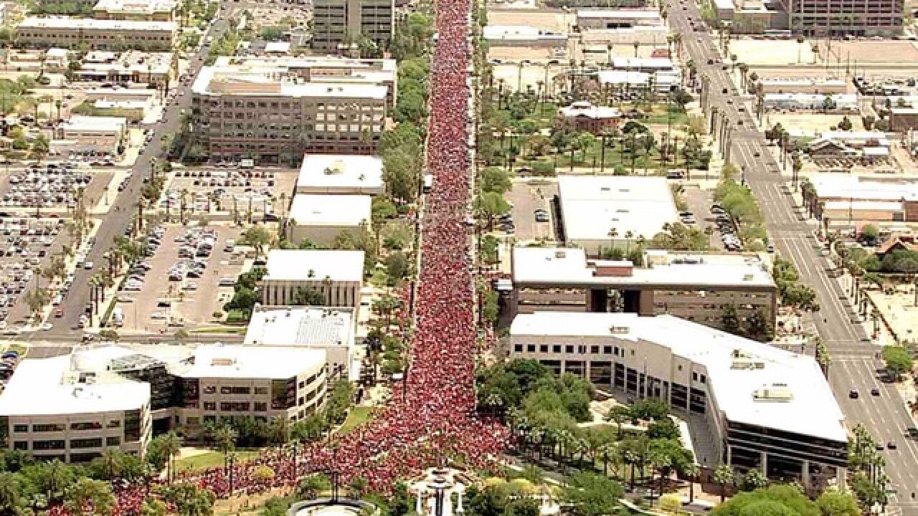
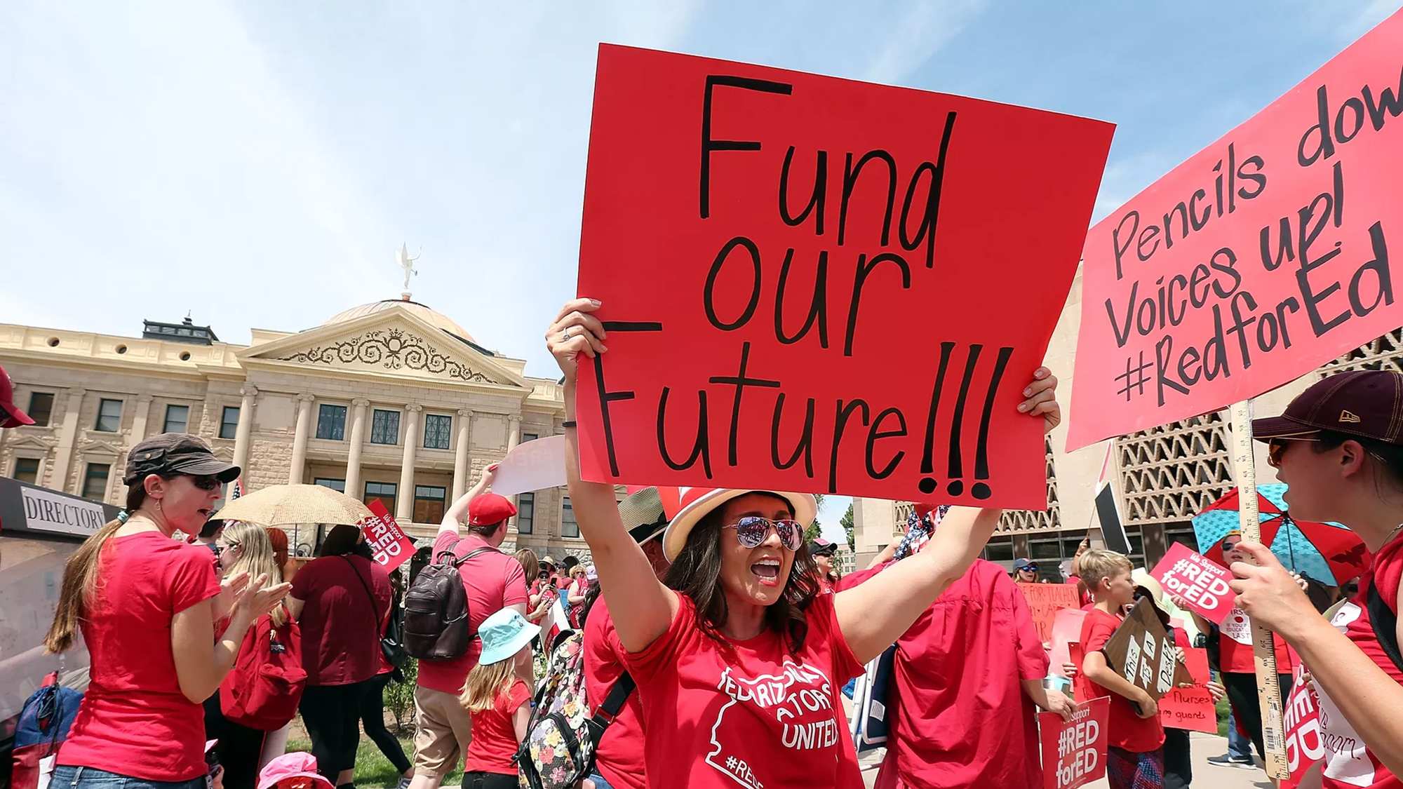

Slide 3
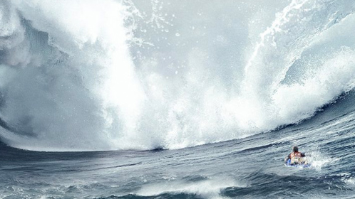
The Perfect Storm
School Funding Cuts
Privatization through Charters and Vouchers
War on the Teaching Profession

Slide 5
The Great Disinvestment

Slide 7
Florida’s Voucher Escalation

Slide 9
A War on Teachers
Tenure, Tests, and Benefits

Slide 10
A Fourth Wave
A War on Public Education Itself

Slide 12
The Lens of History

Slide 13
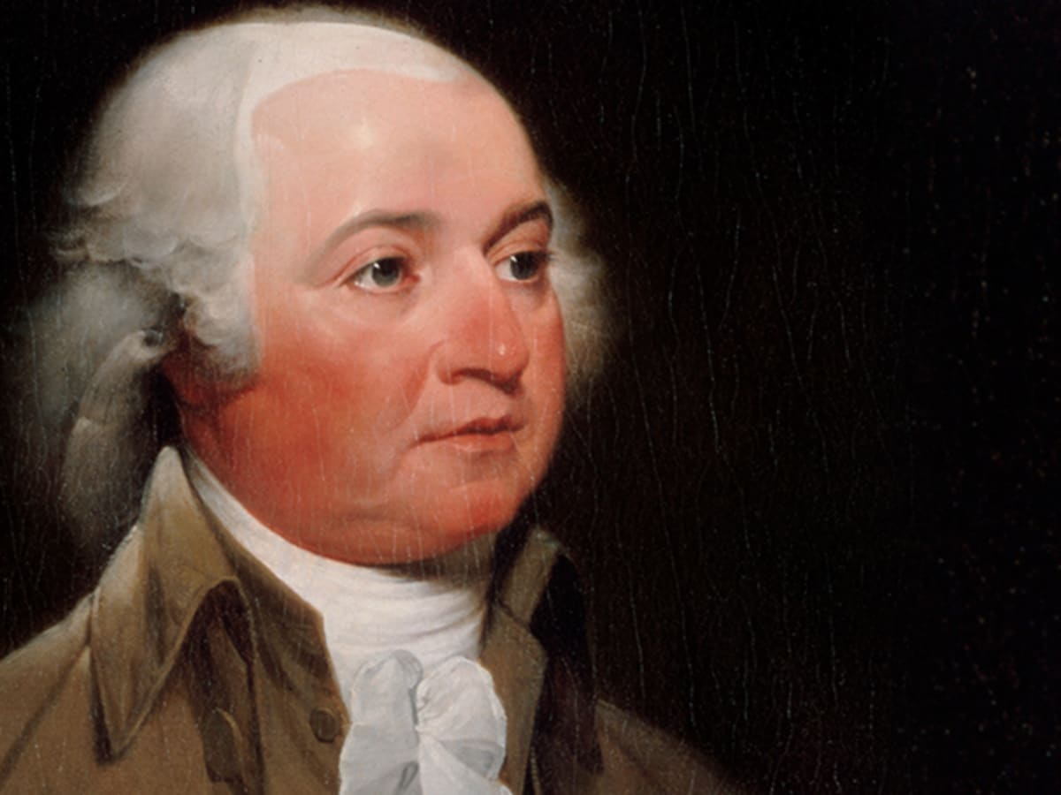
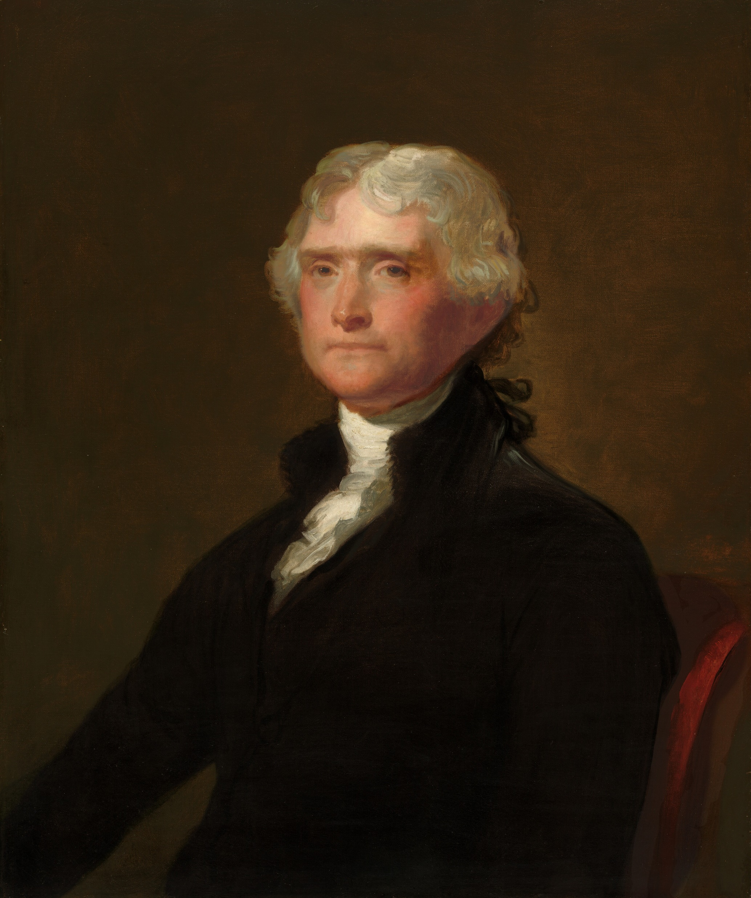
Adams and Jefferson Common Good, Liberty and Policy

Slide 14
Massachusetts Constitution of 1780: “It shall be the duty of legislatures and magistrates, in all future periods of this commonwealth, to cherish… the public schools and grammar schools in the towns.”
Virginia Bill of the More General Diffusion of Knowledge: “the most effectual means of preventing [tyranny] would be ... to illuminate . . . the minds of the people at large” and to do it “at the common expence of all.”

Slide 15
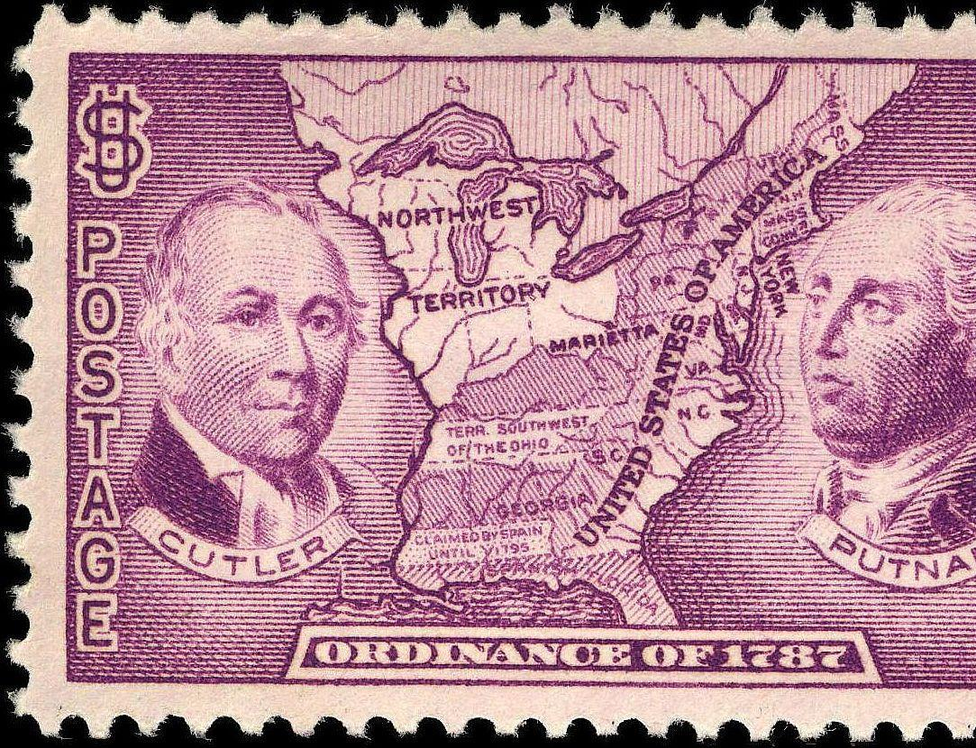
Northwest Ordinances of 1785 and 1787
“schools and the means of education shall forever be encouraged.”

Slide 16
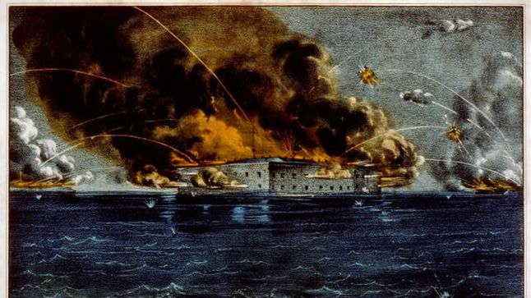
Failed Democracy

Slide 17
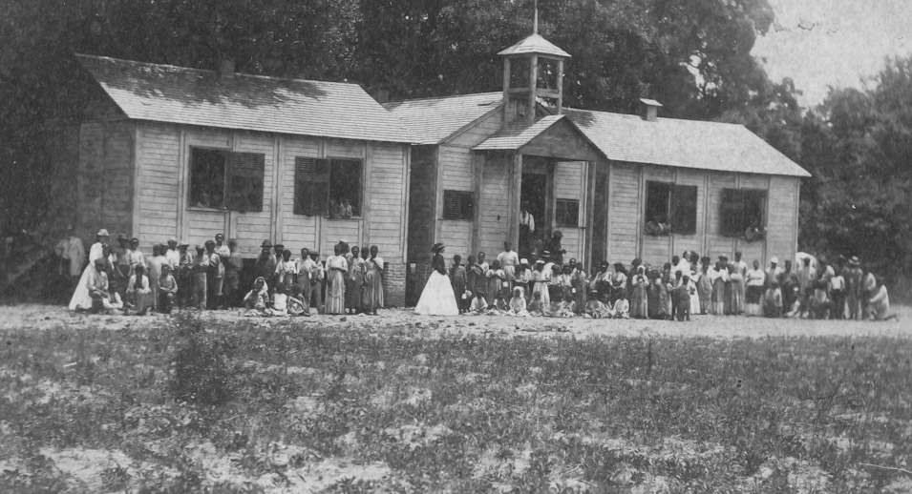

Slide 18
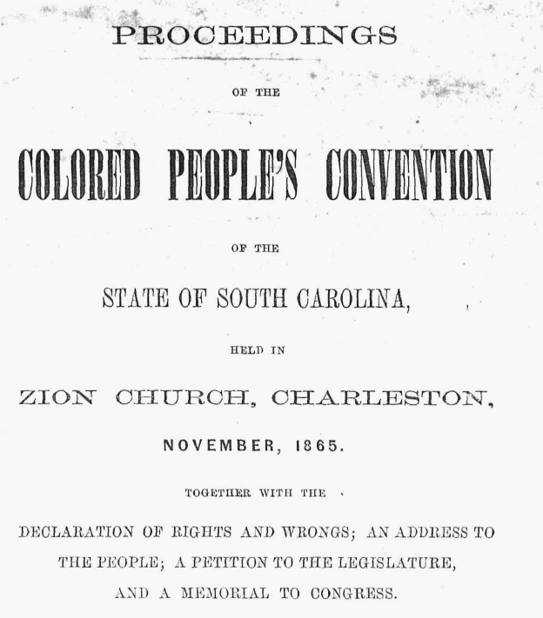
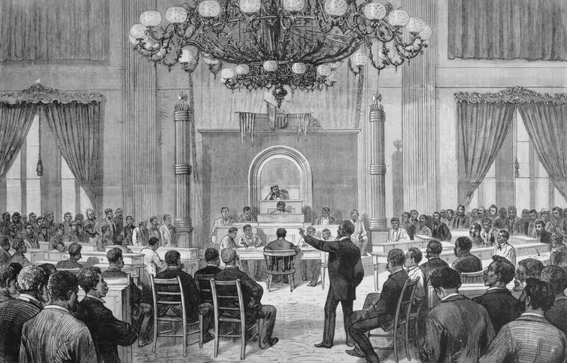

Slide 20
Restoring the Union: The Readmission of Southern States

Slide 21
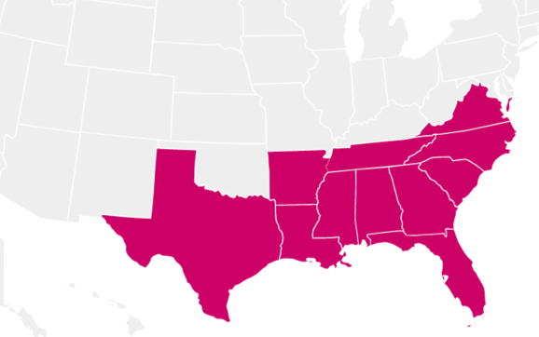
Confederate States with Education Clauses

Slide 22
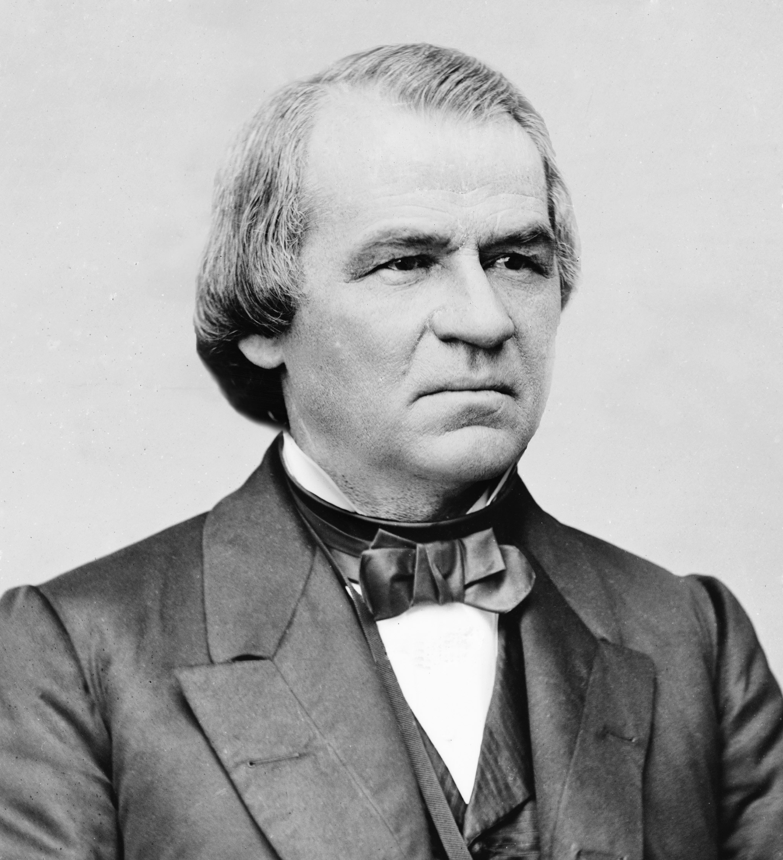
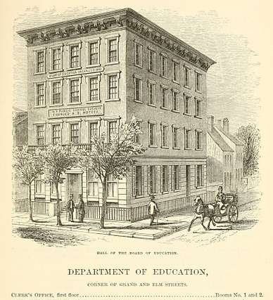
US Dept. of Education (1867)

Slide 23
Mississippi Constitutional Convention of 1890

Slide 24
Charles Hamilton Houston and the NAACP’s Strategy to End Segregation

Slide 25
The New Challenge
“We have come to take democracy for granted, and civic education has fallen by the wayside. In our age, when social media can instantly spread rumor and false information on a grand scale, the public’s need to understand our government, and the protections it provides, is ever more vital.”
“Civic education, like all education, is a continuing enterprise and conversation. Each generation has an obligation to pass on to the next, not only a fully functioning government responsive to the needs of the people, but the tools to understand and improve it.” -- Chief Justice John Roberts
Two out of three Americans agree, indicating that they believe our democracy is growing weaker and that public education is part of the solution.

Slide 26
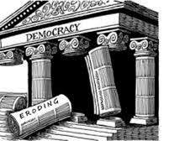
Global Democratic Erosion

Slide 27
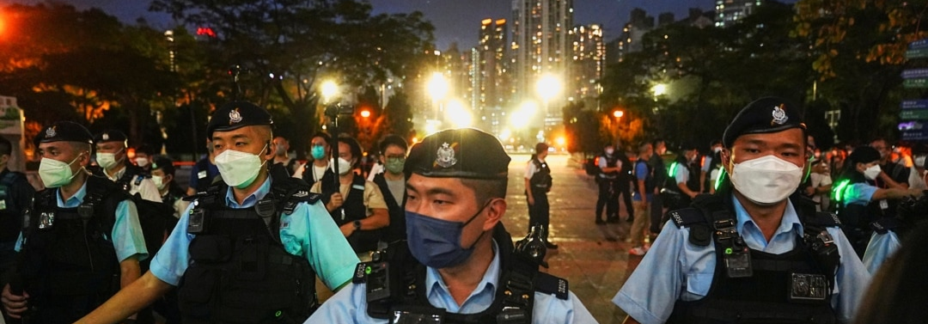
Tools of Erosion
Undermining faith in major public institutions and government
Purging government agencies
Eliminating checks and balance/abusing power
restricting free speech, information, the media, and academic freedom
Populist appeals
Demonizing and repressing the opposition

Slide 28
Derek Gottlieb, Review of Schoolhouse Burning

