Slide 1
Supporting Students by Decolonizing course content: Teaching using indigenous paradigms
Crystal Huckabee M.A (she/her)
California Teachers Association
Community College Association

Slide 2
Let me introduce myself
Crystal Huckabee (she/her)
Central American and Indigenous
Professor of Anthropology, Study Strategies
Doctoral Student of Ed. Doctoral program at Cal State University Fullerton, Community College Leadership, Cohort 16
Long Beach City College, Cerritos College, Crafton Hills, Citrus College, Mt. San Antonio College, and LA Harbor College

Slide 3
Lenapehoking territory
Land acknowledgements
“Native Land brings about discussions of colonization, land rights, language, and Indigenous history tied to our personal histories.” (Native Land Teachers Guide, 2019)
Dig deeper than a land acknowledgment.

Slide 4
Student Development theory: Indigenous Paradigms
As educators we need to understand Indigenous and decolonizing paradigms
These paradigms are a collection of diverse groups nations, cultures, and languages who have experienced colonization
Challenge Eurocentric assumptions allowing for diverse approaches to support all students.
Who are Indigenous Peoples?
Not a monolithic group
Emerging in the 1970’s as a collective hegemonic term to reclaim their experiences with colonization.

Slide 5
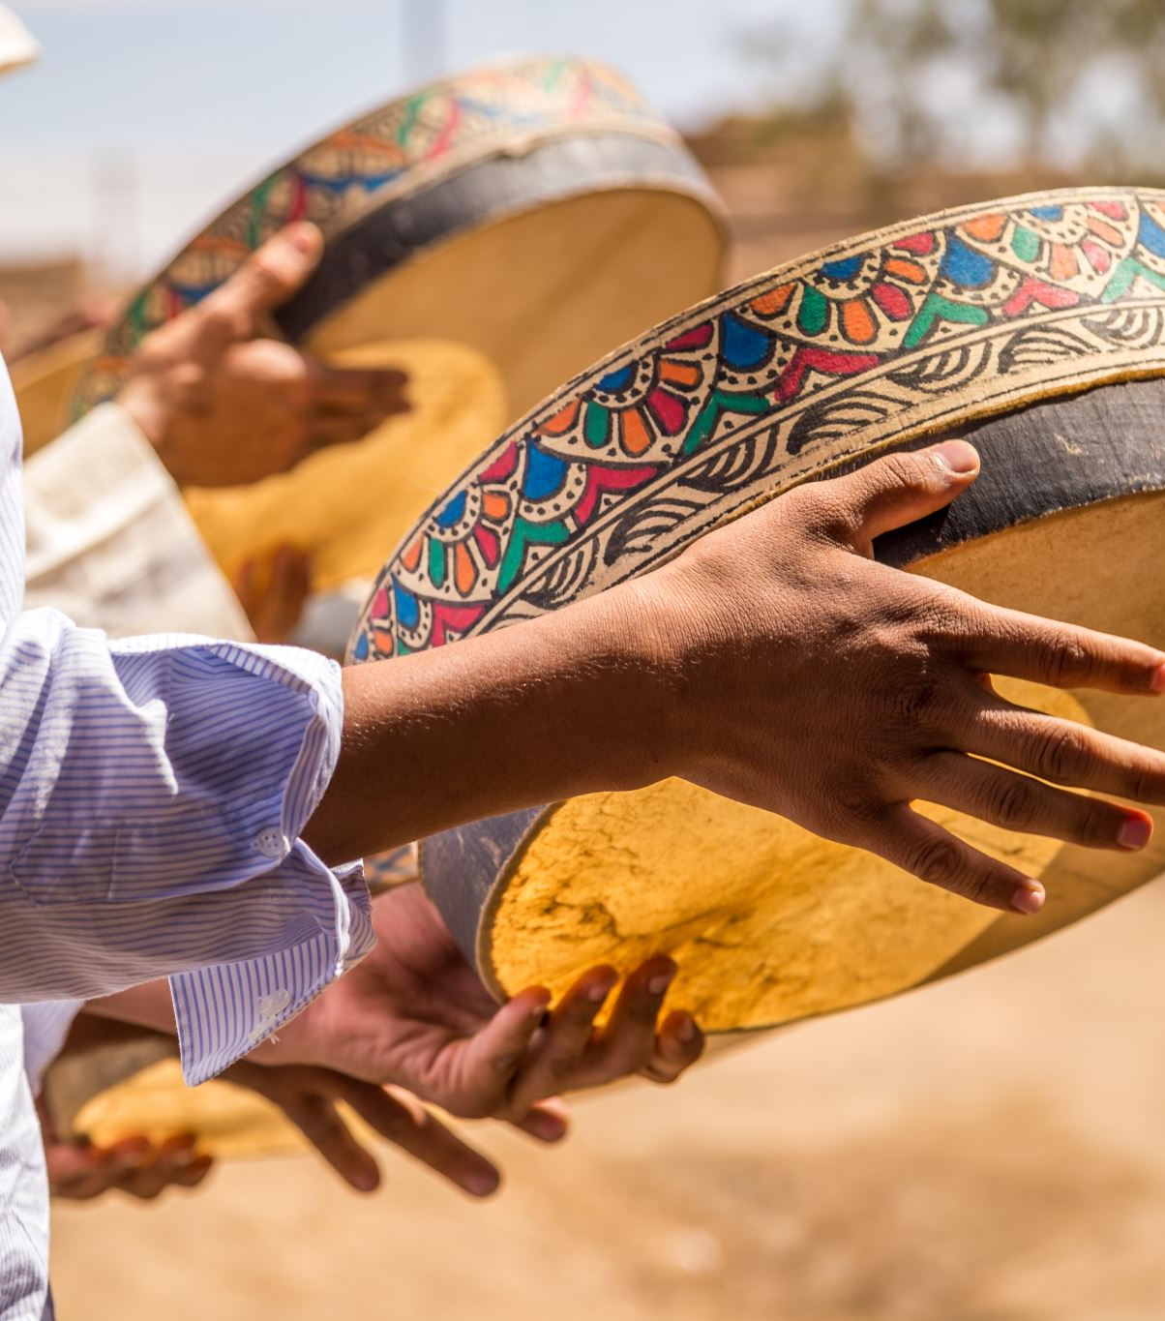
Tribal Critical Race Theory in Education
Colonization is endemic to society
TribalCrit grounded in multiple epistemologies and ontologies
Emphasis on Lived Experience and Storytelling
Tied to CRT
Culture, knowledge, power
Commitment to Social Justice

Slide 6
Key concepts
What Indigenous Paradigms emphasize:
Relationality & Reciprocity
Self-Determination & Sovereignty

Slide 7
Student development
Current Student development:
Theories take a Eurocentric approach
Emphasis on individual autonomy
Deficit based
Learning about
Learning from
Indigenous paradigms focus on decolonization approach, the collective
Home going behaviors
Giving back mentality
Indigenous Pedagogy
(Abes, 2019: Absolon, 2022; Chorna, 2022)

Slide 8
Decolonizing and Indigenizing College Student Development
Put in practice
Decolonizing education
Cultural competency on the diversity of knowing and existing
Removing the individual as focus
Building on student strengths and values
Involve Communities in development, this will benefit all students from collectivist cultures
Benefit more than Indigenous students this supports the diverse experiences of all students by being inclusive of different communities and promote social justice.

Slide 9
A Case study of Māori
A shift in research
The establishment of the Waitangi tribunal
The development of a language revitalization movement known as Te Kohanga Reo
The spaces opened up in social sciences by more critical and reflective approaches to research.

Slide 10
Where are we?
3 sisters
Recipe card
Why seeds?

Slide 11
Reflection
What role should land acknowledgements play in creating meaningful connections between academic institutions and Indigenous communities?
Notes:
https://padlet.com/profmejiahuckabee/what-role-should-land-acknowledgements-play-in-creating-mean-mde0jqf1s6dij2xf

Slide 12
Citations
Abes, E. S. (2019). Rethinking college student development theory using critical frameworks (E. S. Abes, S. R. Jones, & D. L. Stewart, Eds.; 1st ed.). Stylus Publishing, LLC.
Absolon, K. E. (2022). Kaandossiwin: How we come to know: Indigenous re-search methodologies (2nd ed.). Fernwood Publishing.
Brayboy, B. M. J. (2005). Toward a tribal critical race theory in education. The Urban Review, 37(5), 425–446
Chrona, J. (2022). Wayi Wah!: Indigenous pedagogies: An act for reconciliation and anti-racist education. Portage & Main Press.
Hernandez, J. (2022). Fresh banana leaves: Healing indigenous landscapes through indigenous science. North Atlantic Books.
Miller, B. (2023). What is the haka and why do the New Zealand rugby team do it? explaining the origins and lyrics of famous all blacks dance. Sporting News. https://www.sportingnews.com/us/rugby-union/news/haka-new-zealand-rugby-team-origins-lyrics-all- blacks/tqgwkgx9zmm11wztz2iyj5du
Our home on Native Land. Native-Land. (n.d.). https://native-land.ca/
Smith, L. T. (2024a). Decolonizing methodologies: Research and indigenous peoples (3rd ed.). Bloomsbury Academic.
Wolfman, D. (2015). Three Sister Corn Relish. Chef David Wolfman recipes. http://www.cookingwiththewolfman.com/cookbookandrecipes.html

Slide 13
Questions, comments, Concerns?
Email: ProfMejiaHuckabee@gmail.com
Follow me on Instagram @Prof_Huckabee
Follow me on LinkedIn Crystal (Mejia) Huckabee
(https://www.linkedin.com/in/crystal-huckabee-9941b2207/)

