Slide 1
Thriving under fire: Lessons from graduate employees in Florida
Tessa Barber (she/her), MA; 2024-2025 Co-President of USF Graduate Assistants United
Lee Robertson (they/them), MS; 2023-2025 President of FSU Graduate Assistants United

Slide 2
Disclaimer:
By attending this session, you confirm that you are a registered attendee of the National Education Association (NEA) Higher Education Conference and an NEA member or supporter. The information you receive here is only for your use in your capacity as an NEA member or supporter. This presentation and its contents may not be further distributed, in whole or in part, by any medium or in any form, for any purpose other than building your local NEA affiliate.
Violation of these terms may result in legal action.

Slide 3
Land acknowledgment & positionality
We are currently gathering on unceded Lenapehoking (the Lenape name for the Lenape homeland)¹. Upon the arrival of the European colonists, the Lenape were culturally and physically devastated through violence and disease. In the 18th and 19th centuries, European settlers, and later, the U.S. government, forcibly removed the Lenape to Ohio. Today, after several more forced removals, the Lenape live in Oklahoma, Wisconsin, and Ontario, Canada. We pay our respects to the Lenape elders, past and present.
One of the presenters is an Afro-Caribbean, nonbinary Clinical Psychology PhD student with chronic illness who hails from a middle-class immigrant family in southwest Florida. The other presenter is a white, female Politics & International Affairs PhD student hailing from the Tampa Bay area in Florida. We acknowledge that our social positions influence our perspectives and our work, and we ask that you please consider that as you participate in today's workshop.

Slide 4
agenda
Some notes on terminology
Challenges to graduate employee organizing, past and present
National level
State (Florida) level
Local level
Tallahassee (FSU-GAU)
Tampa (USF-GAU)
Solutions and opportunities to tackle these challenges
Tampa (USF-GAU)
Tallahassee (FSU-GAU)
Discussion: How can you tackle your challenges at home?

Slide 5
Some notes on acronyms/language
Graduate Assistant or GA / Graduate Employee: a graduate student who is part-time employed with the university, and whose paid position is contingent on their status as a student
UFF: United Faculty of Florida, the statewide labor organization for higher education faculty which is affiliated with FEA/NEA
GAU: Graduate Assistants United, one of the four GA-only Chapters of UFF
FSU: Florida State University, located in Tallahassee, FL
USF: University of South Florida, located in Tampa, FL
PERC: Public Employee Relations Commission, the government body that mediates employment disputes and certifies collective bargaining entities in Florida's public sector

Slide 6
Challenges to graduate employee organizing in Florida
From the national level to our local cities, graduate employees in Florida have been struggling against serious social and legislative challenges since the 1970s

Slide 7
National challenges
The growth of the Graduate Student Employee Labor Movement and the challenges it has faced along the way.

Slide 8
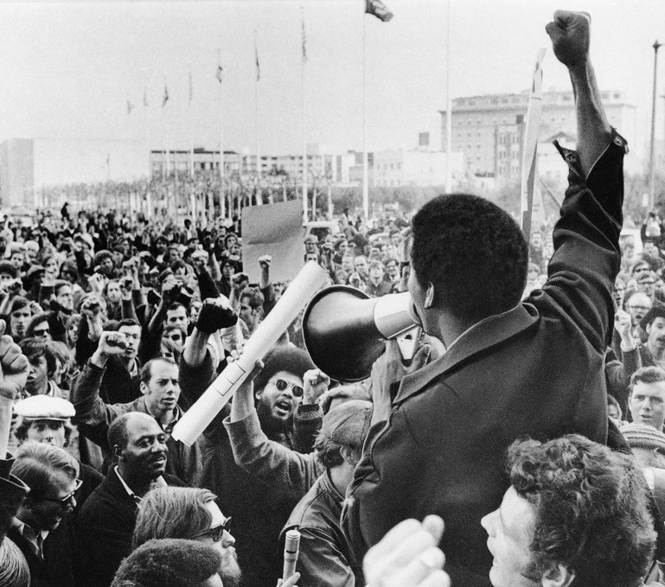
The 1960s:Beginnings of Change
Though the National Labor Relations Board (NLRB) was formed in 1935 to safeguard employees’ rights to organize and seek safer working conditions, prior to the 1960s graduate student employees were not generally considered employees and were denied the right to organize. The work they did was considered a component of their education.
Beginning in 1964, the UC-Berkeley Free Speech Movement(led by grad student Mario Savio) canonized the fact that higher educational campuses are political spaces and set the blueprint for graduate student organizing in the years to come.
In 1969, GAs at the University of Wisconsin-Madison became the first graduate student employees to unionize, forming the Teaching Assistants’ Association. This was the first time a graduate student union was voluntarily recognized.

Slide 9
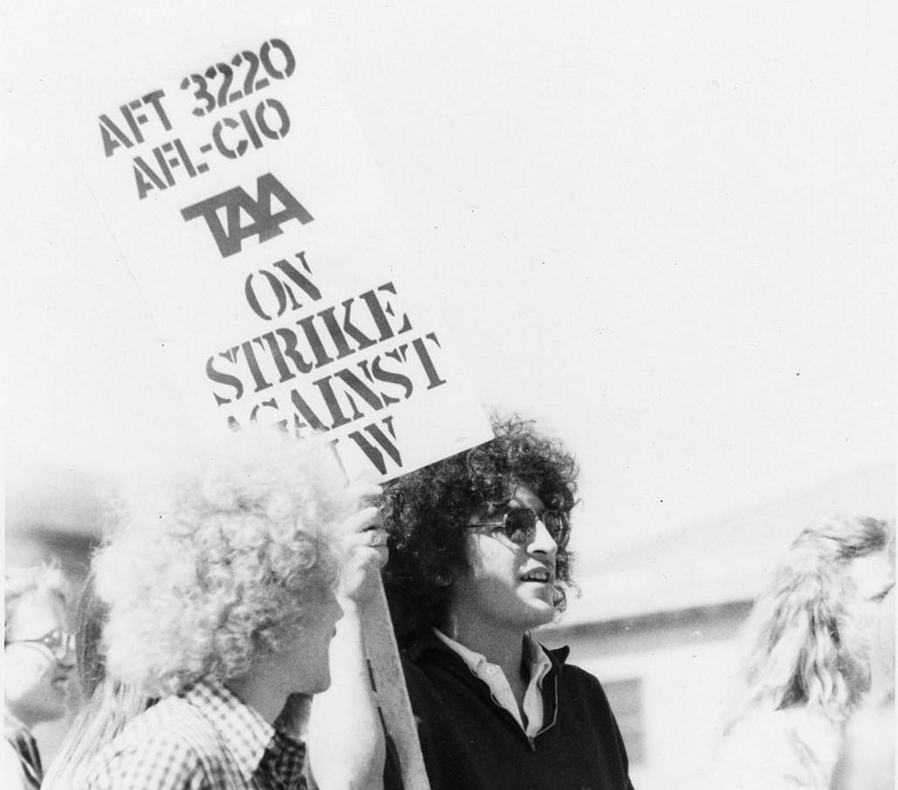
The 1970s: the movement grows, despite legal setbacks
In 1974, the National Labor Relations Board (NLRB) ruled against GAs at Stanford, saying that it would NOT grant graduate student employees the right to unionize under the claim that their student status superseded their work, denying them the title of “employee”.
Despite this setback, GAs at the University of Michigan won their contract in 1975, and were followed by a wave of recognized GA unionization at the University of Oregon (1976), the University of Florida and the University of South Florida (1980)

Slide 10
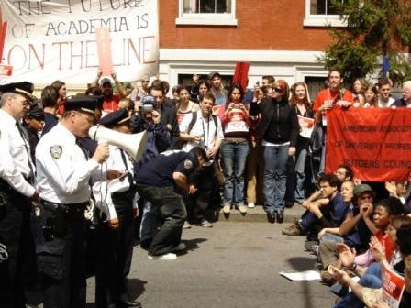
The 1990s-2000s: A Turning point
The amount of unionized graduate student employees nearly tripled between 1990 and 2001, from appx 14,060 to 38,750.
In 2000, the NLRB finally granted GAs the title of “employee” and the right to collectively bargain, ruling in favor of NYU GAs.
After victories at NYU, Temple University, and Michigan State University, journalist Scott Smallwood declared 2001, “The Year of the TA” in the Chronicle of Higher Education.
In 2004, the NLRB ruled against Brown University GAs and reversed its 2000 NYU decision, revoking the ability of GAs at private institutions to collectively bargain.

Slide 11
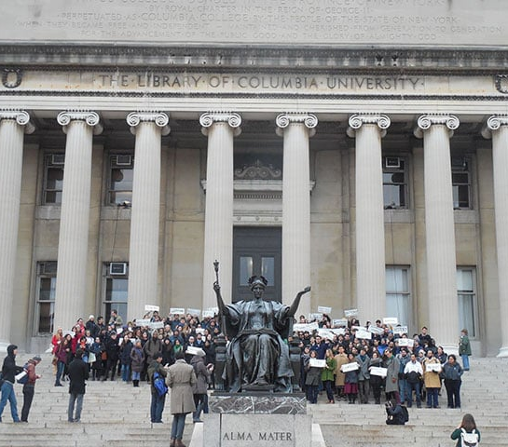
2016-2020: Give and take
In 2016, the NLRB’s 2004 Brown decision was successfully overturned following petitions filed by GAs at Columbia University and The New School. This granted private university GAs the right to collectively bargain, again.
This victory led to a resurgence in GA organizing efforts; however, 9 universities (including Brown University) filed amicus briefs challenging the Columbia decision, arguing that the decision hampered their academic freedom.
After the 2016 election, GA unions withdrew other NLRB claims to prevent the overturning of the Columbia precedent.
The NLRB attempted to overturn Columbia in 2019 through regulatory action, but President Joe Biden withdrew the proposed rule in 2021.

Slide 12
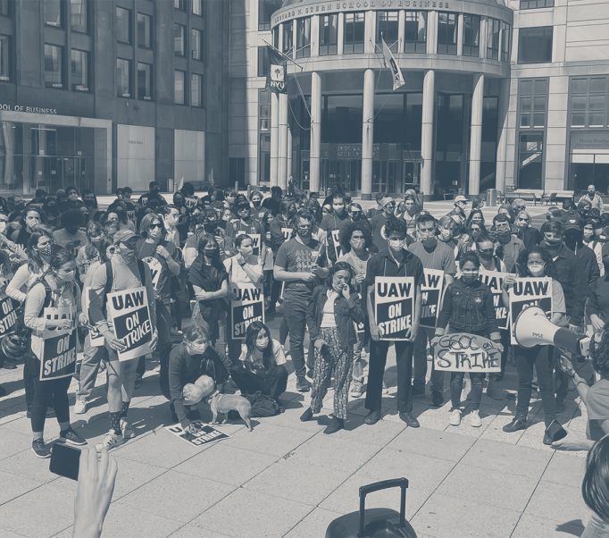
2020-Present: modern challenges
The COVID-19 pandemic sparked a new wave of GA activism and organizing, though distance from physical campuses presented unique organizing challenges.
The pandemic highlighted the benefits of unionization across a variety of sectors, not just higher education, spurring a push for safer working conditions and a renewed vigor for workers’ rights.
While an estimated 38% of GAs are now in unions, state-level challenges to academic labor organizing have continued to emerge. In January 2025, President Donald Trump idled the NRLB by removing board member Gwynne Wilcox and General Counsel Jennifer Abruzzo.
In February 2025, federal funding cuts and politically motivated federal grant restrictions have left GAs across the country feeling vulnerable and under attack.
State-level legislation has continued to emerge, specifically targeting academic labor organizing, with Florida serving as a testing-ground for new “union-busting” tactics.

Slide 13
Challenges in Florida
Persistent attacks on education and labor organizing over the decades

Slide 14
The 1960s: Setting the Stage
In 1966, the Florida Education Association (FEA) integrated with the all-Black American Teacher Association, becoming one of the first teachers' unions in the South post-Brown to integrate.
That same year, the NEA released a report finding that Florida's school enrollment was dramatically increasing while funding was decreasing.
Continued segregation of Black and White teachers, poor wages and benefits, and insufficient supplies and facilities increased militancy and union interest amongst teachers in the 60s.

Slide 15
The 1960s: Setting the Stage
In the 1967 legislative session, the FEA successfully lobbied for better pay for teachers, but Governor Kirk vetoed it.
In September 1967, most teachers in two of the largest counties in the state – Pinellas and Broward – resigned in protest, pressuring the state government by closing schools.
Kirk called a special session in January 1968, agreeing to raise certain taxes to fund schools, but teachers were unsatisfied.
In February of 1968, between 25,000 and 35,000 (40% of the state) teachers illegally struck, supported financially by the FEA.
While the strike didn't win higher pay, the strike radicalized FEA members, and within two years, public employees had won a constitutional right to collectively bargain.

Slide 16
The 1970s: University of Florida GRads pave the way
Out of fear of future strikes, the Florida government doubled down on its previous work to make striking illegal by enshrining it in the constitution and passing legislation allowing local school districts to hire uncertified teachers as strikebreakers.
However, UFF's first chapter formed at University of Florida the same year as the teacher's strike, and, seeing the wave of organizing, graduate students at University of Florida organized a Graduate Student Unio (GSU) in 1972.
UF's Graduate Student Union lobbied the university for better wages and financial aid for years, despite not being legally recognized as a labor union.
In 1975, the GSU applied for recognition and to be affiliated with the AFT and UFF, but the Florida Board of Regents opposed them, even when PERC agreed that GSU should be certified.
The Florida District Court of Appeals, First Circuit, decided that GAs were employees and had the right to collectively bargain.

Slide 17
The 1980s: Growing the movement
In 1980, UF and USF's GA unions applied again, successfully, to become affiliated with UFF.
However, the state legislature passed a law exempting GAs from recognition as public employees.
But with the support of UFF, who filed a lawsuit, we again won the right to collectively bargain from the Florida District Court of Appeals.
In 1986, the state legislature voted to waive tuition for GAs in Florida.

Slide 18
The 1990s: Reaching the Capital
Throughout the 1990s, the GAs at FSU organized for better allocation of their fees, lower tuition costs, and better representation in student government
At Florida Agricultural and Mechanical University (FAMU), the GAs successfully certified a GAU Chapter in 1997
FSU GAs earned their right to collectively bargain in 2009, the most recent certification of a GAU in Florida

Slide 19
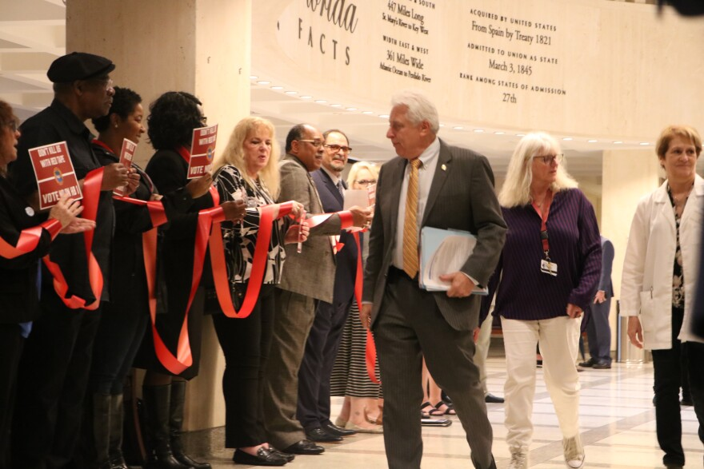
The 2000s-2010s: "thousands of little paper cuts"
Organizations like ALEC, the Heritage Foundation, and the Freedom Foundation supported numerous attempts to reduce union power in Florida throughout the 2000s and the 2010s.
Fortunately, most of the sweeping ones failed to pass committees and died, but many smaller bills
But Governor Ron Desantis's election in 2018, alongside Rick Scott's narrow win for the U.S. Senate seat from Florida, signified a serious conservative turn in Florida politics.

Slide 20
The 2000s-2010s: "Thousands of little paper cuts"
In 2018, after many years of attempts, the legislature finally passed HB 7055, which required teachers' unions to maintain 50% membership density to remain certified.
Most K-12 chapters saw a surge in membership, fortunately, but a few rural counties fell below the new threshold.

Slide 21
The 2020s: thriving, against all odds
In 2023, Desantis signed SB 256, which raised the density bar for certification to 60%, expanded it to all public employees (excluding cops, corrections, and firefighters), and outlawed payroll deduction, amongst other things.
That same year, he also signed HB 999, which bans "critical race theory" in hiring decisions and restricts what can be taught at public universities.
In 2024, SB 1746 became law, which exempts emergency and mass transit workers from SB 256.

Slide 22
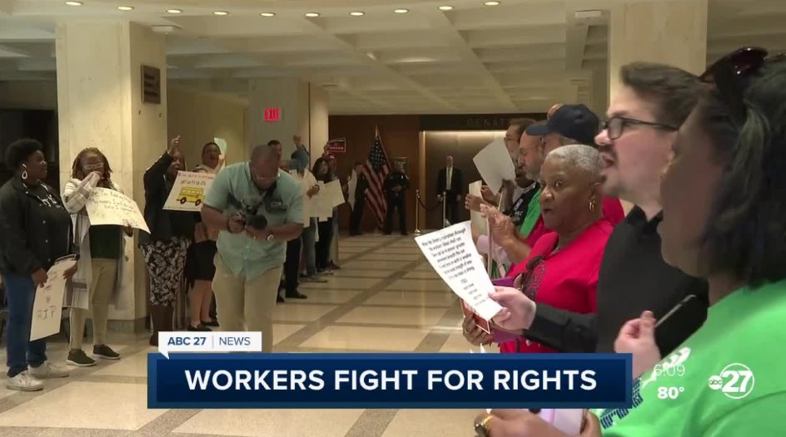
The 2020s: thriving, against all odds
The results have been devastating for many public sector employees
20 bargaining units for non-instructional employees at the state universities have gone under
AFSCME and other municipal units representing janitors, groundskeepers, clerks, accountants, etc. Were decertified, leaving about 42,000 people in those areas unrepresented
All eight adjunct units were decertified
However, GAUs and other UFF chapters have pushed through
All the GAU chapters have collected enough cards to extend our time
UFF overall is up 5% in members from 2022

Slide 23
Challenges in our local communities
Apathy, institutional barriers, and downstream effects of legislative attacks in the modern day at Florida State University and the University of South Florida

Slide 24
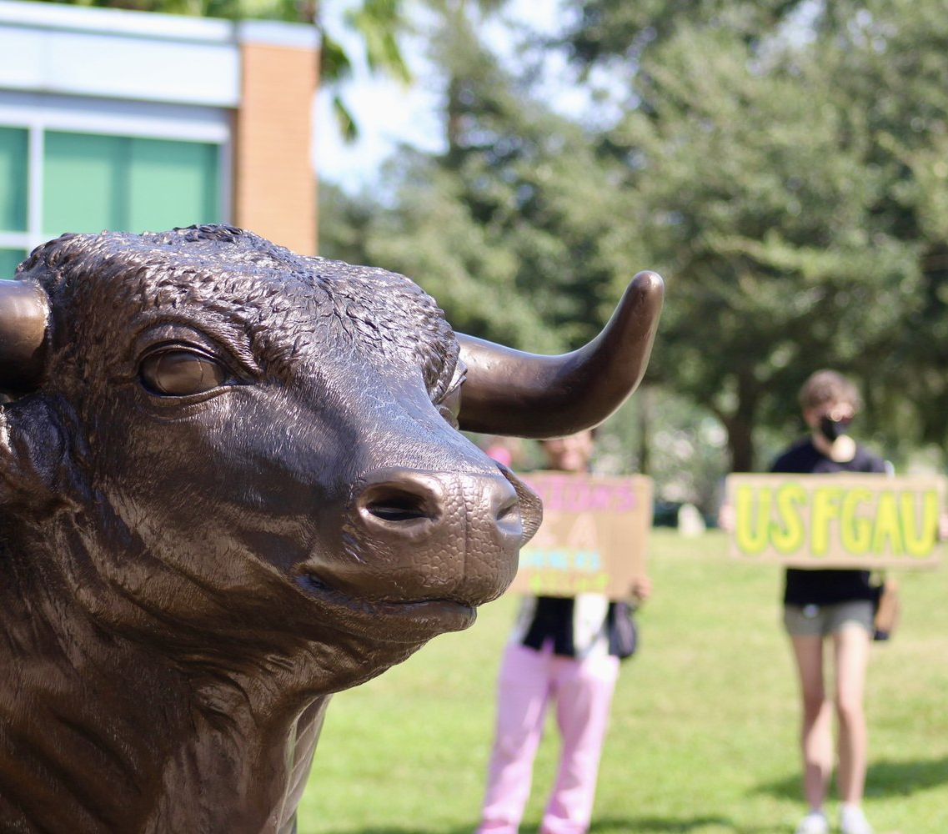
USF: in the shadows of law
Florida Senate Bill 256 mandated that all public sector unions (except Police, Corrections, Fire, Mass Transit, EMTs, and 911 Operators)…
Must meet 60% membership by a designated “Snapshot” date in order to retain certification.
Are banned from deducting dues directly from the employee’s paychecks (unless that is stipulated in their CBA, as decided in a later court decision).
Must have all members sign a “membership authorization form” with a “wet signature” in order to retain certification, in addition to the supermajority of membership within the unit.
With high semester-to-semester turnover, low density, and unpredictable unit size fluctuations over the summer, these stipulations represent huge hurdles to maintaining strength on campus and retaining certification.

Slide 25
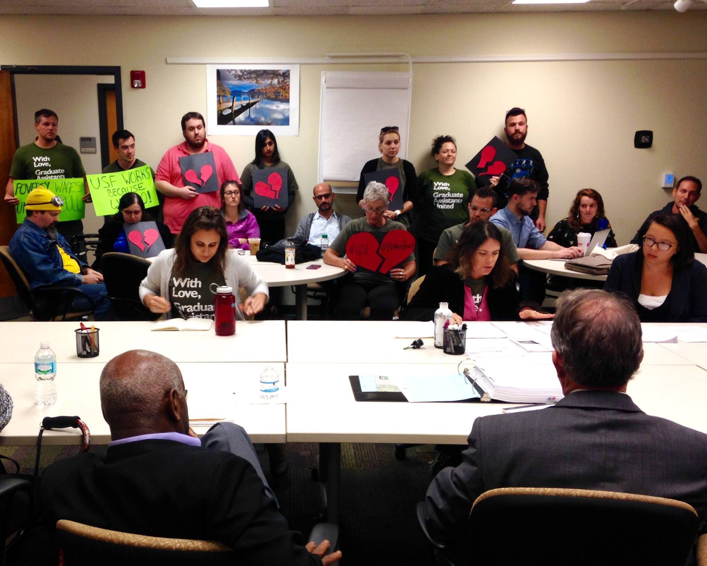
USF: campus challenges
The University of South Florida Board of Trustees (USF BOT, our employer per our CBA) continually dismisses the concerns of GAU and refuses to hold delinquent departments fully accountable for CBA violations.
The USF BOT has also worked to undermine the presence of USF GAU on campus and reduce visibility with changes to campus use policy, including restrictions to temporary signage that directly contradict our CBA, restricting access to “academic spaces” and areas adjacent to them on campus for non-students and non-student organizations, and mandates against amplified sound on campus which have been used to curtail our rallies in the past.

Slide 26
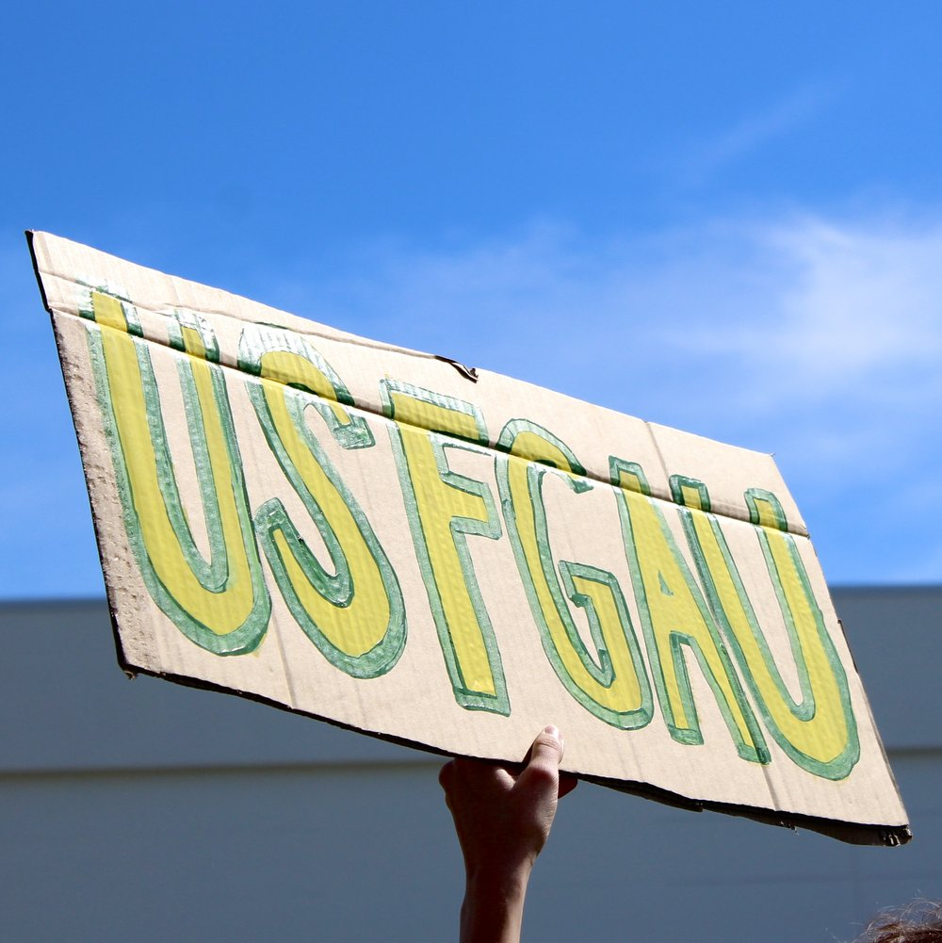
USF: community challenges
A culture of fear and ambivalence around joining the union persists despite efforts to educate the unit:
GAs are concerned about anonymity and potential negative impacts of union membership due to legislative challenges
Many are not compelled to join under the impression that their membership will not make a difference in preventing de-certification.
The cost of living in Tampa makes the prospect of paying even 1% of each paycheck (our dues rate) daunting, which is a huge barrier for membership.
STEM GAs and Non-STEM GAs often receive vastly different stipends and are subject to wildly different expectations and job environments, so inter-sectoral division persists despite shared broader challenges.

Slide 27
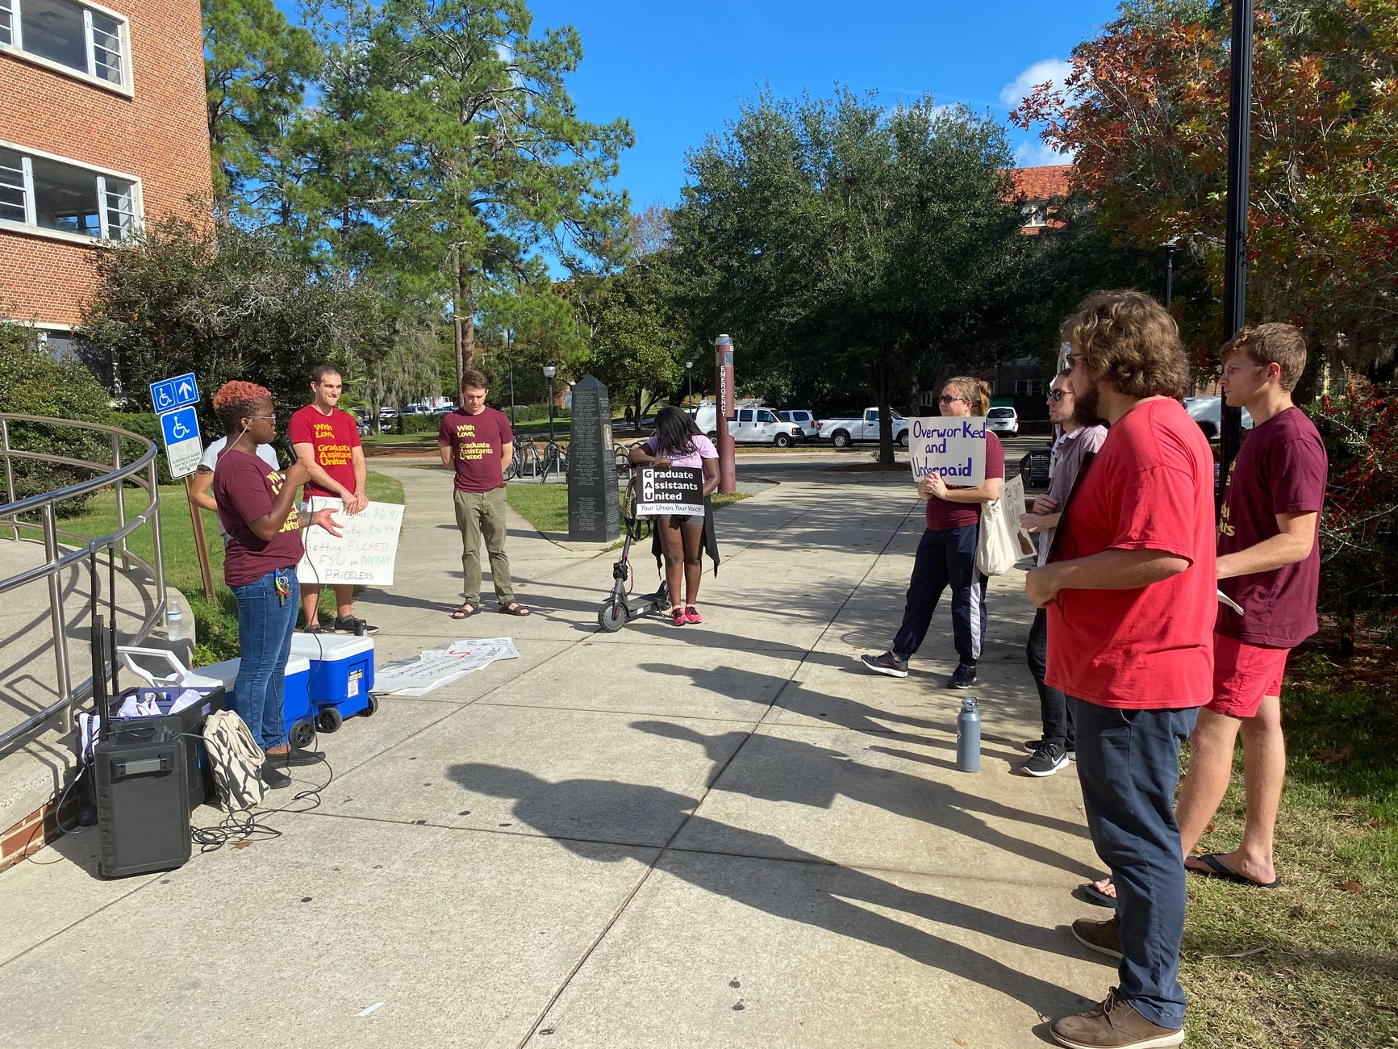
FSU: In the Belly of the beast
FSU's board of trustees (our employer for the purpose of collective bargaining) has repeatedly demonstrated a lack of interest in improving GAs' working conditions
FSU and Tallahassee Memorial Hospital collaborating on a $125 mil academic medical center
Dismissed concerns about unit erosion and overwork in Sociology and Math
They have also taken concrete steps to reduce GAU's visibility and organizing ability
Amplified sound banned at most campus locations besides the student union, and FSU police have tried to shut down our rallies in the past
Citing FERPA to back up their continued refusal to provide a complete bargaining unit list

Slide 28
FSU: A culture of ambivalence
Despite efforts to educate the unit, ignorance, fear, and animosity about joining the union persists
Many GAs remain unaware that they are represented by a labor union due to our inability to contact them
A large number of our unit are represented in College of Business and Department of Economics, where there is strong anti-union sentiment
International GAs often fear that joining might cause conflict or waves in their department and result in termination
A larger problem, though, is apathy and doubt about FSU-GAU's capabilities
People who refuse to join often state that they don't see the point of joining an organization that may be disbanded at any moment
They also report being unsatisfied with bargaining wins
Most importantly, even among our supporters, few are willing to make the financial commitment – dues are the largest barrier as cost of living in Tallahassee continues to soar

Slide 29
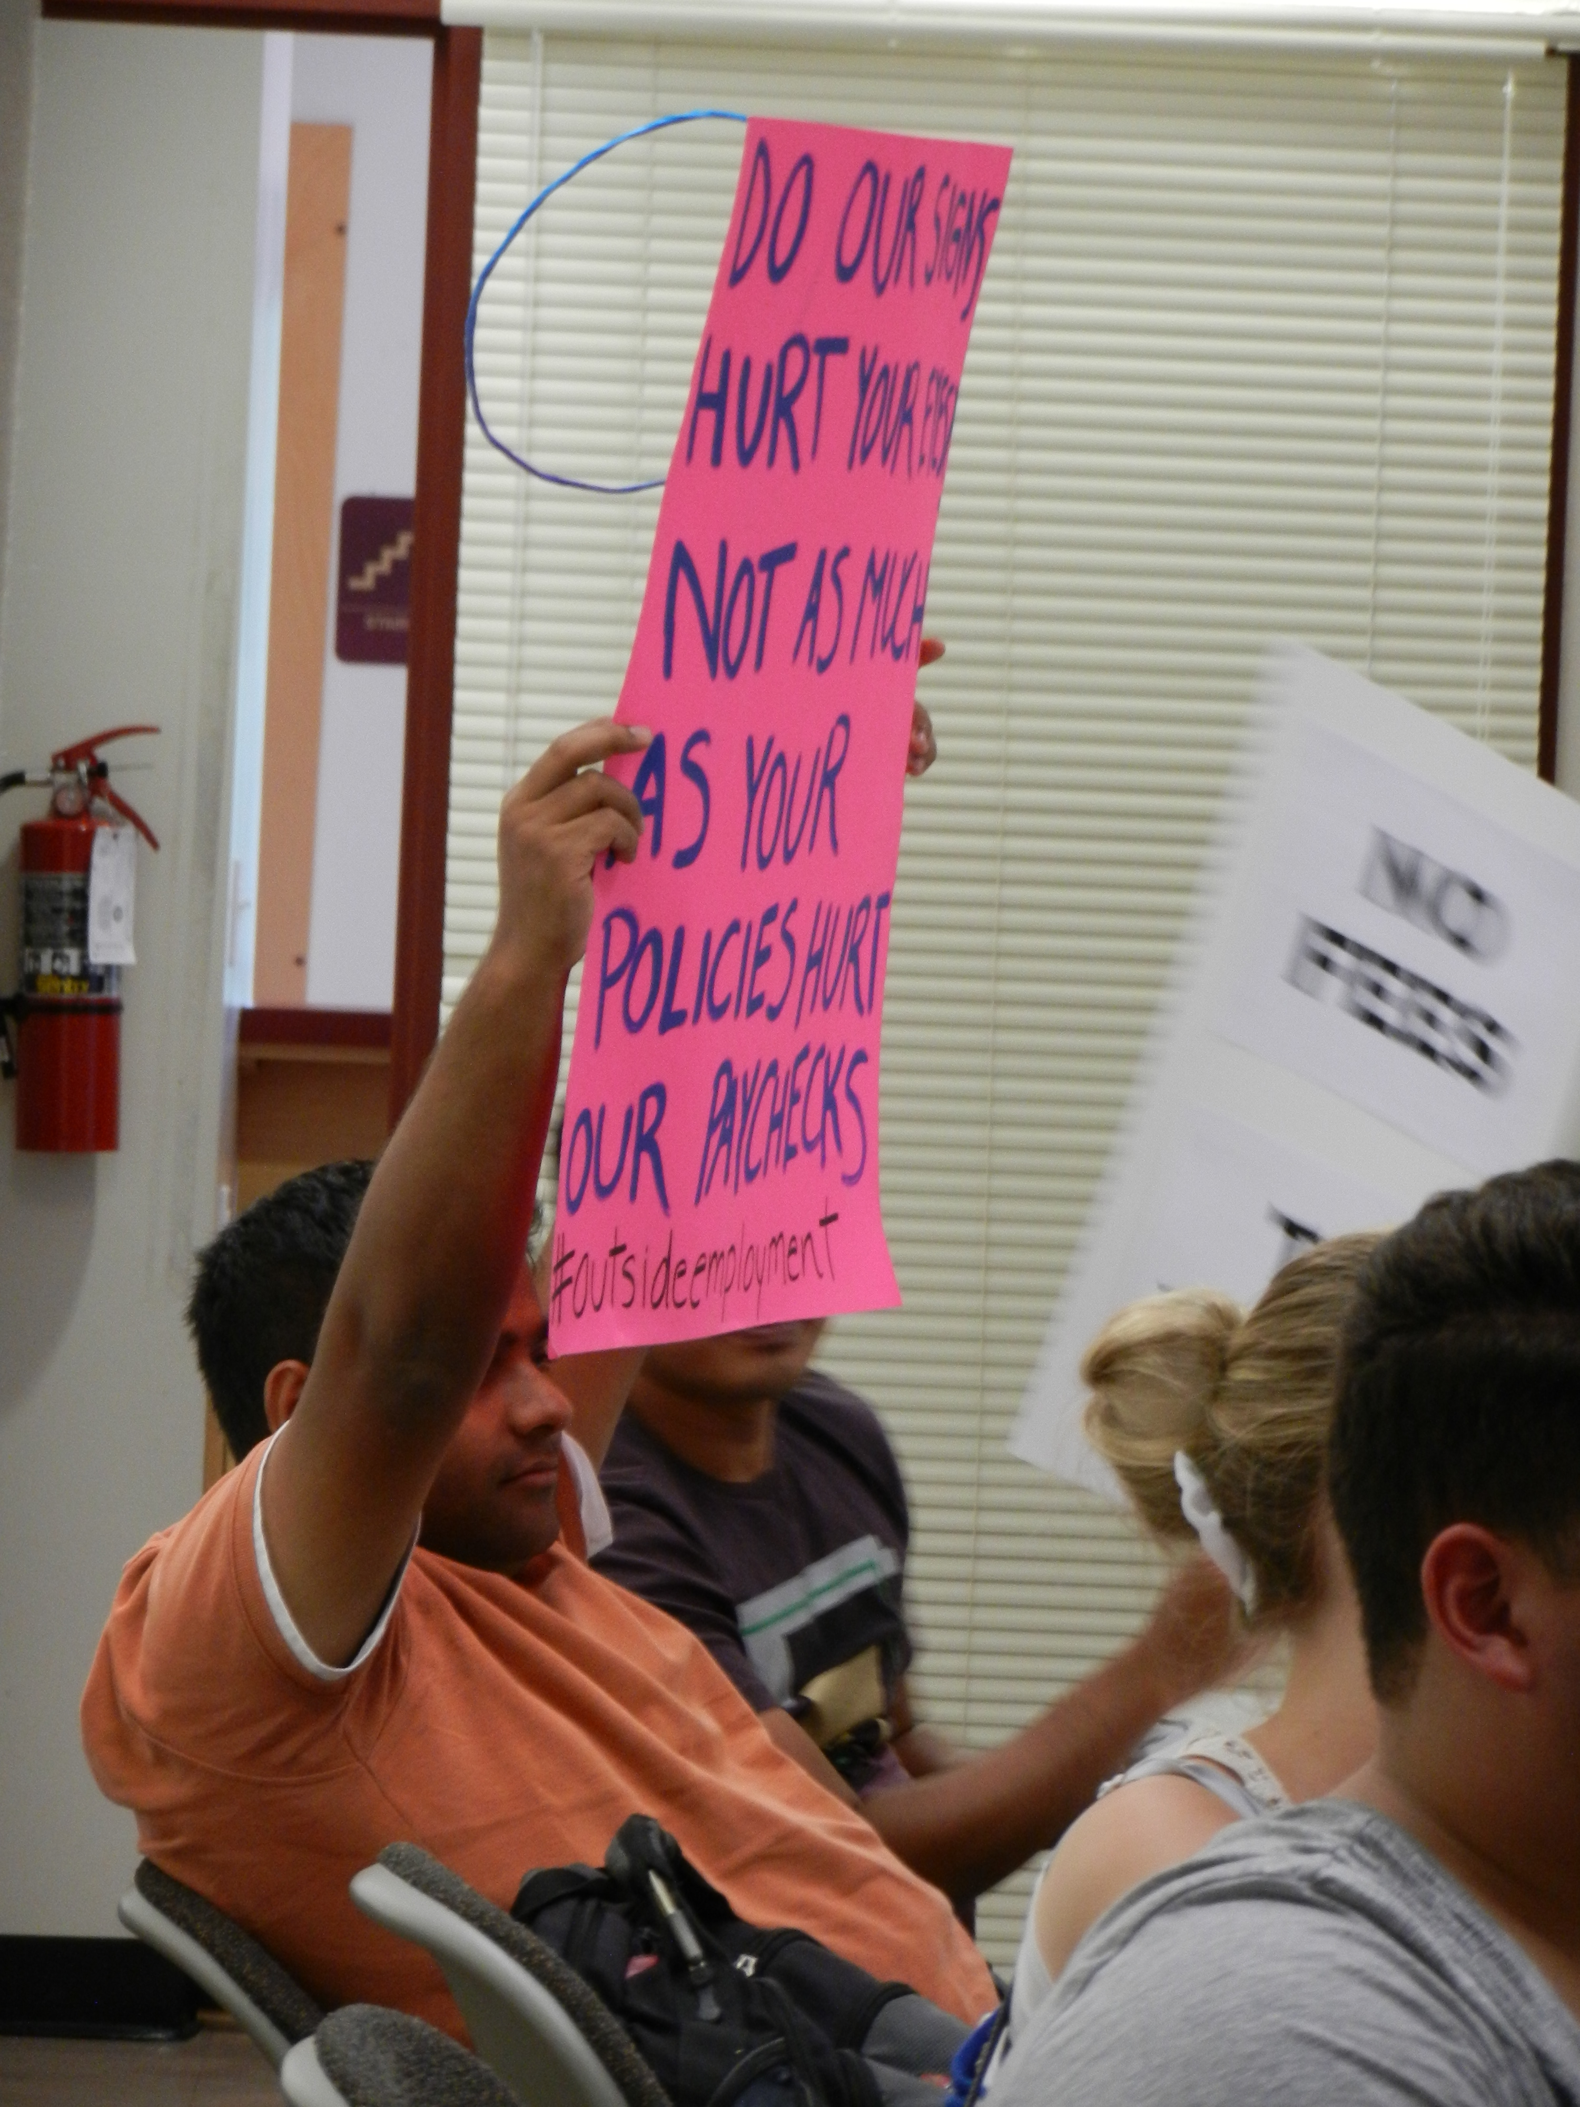
FSU: a community Divided
STEM GAs and non-STEM GAs are treated differently and have different needs
Newer and older GAs receive different offers, generating division
FSU and Florida Agricultural and Mechanical University (FAMU) have a history of racism-related animosity that hinders solidarity
Geographic spread of the unit hinders in-person organizing
Tallahassee is regarded as a stepping stone rather than a home or community

Slide 30
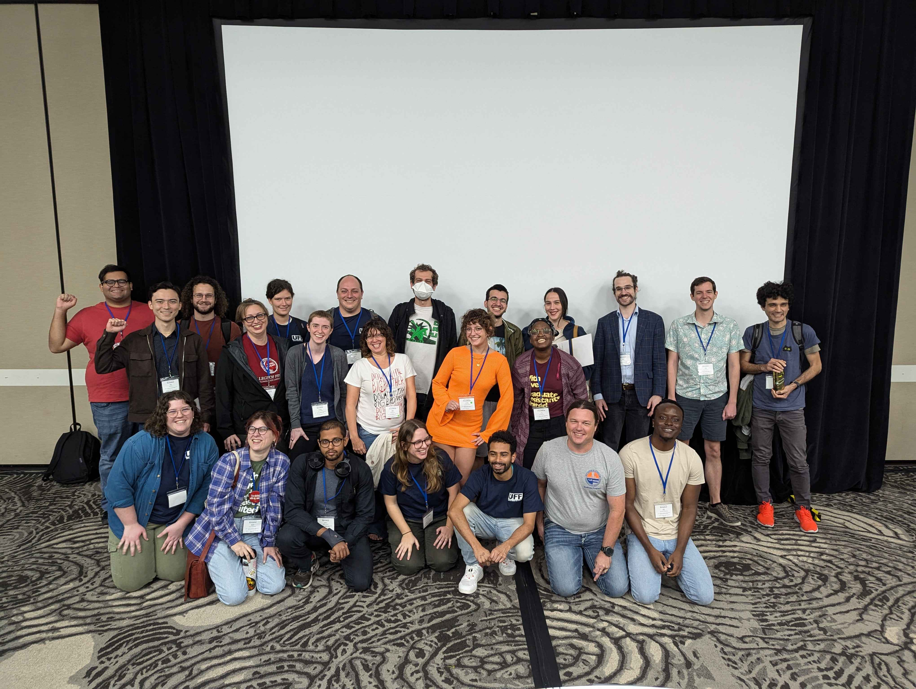
Solutions and opportunities
How we are struggling to thrive in our locals

Slide 31
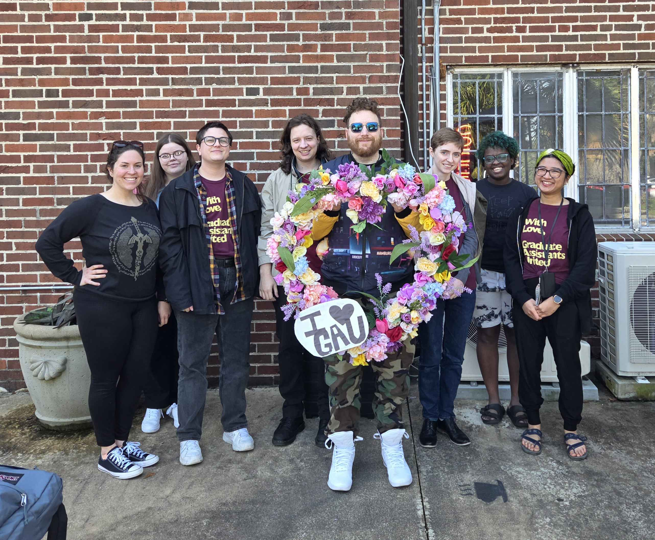
Solutions and opportunities at FSU
Sociopolitical attacks on rights of GAs of marginalized backgrounds (e.g., IGAs, trans folks) and others (e.g., STEM GAs on federal funding, humanities and social science GAs facing academic freedom threats) present opportunities for solidarity within the unit
Improving solidarity with FAMU-GAU, as well as faculty chapters and other unions (e.g., Leon County Teachers' Association) through collaboration and resource sharing
Strong relationship with the Congress of Graduate Students student organization, which has more funding from FSU and greater reach

Slide 32
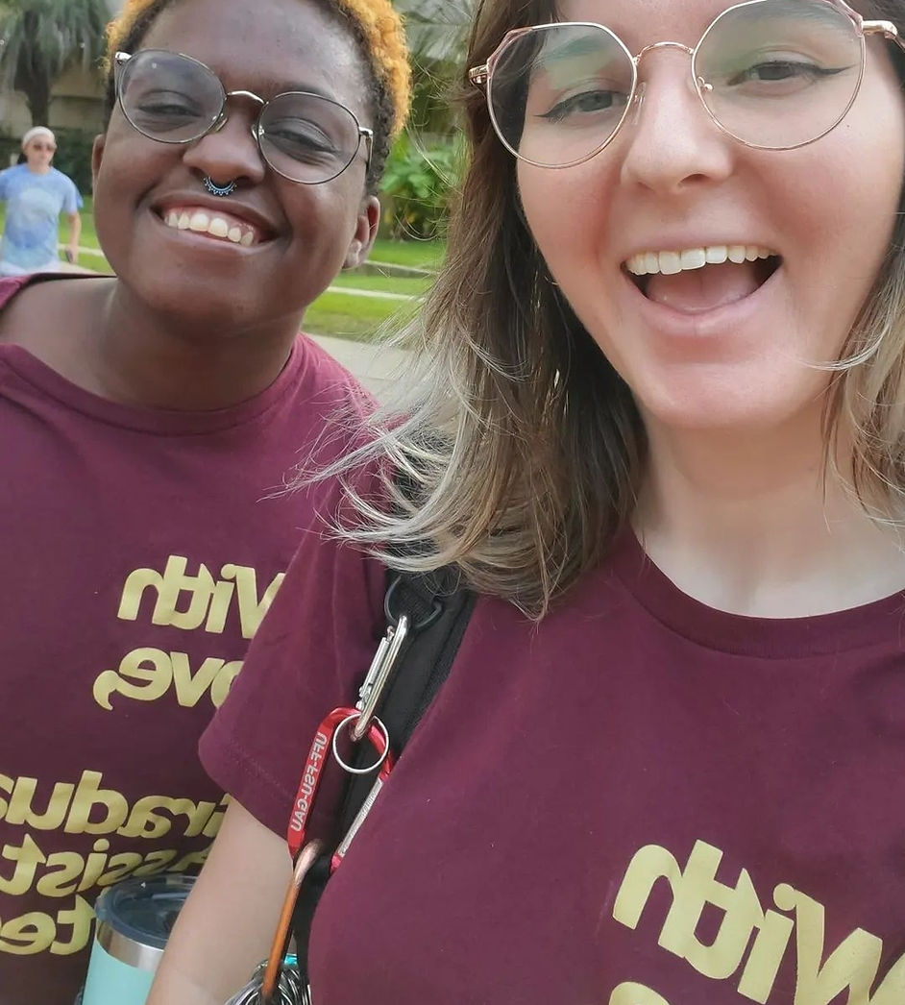
Solutions and opportunities at FSU
Increasing legislative advocacy due to access to the state Capitol
Utilization of our collectively bargained student organization-level rights to tabling, reserving space, and hanging flyers
Taking advantage of trainings from affiliates to develop internal legacy documents on bargaining, grievance, organizing, and governance to crystallize historical knowledge and facilitate turnover
Possibility of an austerity fund

Slide 33
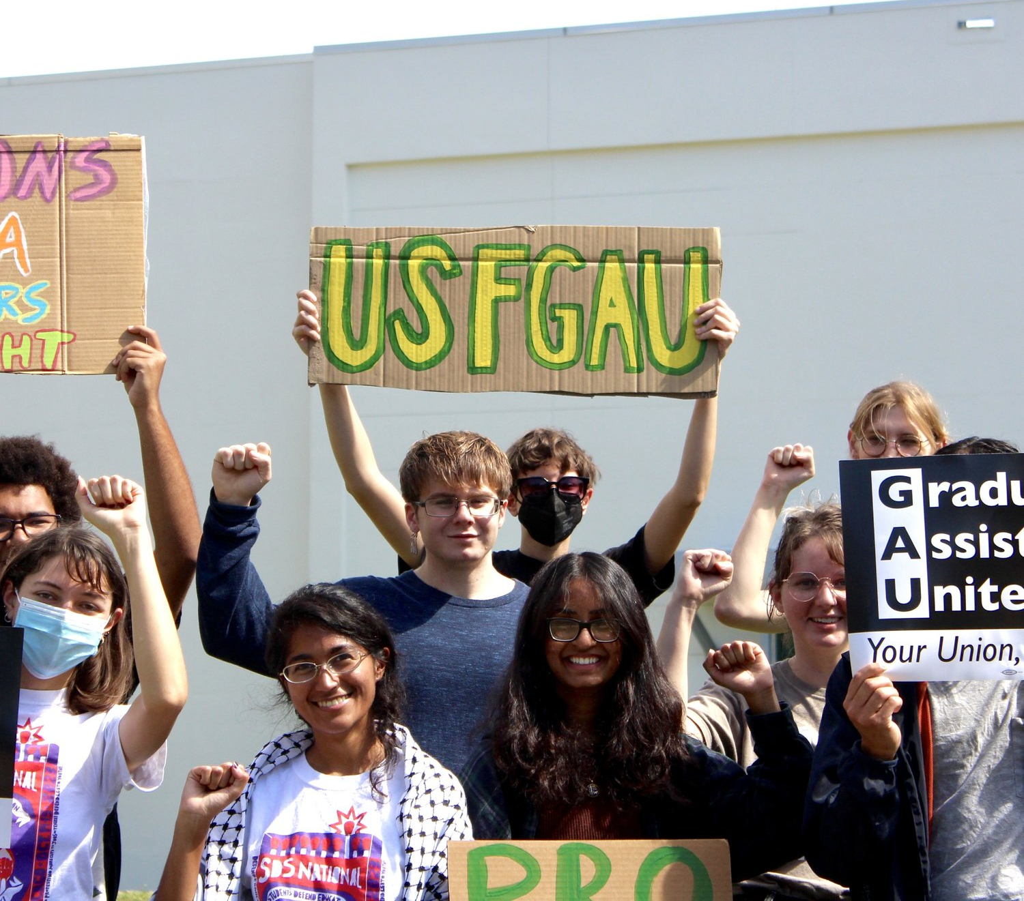
Solutions and opportunities at USF
Strengthening our alliance with campus organizations and offices such as Graduate Student Organizations and the offices supporting International GAs opens a critical pathway to accessing GAs in departments with limited physical access, communities in which we have limited reach, and resources outside of our purview.
Using our CBA, we can push back against campus-level incursions on our rights to organize:
Maintaining access to academic spaces for office visits
Reserving the right to post signage for events and awareness
Exercising our ability to reserve campus space for tabling and events.

Slide 34
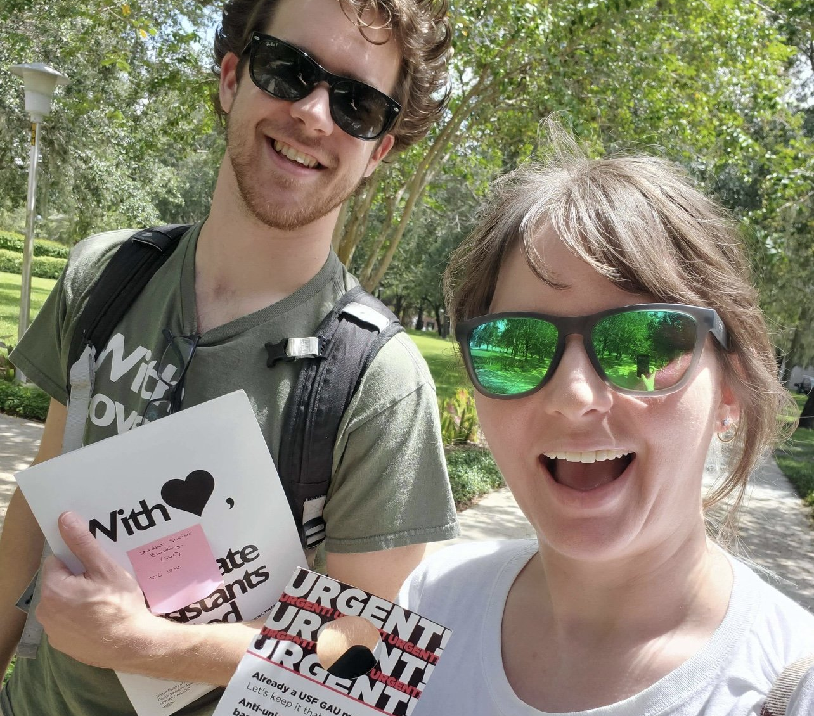
Solutions and opportunities at USF
Attacks on our membership, our academic freedom, and our funding are opportunities to increase solidarity under fire, both for our bargaining unit and the broader Graduate Student Community.
Increasing solidarity between USF GAU and other Florida GAUs such as UF-GAU and FSU-GAU and faculty unions has facilitated greater sharing of resources and strength in the face of both local-level and state-level challenges.
Both our leadership and our members have been able to participate in training initiatives and programs sponsored by our parent unions to get more involved with both the GA labor movement and the broader Higher Ed labor movement in Florida.

Slide 35
Discussion: what opportunities can we turn into solutions in our locals?
Small Group Solution Generation & Discussion
Large Group Sharing: Solutions & Resources

Slide 36
Disclaimer:
By attending this session, you confirm that you are a registered attendee of the National Education Association (NEA) Higher Education Conference and an NEA member or supporter. The information you receive here is only for your use in your capacity as an NEA member or supporter. This presentation and its contents may not be further distributed, in whole or in part, by any medium or in any form, for any purpose other than building your local NEA affiliate.
Violation of these terms may result in legal action.

Slide 37
Thank you for attending!
KEep up with LEe and FSU-gau:
Keep up with Tessa and USF-GAU:
FSU-GAU
Instagram: @FSUGAU
X/Twitter: @FSU_GAU
Facebook: FSU Graduate Assistants United
Online: www.FSUGAU.org
Email: info@fsugau.org
Lee
Email: president@fsugau.org
X/Twitter: @robertson_lee_
USF-GAU:
Instagram: @USFGAU
X/Twitter: @USFGAU
Online: www.USFGAU.org
Tessa:
Email: usfgau@gmail.com

