Slide 1
These Are the Times That Try Men’s Souls: Organizing for Power - How HBCUs & Unions Transformed Higher Ed
A Call to Action for NEA Conference Attendees
Dr. Amanda Wilkerson
University of Central Florida

Slide 2
Disclaimer
By attending this session, you confirm that you are a registered attendee of the NEA Higher Education Conference and an NEA member or supporter. The information you receive here is only for your use in your capacity as an NEA member or supporter.
This presentation and its contents may not be further distributed, in whole or in part, by any medium or in any form, for any purpose other than building your local NEA affiliate.
Violation of these terms may result in legal action.

Slide 3
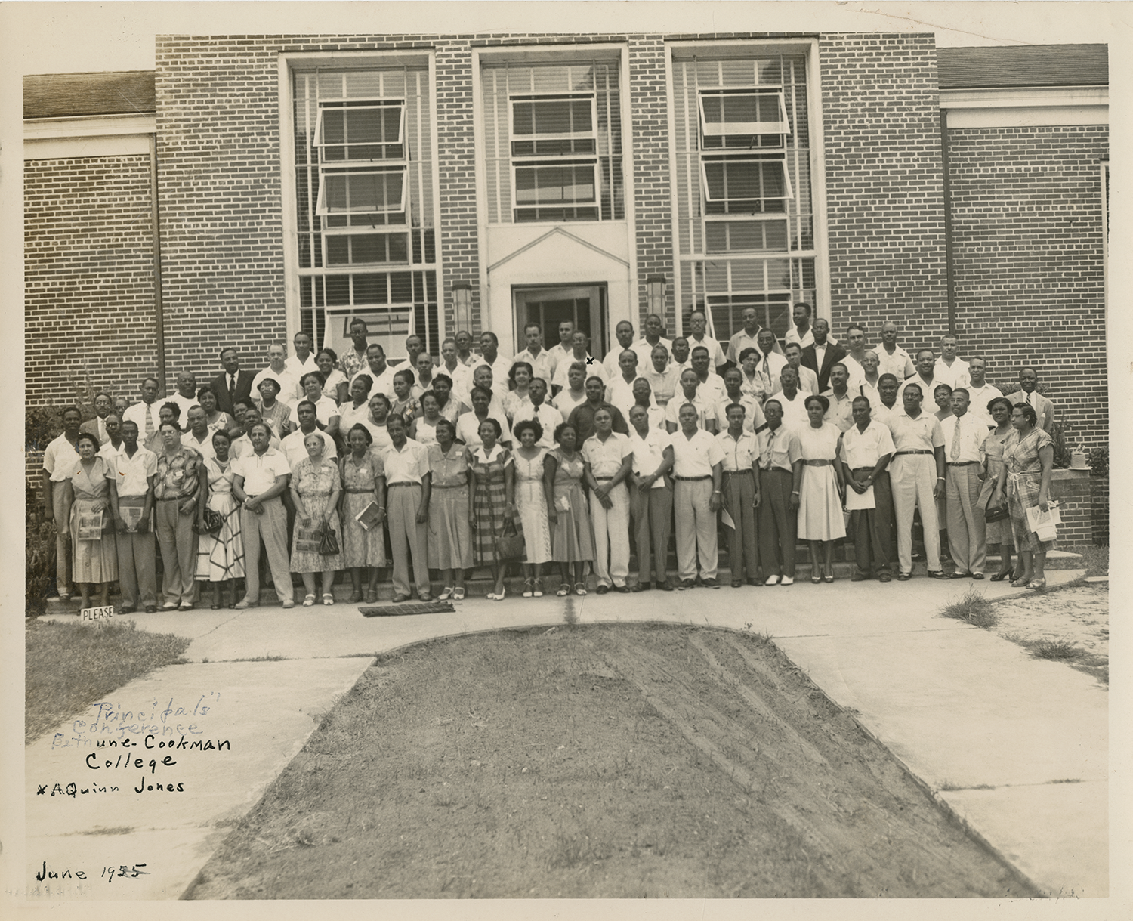
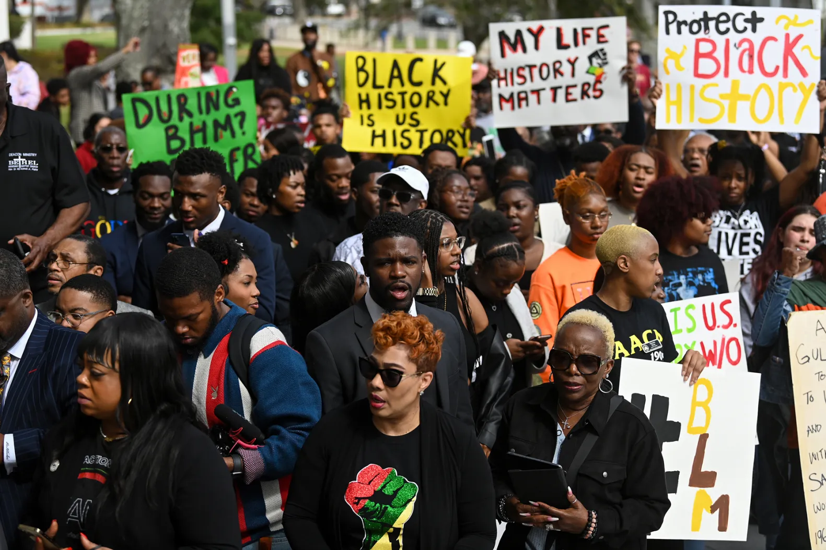
Introduction
These are the times that try men’s souls- Thomas Paine
Tie In: HBCUS have historically organized and thrived despite systemic neglect
Purpose: Explore how HBCUs leveraged unions and collective action, and how these lessons can inform current efforts.
What can today’s educators and union leaders learn from HBCU’s legacy of resistance and organizing?

Slide 4
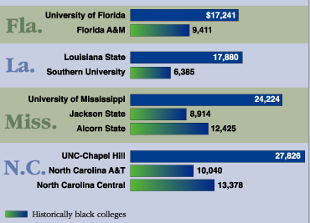
The Problem
Systemic inequities hinder student organizing and activism at HBCUs.
Examples: Limited funding, political barriers, lack of coalition-building opportunities.
Impact: Reduced student participation in educational justice movements.
So WHAT???
Collective Action Can Combat Inequities!!!
Collective Action with Community
Collective Action with Systems
Collective Action with Peers

Slide 5
Background Context
Historical Significance of
HBCUs: Founded to educate Black Americans during segregation.
Current Challenges: Persistent underfunding, systemic racism.
Why This Matters: HBCUs are vital to democracy and social justice.
Question:
How have political forces today attempt to shape funding and operation of:
Higher Education?
Teaching and Pedagogy?
Research?

Slide 6
Theoretical Lens
Framework: Drawing from The Crisis of Democracy: Authoritarianism vs. Activism and the Opportunity to Reduce Inequality.
Key Concepts: Tension between authoritarian structures and grassroots activism; role of collective action in reducing inequality.
Application to HBCUs: How HBCUs organized without state support, relying on unions and community partnerships.
HBCUs Resisted Authoritarian Control through:
Curriculum and Pedagogical Approaches (Givens. 2021)
Student Support (Favor, 2020
Faculty Support (Florida State Teachers Association |Segregated Union in Florida 1955)

Slide 7
Disclaimer
By attending this session, you confirm that you are a registered attendee of the NEA Higher Education Conference and an NEA member or supporter. The information you receive here is only for your use in your capacity as an NEA member or supporter.
This presentation and its contents may not be further distributed, in whole or in part, by any medium or in any form, for any purpose other than building your local NEA affiliate.
Violation of these terms may result in legal action.

Slide 8
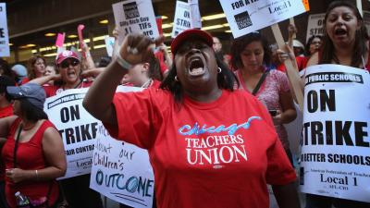
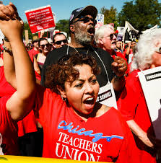
Strategies for Empowerment
Union Partnerships: Resources, mentorship, and advocacy training.
Coalition-Building: Alliances between unions, HBCU students, and community organizations.
Amplifying Voices: Media and storytelling to highlight student-led initiatives.
Case Studies: Examples of successful union-HBCU collaborations.
Notes:
Talk about Union Collaboration with the Black Educators and the HBCUs explain the challenges and the Triumps

Slide 9
Frameworks for Action
Strategic Mobilization & Advocacy: Develop clear goals and collective actions that align with shared values. Utilize data driven insights to advocate for changes and resource allocation that address structural inequities.
Sustaining Engagement & Impact: Establish mechanism for long-term collaboration, such as advisory councils, leadership pipelines, and mentorship programs. Ensure continuous learning and adaptation through regular assessment and feedback loops.
Leveraging Institutional & Community Assets: Map out existing resources with schools, universities, and community organizations to maximize impact,. Foster cross-sector partnerships that amplify voices and create sustainable change

Slide 10
Call to Action
Education must rise above politics to fulfill its promise for all learners and those who shape their futures
Champion Investment & Sustainability: Demand consistent funding, policy protections, and resources to ensure that our field, and our work thrives despite shifting political landscapes
Empower Broader Partnerships: Support and amplify education led initiative that push for equity, justice, and academic excellence in the face of systemic challenges.
Strengthen Alliances for Educational Justice: Forge stronger connections between unions communities, and advocacy groups to defend educators, expand opportunities, and safeguard the future of education.

Slide 11
Disclaimer
By attending this session, you confirm that you are a registered attendee of the NEA Higher Education Conference and an NEA member or supporter. The information you receive here is only for your use in your capacity as an NEA member or supporter.
This presentation and its contents may not be further distributed, in whole or in part, by any medium or in any form, for any purpose other than building your local NEA affiliate.
Violation of these terms may result in legal action.

Slide 12
Q& A and Discussion
Prompt: How can we, as NEA members and higher education advocates, take immediate steps to support saving public education?
Next Steps: Share resources and contact information for follow-up.

Slide 13
Thank You and Contact Info
Dr. Amanda Wilkerson
University of Central Florida
College of Community Innovation and Education
Department of Educational Leadership and Higher Education
Amanda.Wilkerson@ucf.edu
#EducationalJustice #NEAConference2025

