Slide 1

NEA Grant Process
NEW USER
Applicant Portal Training Video
Notes:
Welcome to the National Education Association’s Applicant Portal Training Video. It covers all steps required to submit applications and manage grants.
If you have never used the NEA Applicant Portal, there are a few additional steps required before you begin.
CLICK
The NEW USER message in the top right corner identifies these steps.
If you are a returning NEA Applicant Portal user, you can advance this video to the “Sign In to the NEA Applicant Portal slide.”

Slide 2
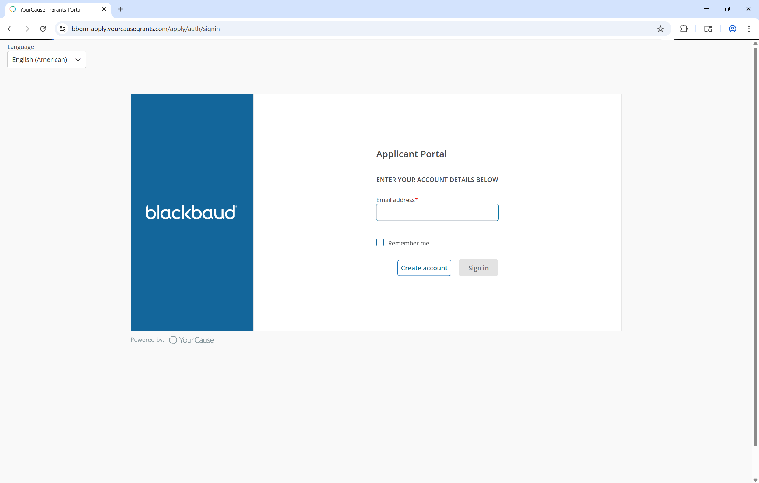
Create NEA Applicant Portal Account
NEW USER
Notes:
If you have never applied for an NEA grant before
CLICK
Click the Create Account button.

Slide 3
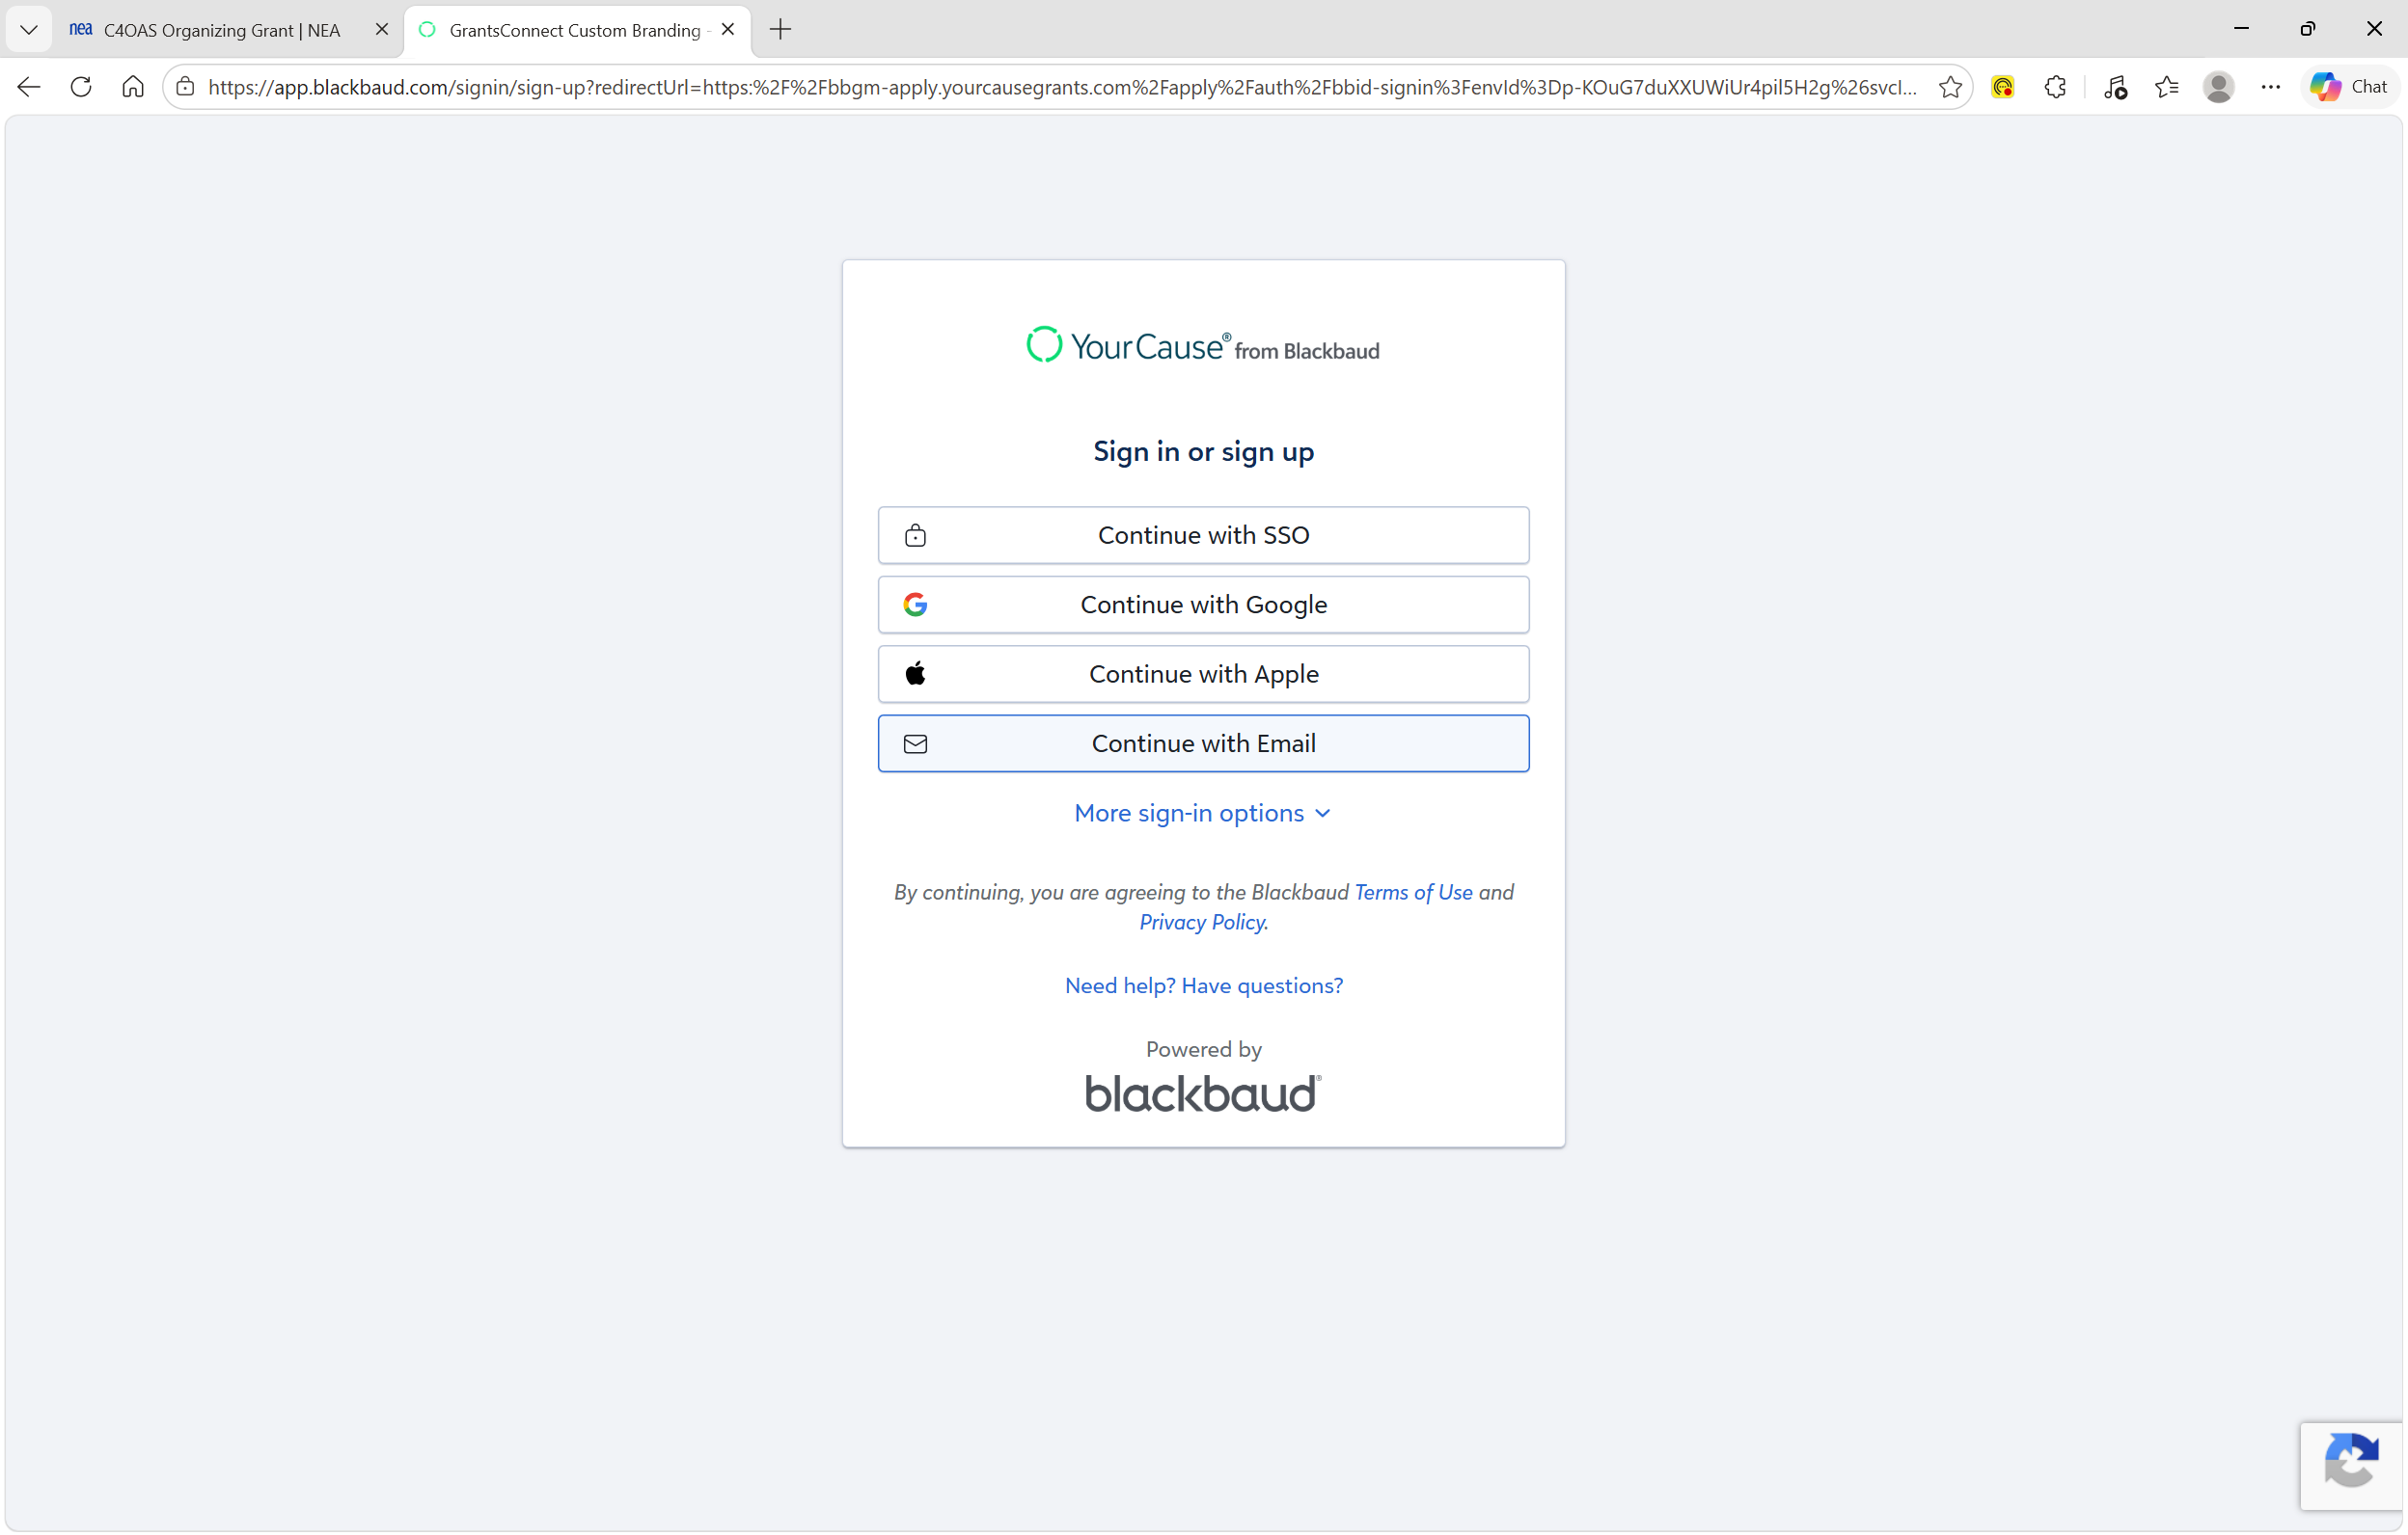
Create NEA Applicant Portal Account
NEW USER
Notes:
CLICK
Click the Continue with Email button

Slide 4
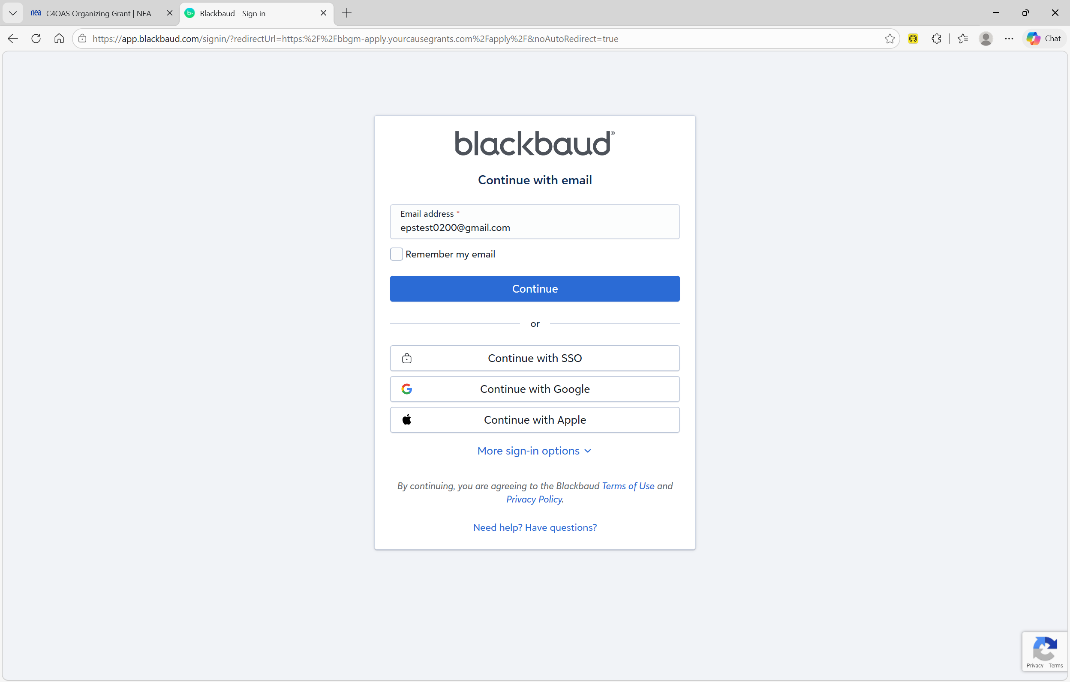
Create NEA Applicant Portal Account
NEW USER
Notes:
CLICK
Enter your email address
CLICK
Then click the Continue button

Slide 5
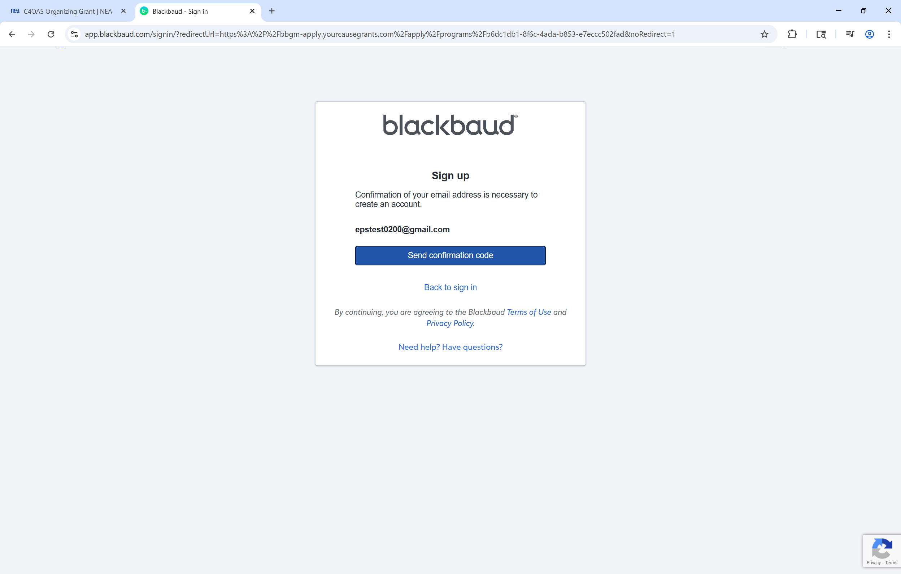
Create NEA Applicant Portal Account
NEW USER
Notes:
CLICK
Click the Send Confirmation Code button.

Slide 6
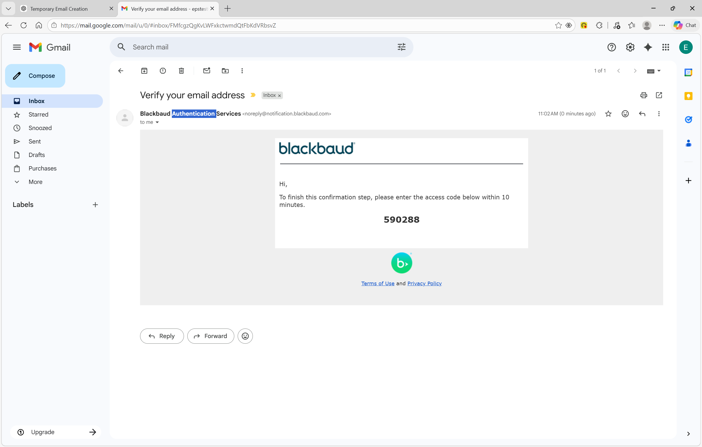
Create NEA Applicant Portal Account
NEW USER
Notes:
CLICK
You will receive an email from Blackbaud Authentication Services
CLICK
Note or copy the Confirmation Code contained in the email

Slide 7
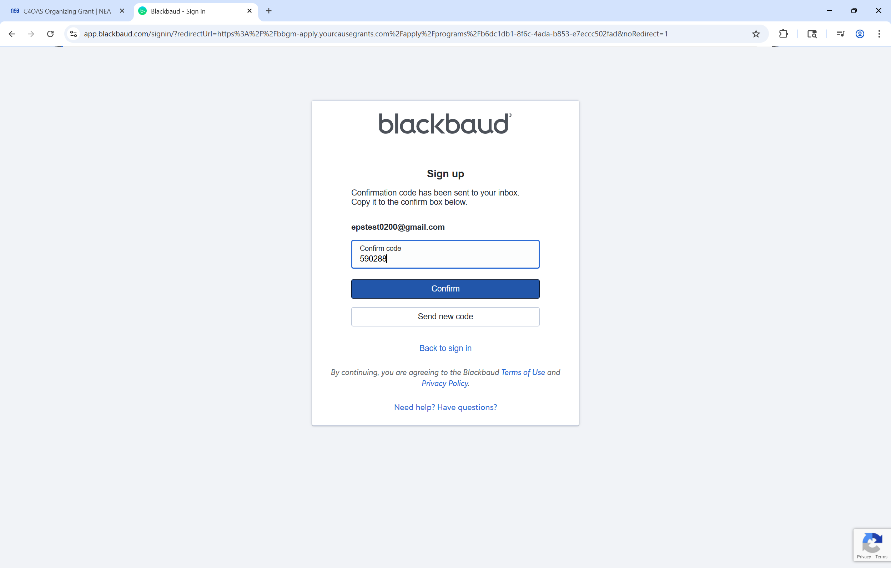
Create NEA Applicant Portal Account
NEW USER
Notes:
CLICK
Enter or paste your Confirmation Code into the Confirm Code field
CLICK
Then click the Confirm button

Slide 8
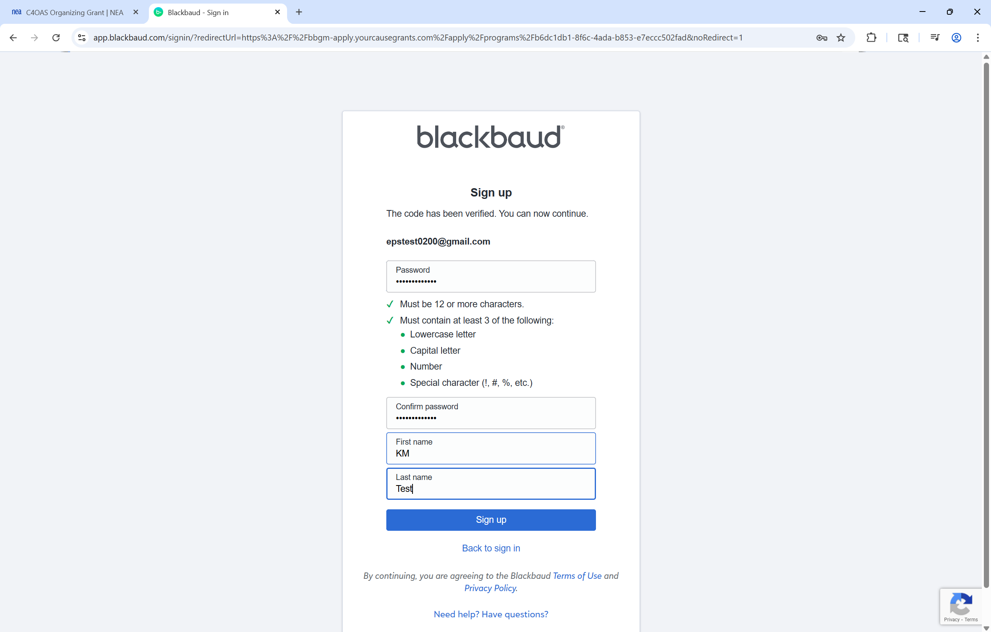
Create New Applicant Portal Account
NEW USER
Notes:
Determine your desired NEA Applicant Portal password in accordance with the rules provided
CLICK
Enter your password here
CLICK
Confirm your password and enter your first and last name
CLICK
Click the Sign-Up button to complete the creation of your new NEA Applicant Portal account
CLICK
Click the Back to Sign In link to continue with the Application submission process.

Slide 9
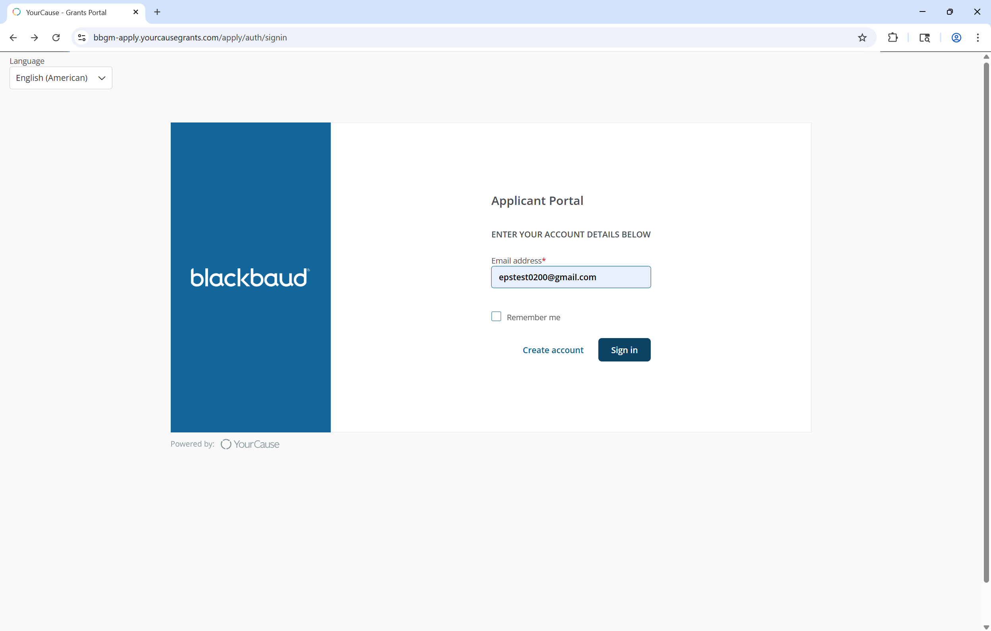
Sign In to NEA Applicant Portal
Notes:
To Sign-In
CLICK
Enter your email address
CLICK
Then click the Sign In button

Slide 10
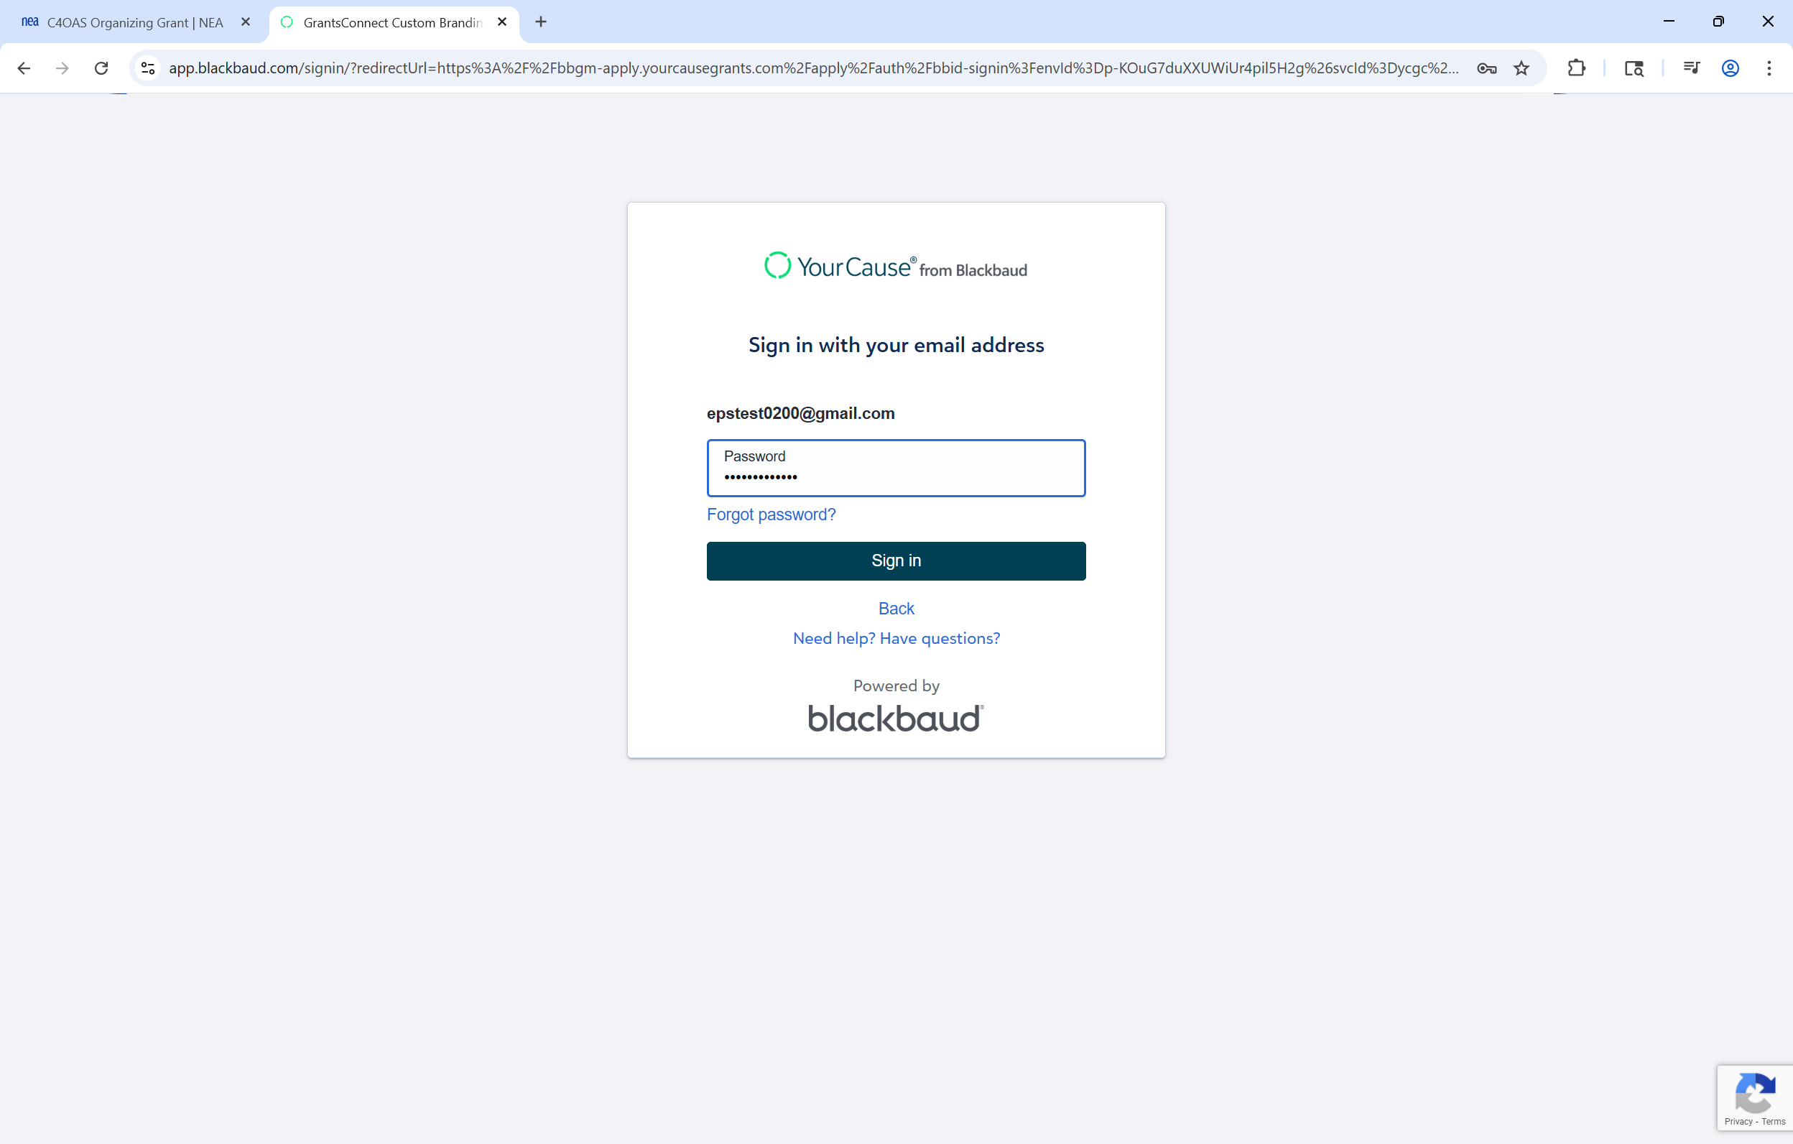
Sign in to NEA Applicant Portal
Notes:
CLICK
Enter your password
CLICK
Then click the Sign In button

Slide 11
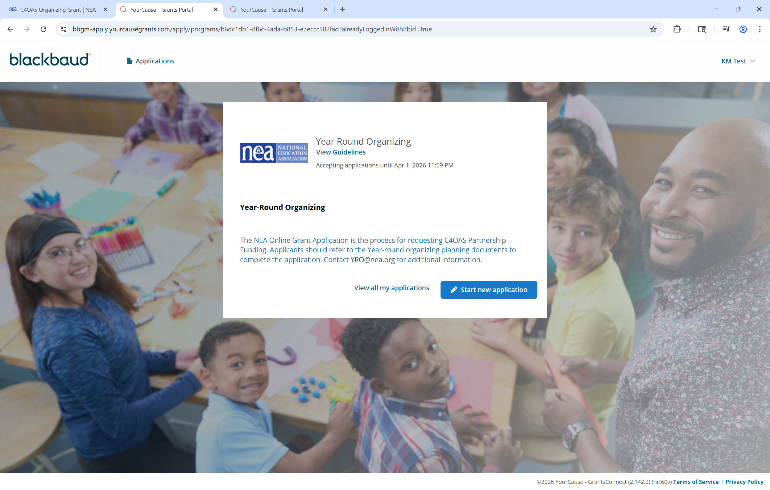
View Program Guidelines
Notes:
The NEA grant program homepage will open
CLICK
Click the View Guidelines link to read the program guidelines

Slide 12
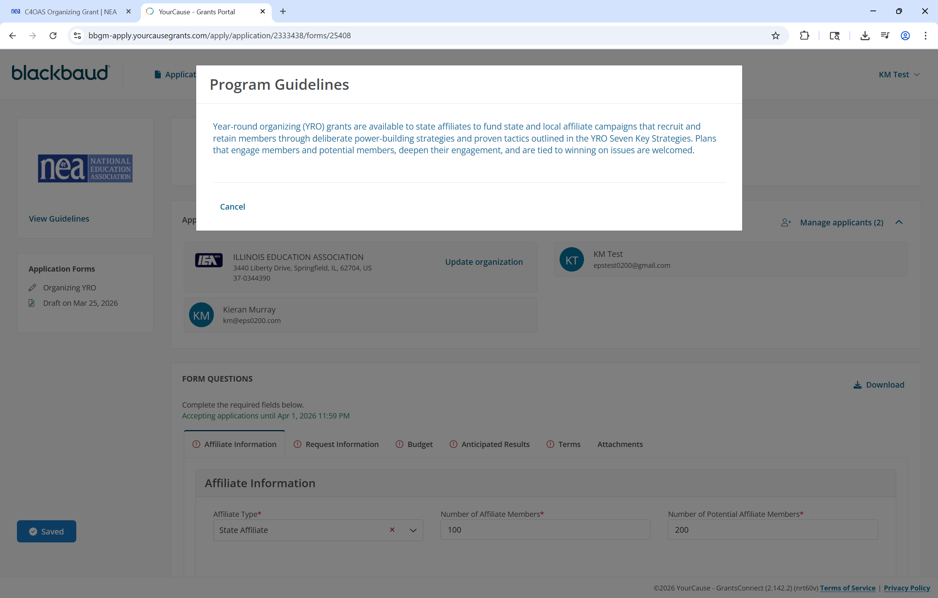
View Program Guidelines
Notes:
The program guidelines window will open.
CLICK
Click cancel to close this window and proceed.

Slide 13
View Program Guidelines
Notes:
To begin the application process
CLICK
Click the Start New Application button

Slide 14
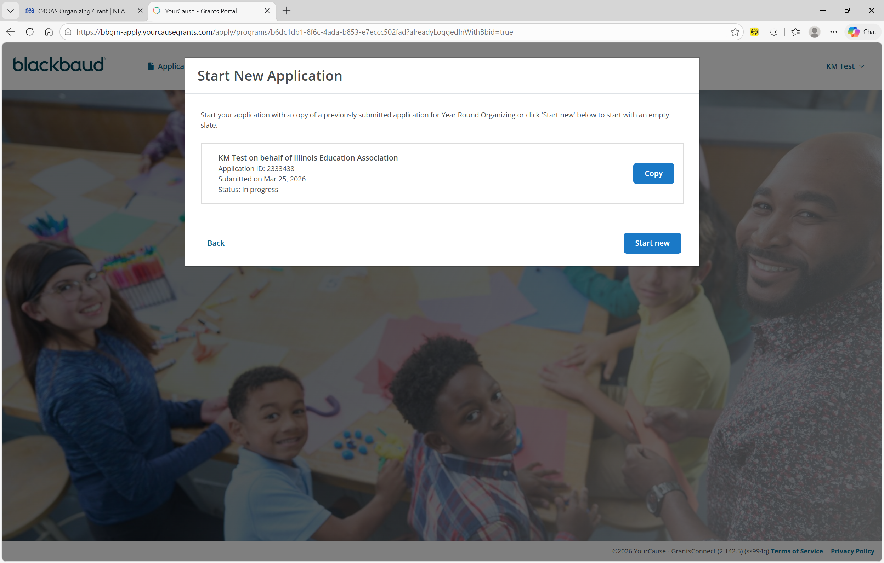
Copy Prior or Start New Application
Notes:
If you have applied to this NEA program before, you will have the option to copy your previous application to save time
CLICK
If you want to start your new application from a copy of a previous one, click the copy button.
CLICK
Click the Start New button to begin a new application from scratch

Slide 15
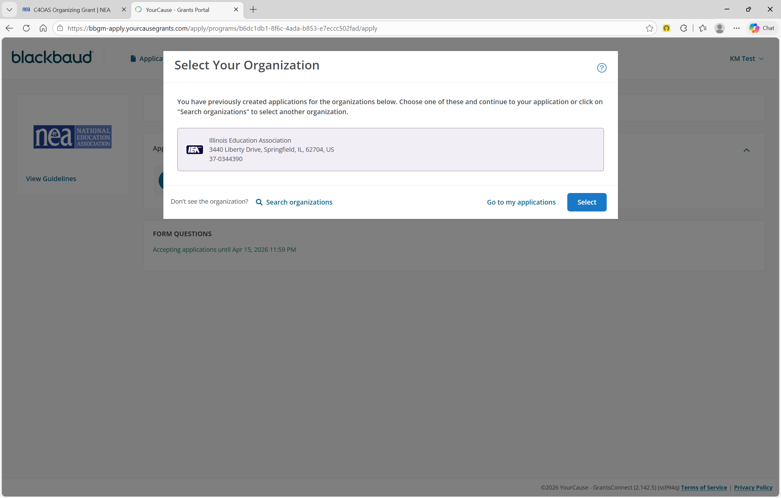
Organization Selection
Notes:
CLICK
If you have applied to an NEA program before, the organization you submitted on behalf of was saved and you can select it from your organization list
CLICK
Then click the Select button. If you want to apply on behalf of a different affiliate,
CLICK
click the Search Organizations link

Slide 16
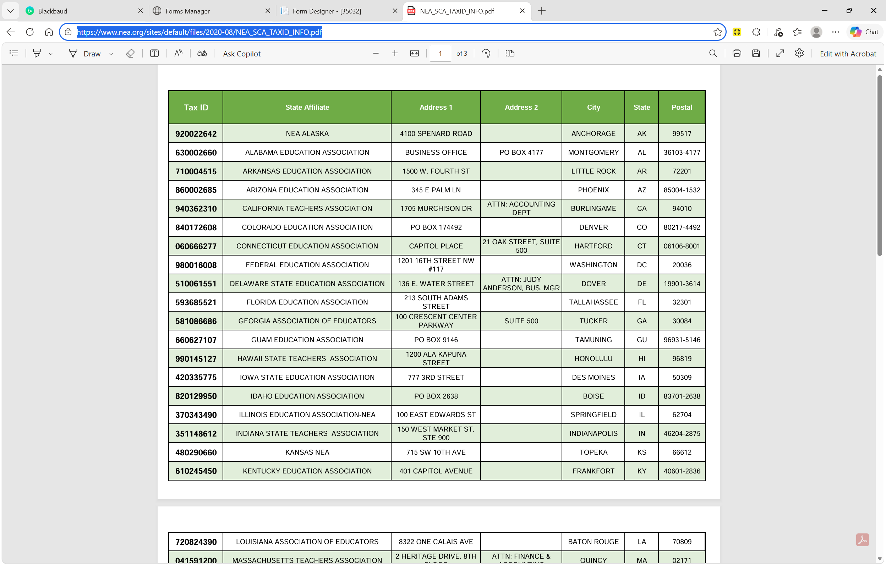
State Affiliate EIN Search (Preferred Method)
Notes:
The preferred and most accurate way to locate your affiliate in the database is searching by its EIN number. To simplify this process, NEA has created reference documents which lists the EIN for each state affiliate
CLICK
Use this URL to open the State Affiliate EIN reference document.

Slide 17
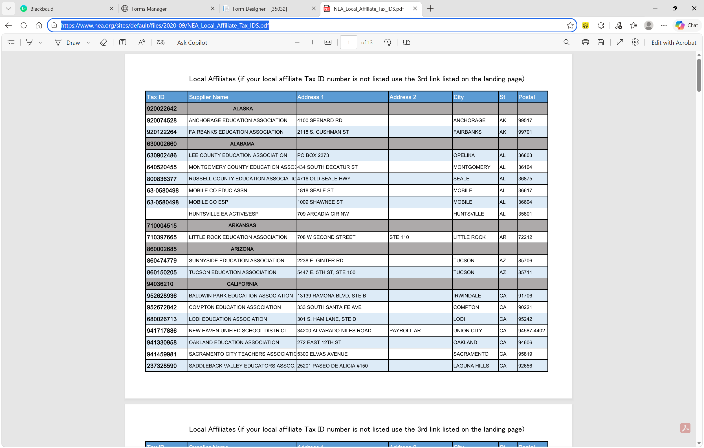
Local Affiliate EIN Search (Preferred Method)
Notes:
If you are a local affiliate
Click
Use this URL to open the Local Affiliate EIN reference document

Slide 18
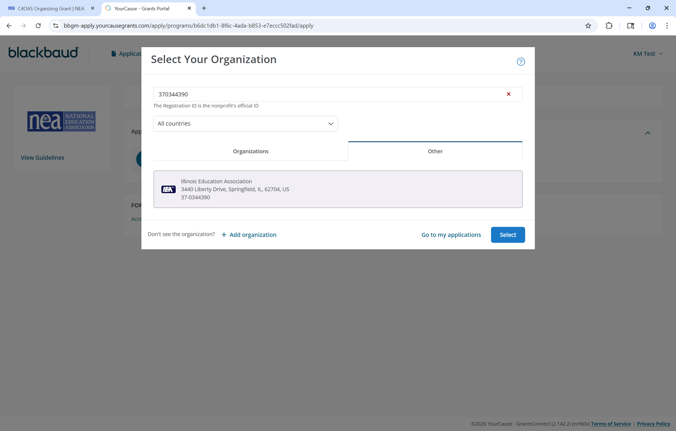
EIN Search (Preferred Method)
Notes:
Copy your affiliate’s EIN number and paste it here
CLICK
Then click enter
CLICK
Your affiliate will display
Click the Select button to proceed

Slide 19
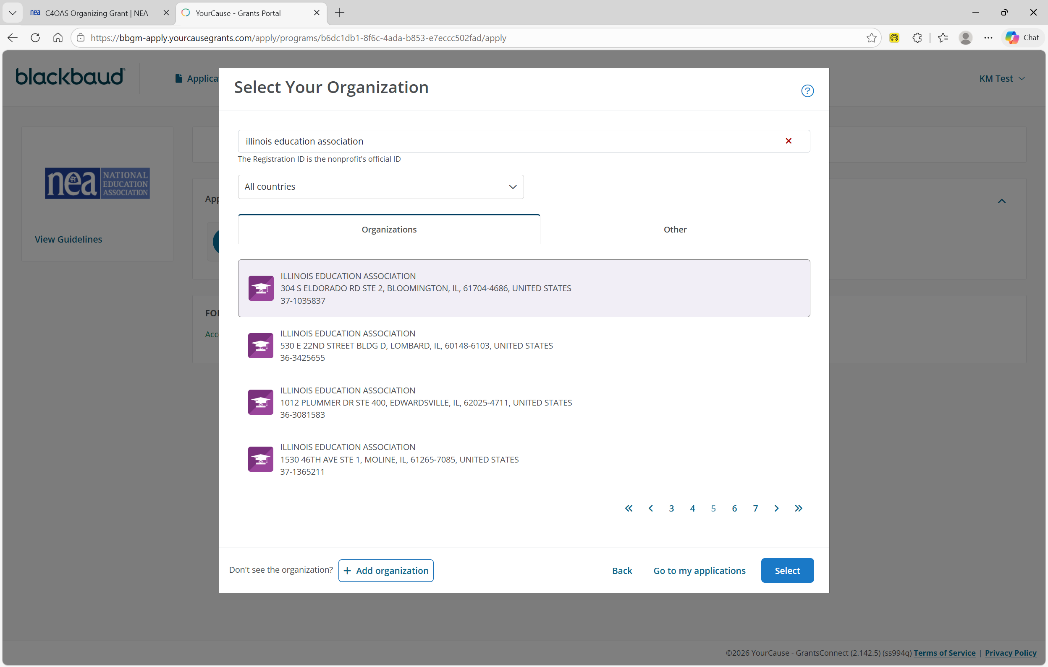
Organization Name Search
Notes:
You can also search for your affiliate using a name search
CLICK
This is less precise as it is a fuzzy name search
CLICK
that may return many pages of results and finding your affiliate may be challenging
CLICK
If you still cannot find your affiliate, you may add it by clicking the Add Organization button
CLICK

Slide 20
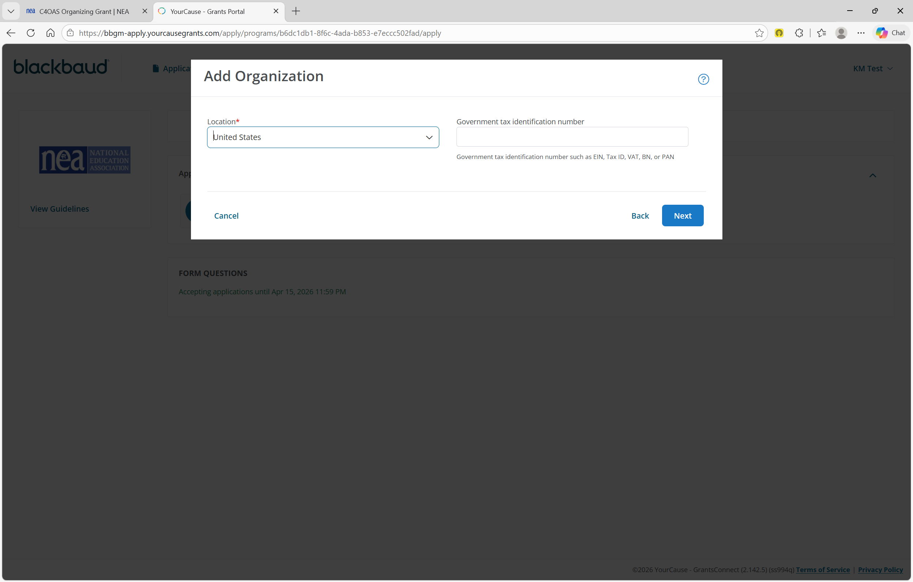
Add New Organization
Notes:
CLICK
Select United States in the Location dropdown
CLICK
Then click the NEXT button

Slide 21
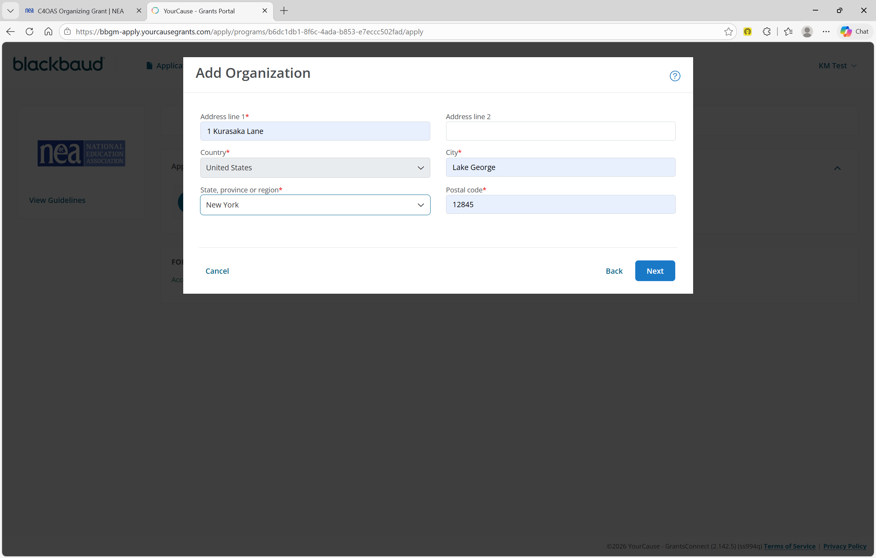
Add New Organization
Notes:
CLICK
Add your affiliate’s address
CLICK
Then click the NEXT button

Slide 22
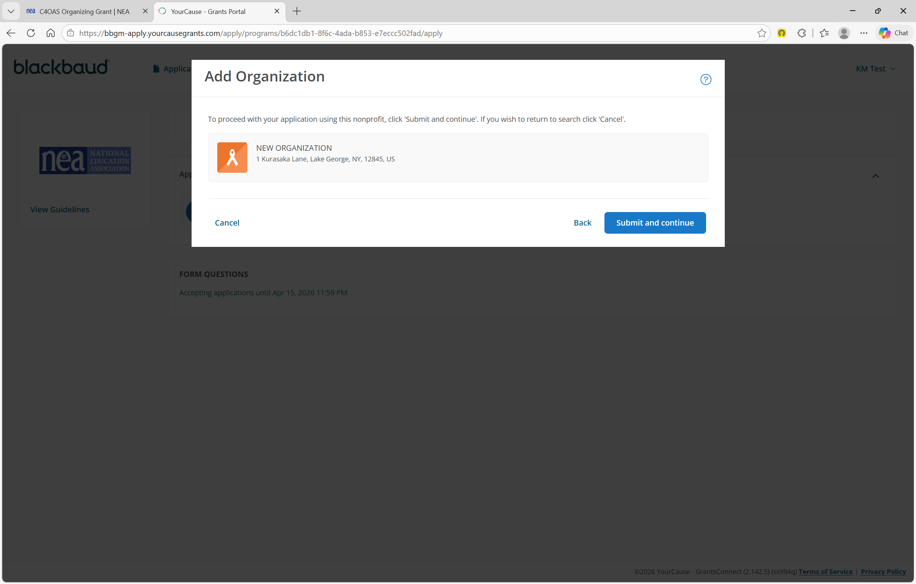
Add New Organization
Notes:
CLICK
Select your affiliate
CLICK
Then click the Submit and Continue button

Slide 23
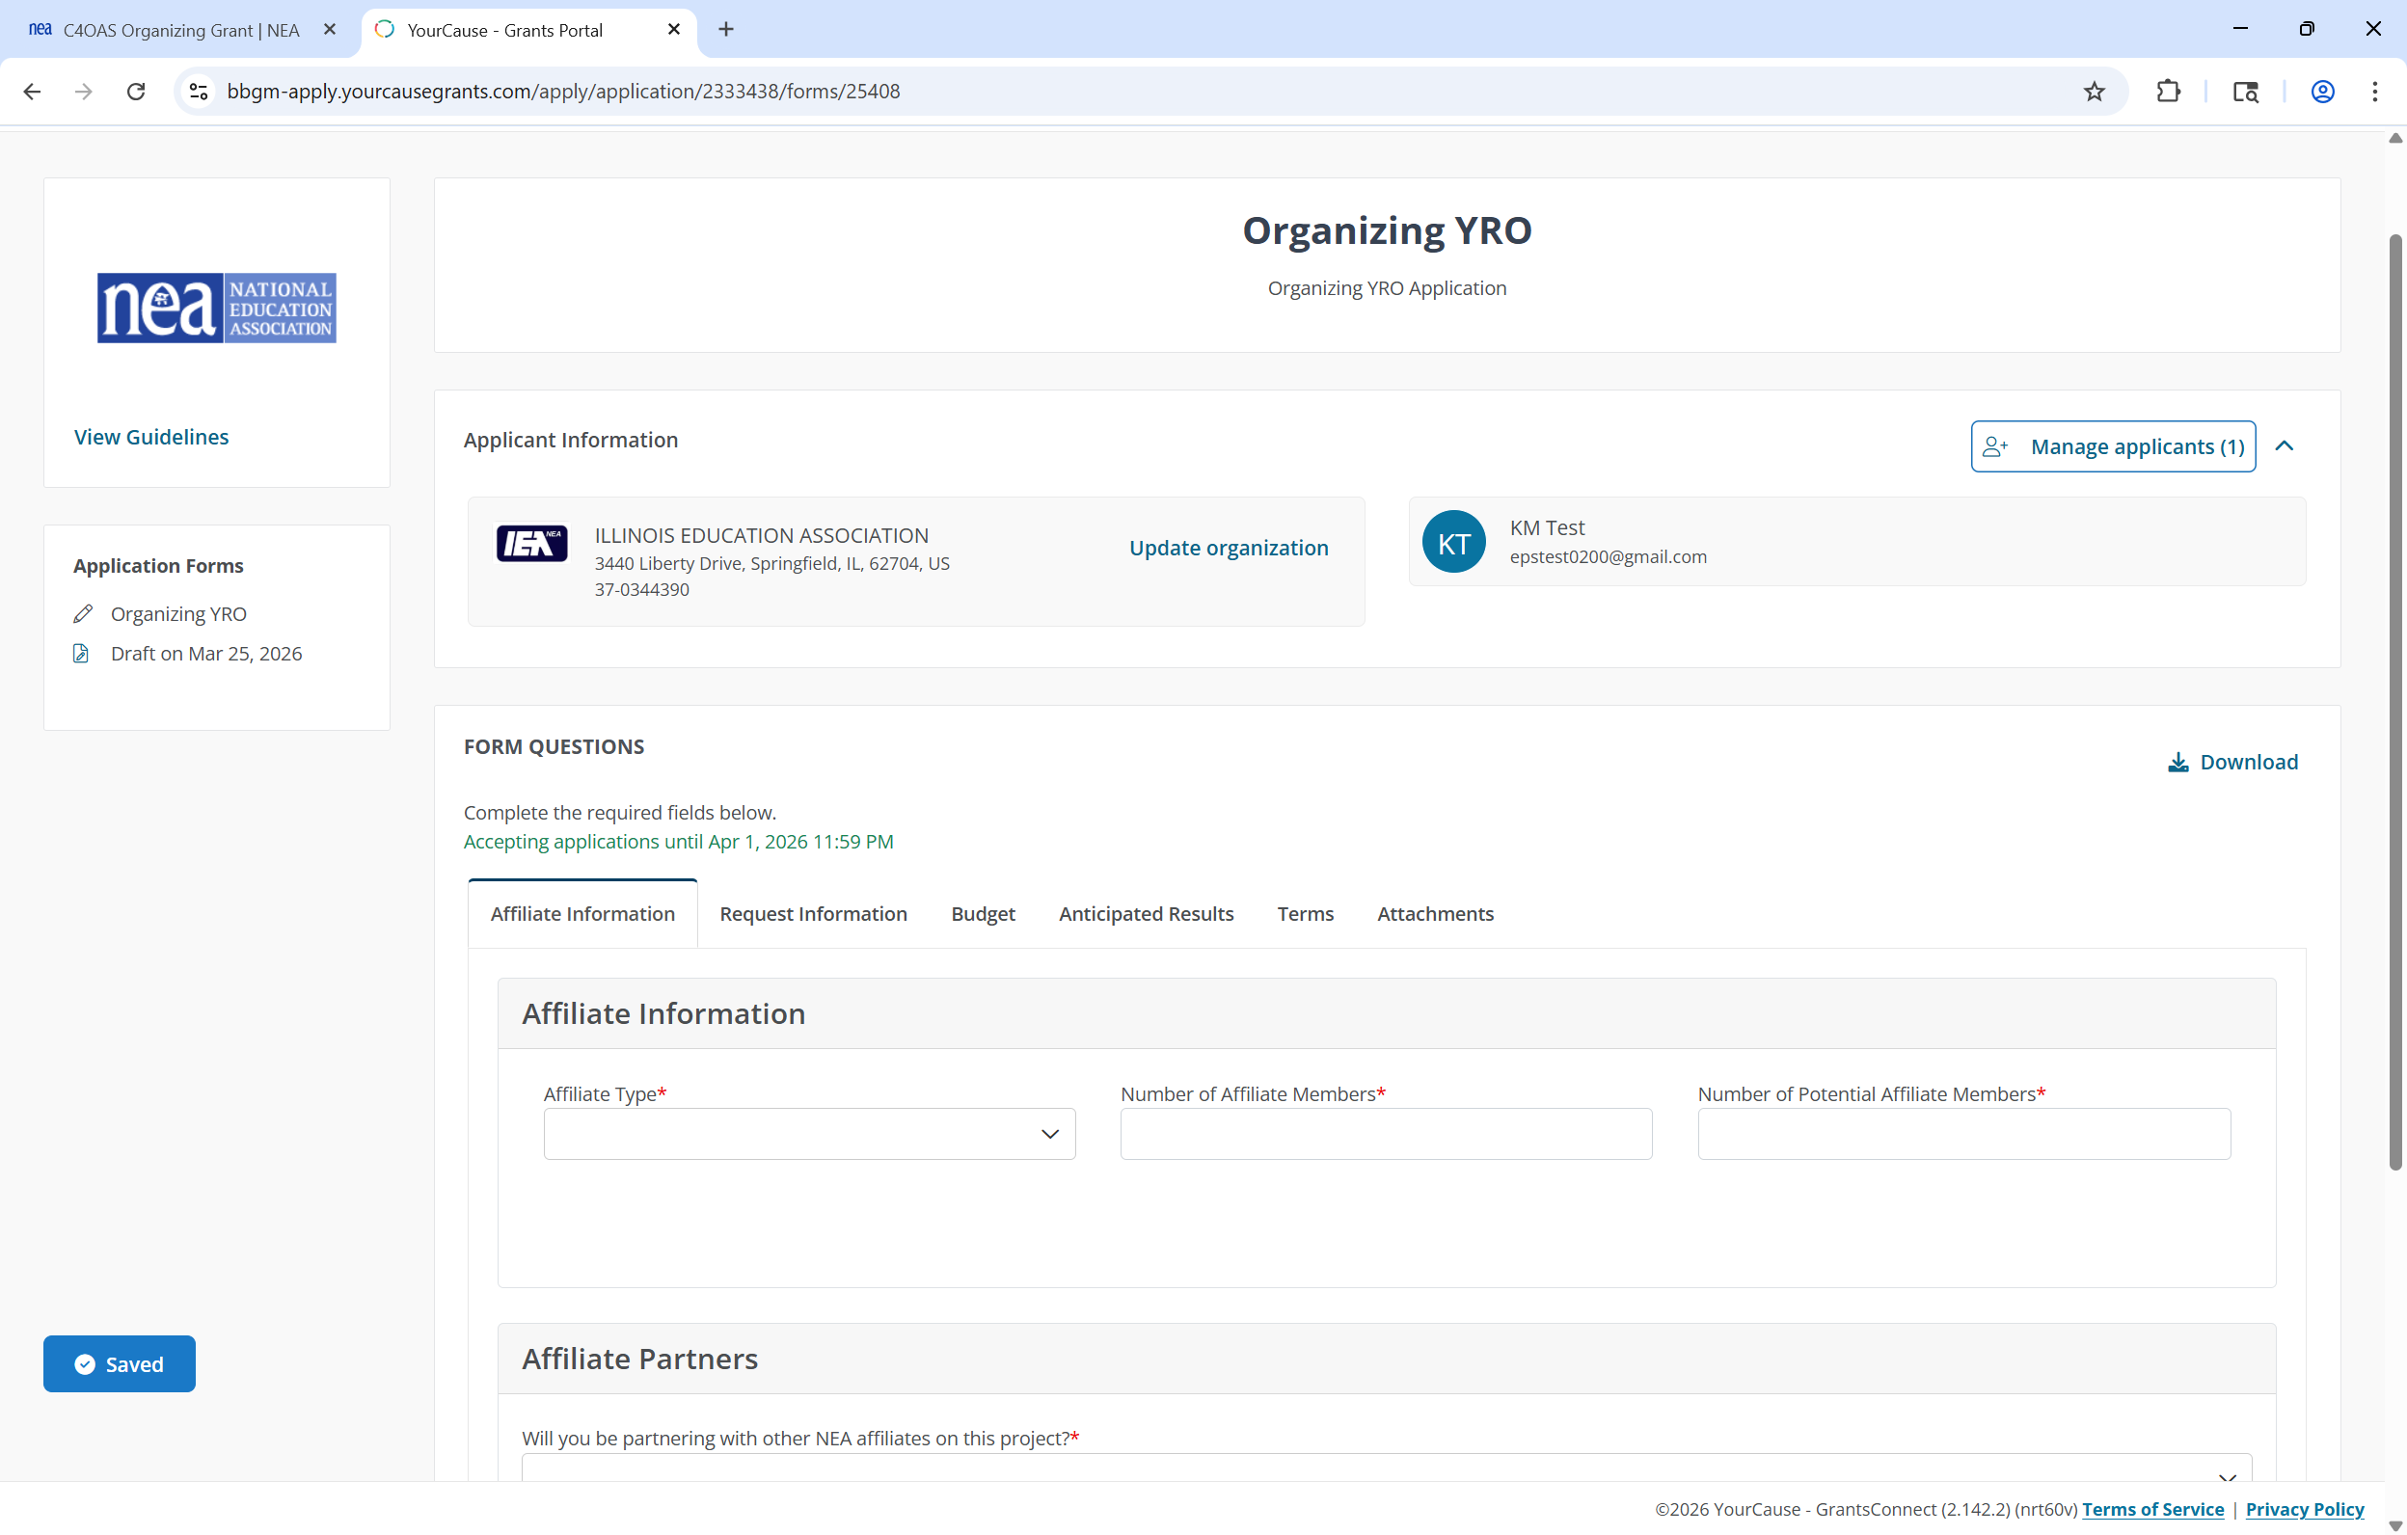
Begin Application
Notes:
CLICK
The application displays for you to complete. In the applicant information section, validate your affiliate. Use the Update Organization link if this is incorrect
CLICK
Confirm you are assigned as the application owner

Slide 24
Manage Applicants
Notes:
To add and manage co-applicants
CLICK
Click the Manage Applicants button

Slide 25
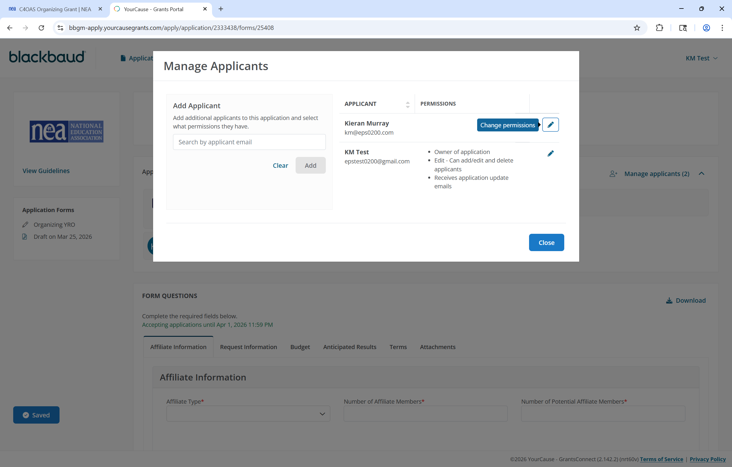
Add Co-Applicants
Notes:
To add an applicant
CLICK
Enter their email address and search
CLICK
Click the Add button
CLICK
The new applicant will appear in the Applicants list

Slide 26
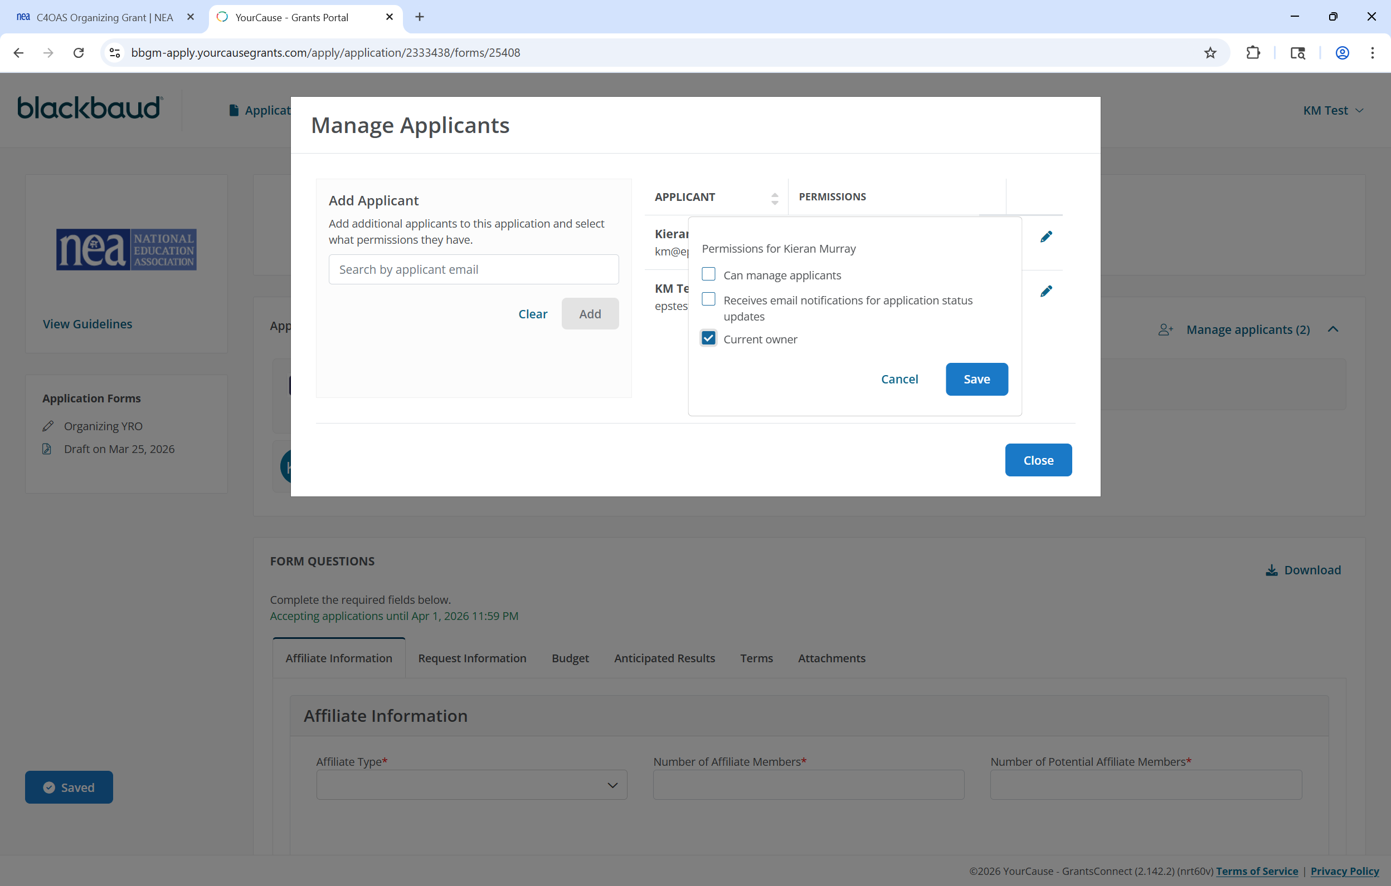
Applicant Permissions
Notes:
To update an applicant’s permissions
CLICK
Click the Pencil icon next to their name
CLICK
Then, update their permissions
CLICK
And click the Save button

Slide 27
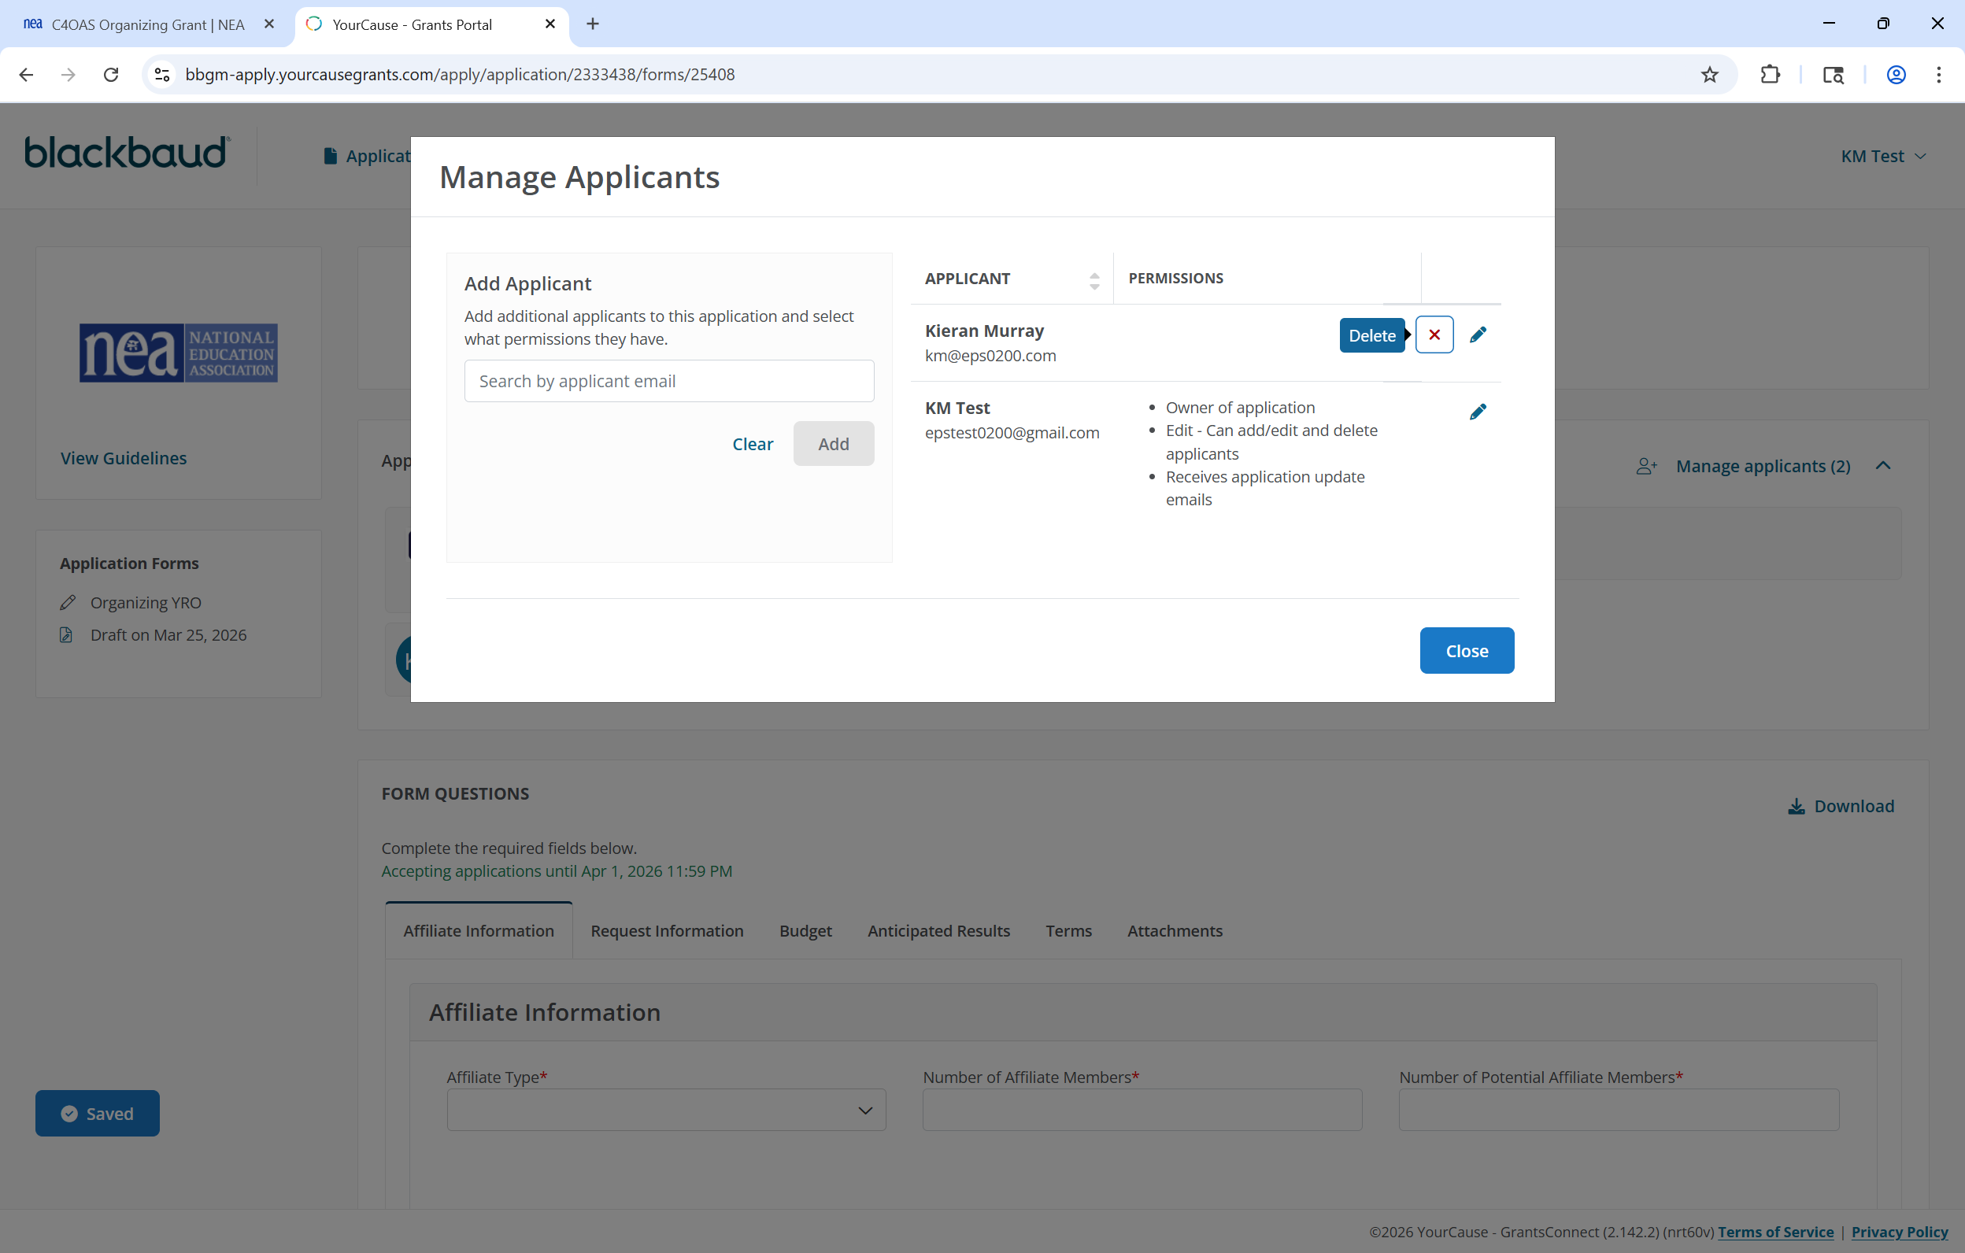
Delete Applicant
Notes:
CLICK
You can delete an applicant at any time during the application process
CLICK
When finished making all Applicant and permission changes, click the Close button

Slide 28
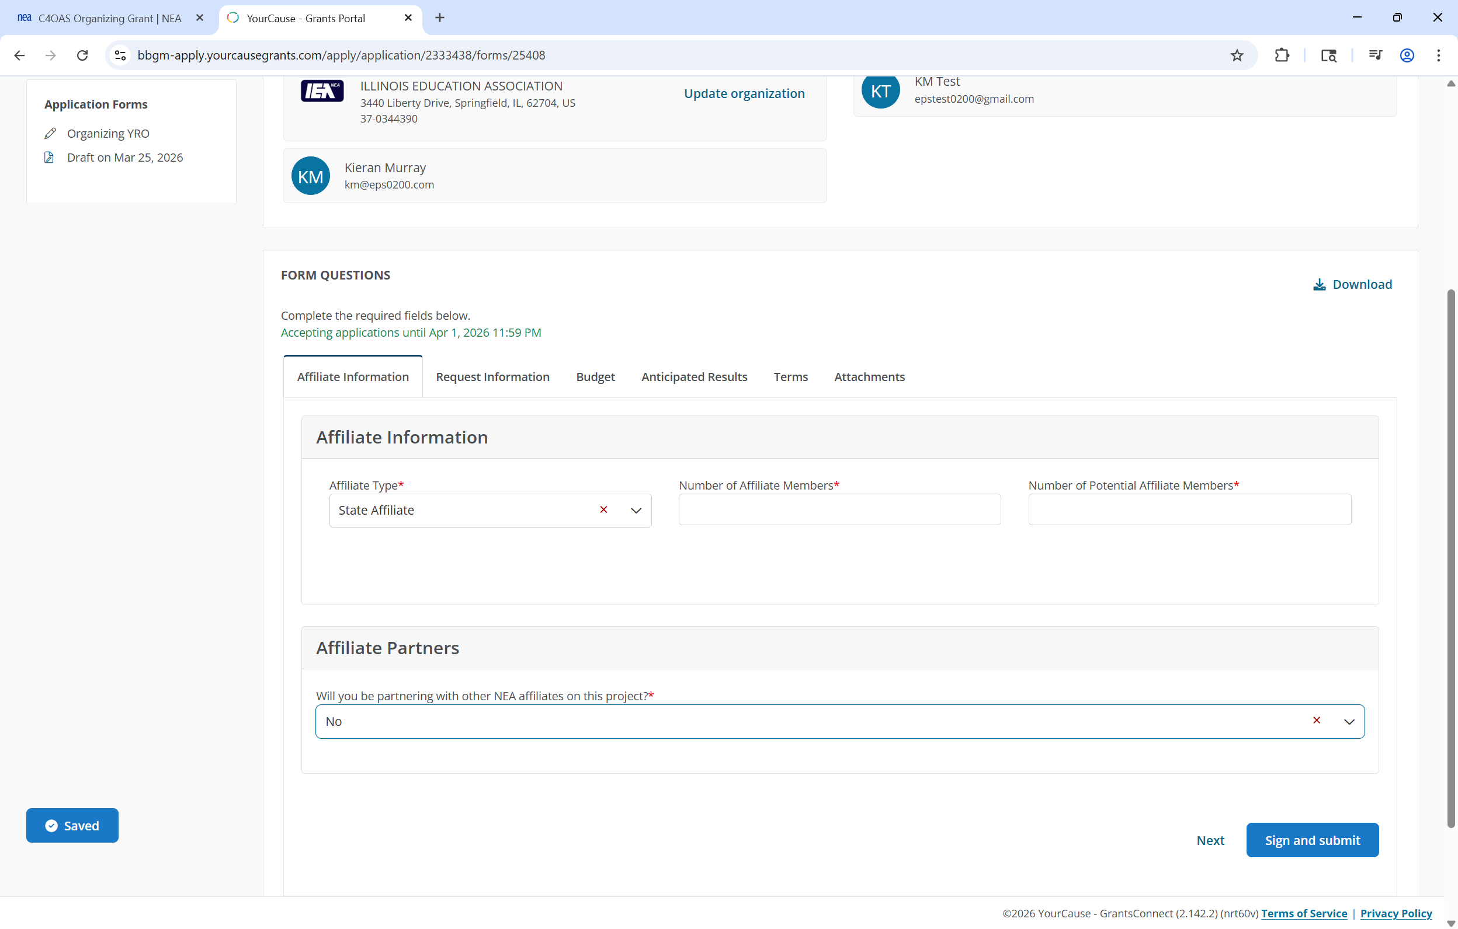
Application Due Date and Navigation
Notes:
The application due date will display here
CLICK
You can navigate between application pages by clicking on the page tab
CLICK

Slide 29
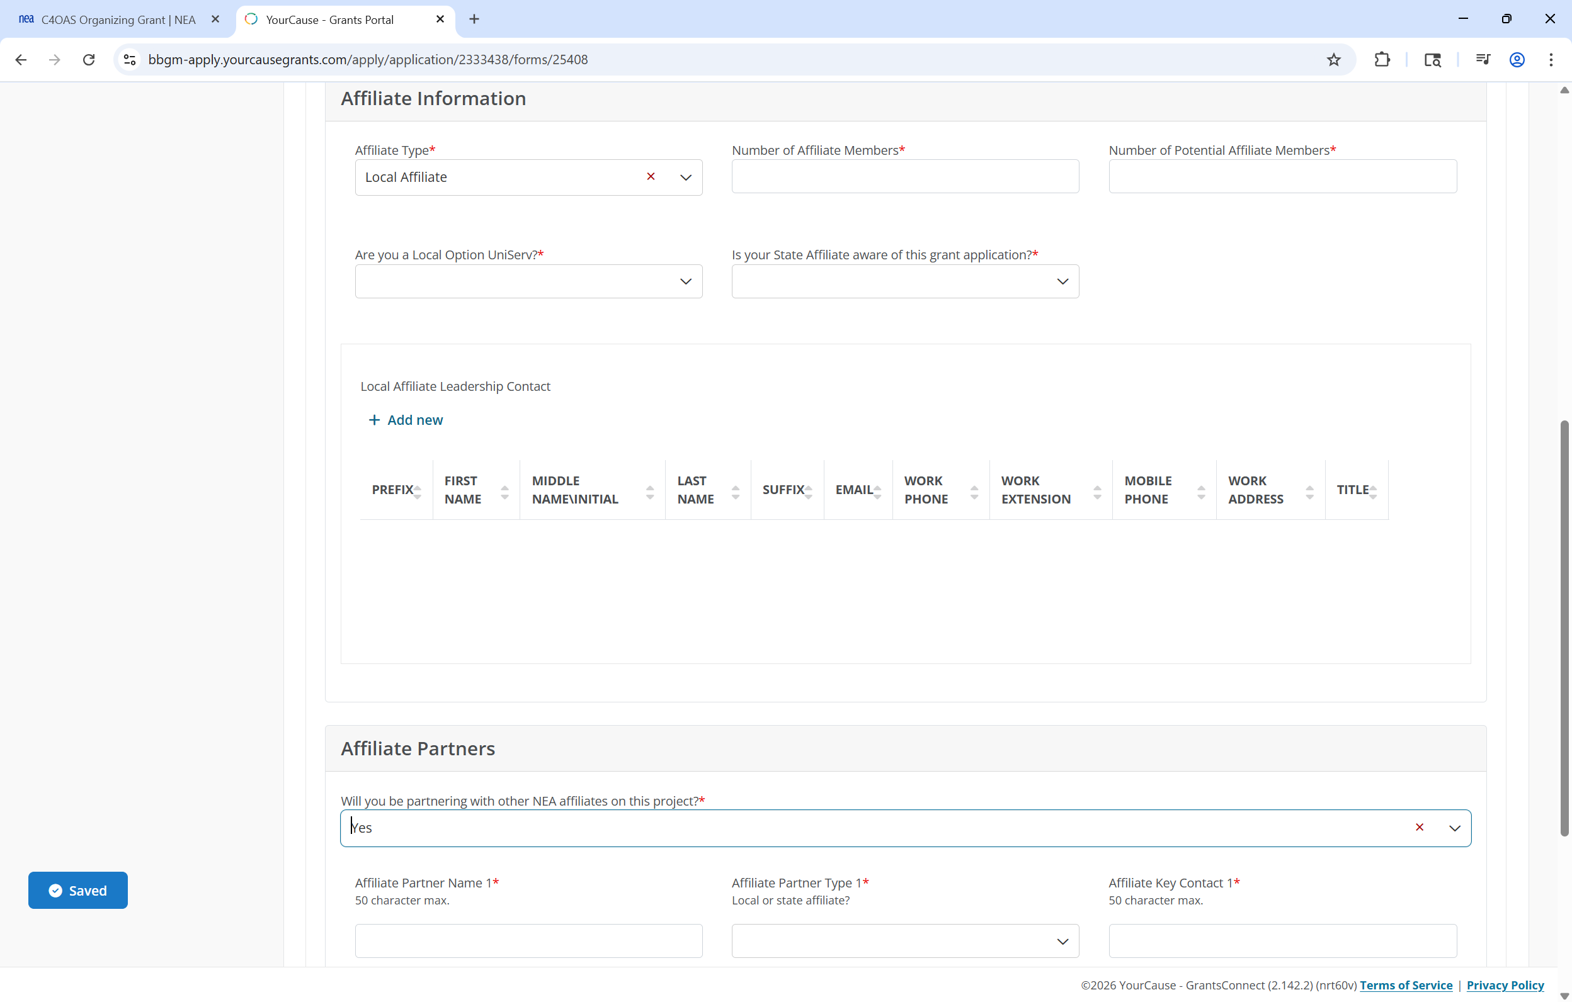
Conditionally Visible Fields
Notes:
To ensure the application does not display fields irrelevant to your grant project, it uses conditional logic. If you indicate you are a local affiliate
CLICK
Two additional local affiliate questions will become visible
CLICK
If you indicate you are partnering with other affiliates on your grant project,
CLICK
then Affiliate Partner fields will become visible.

Slide 30
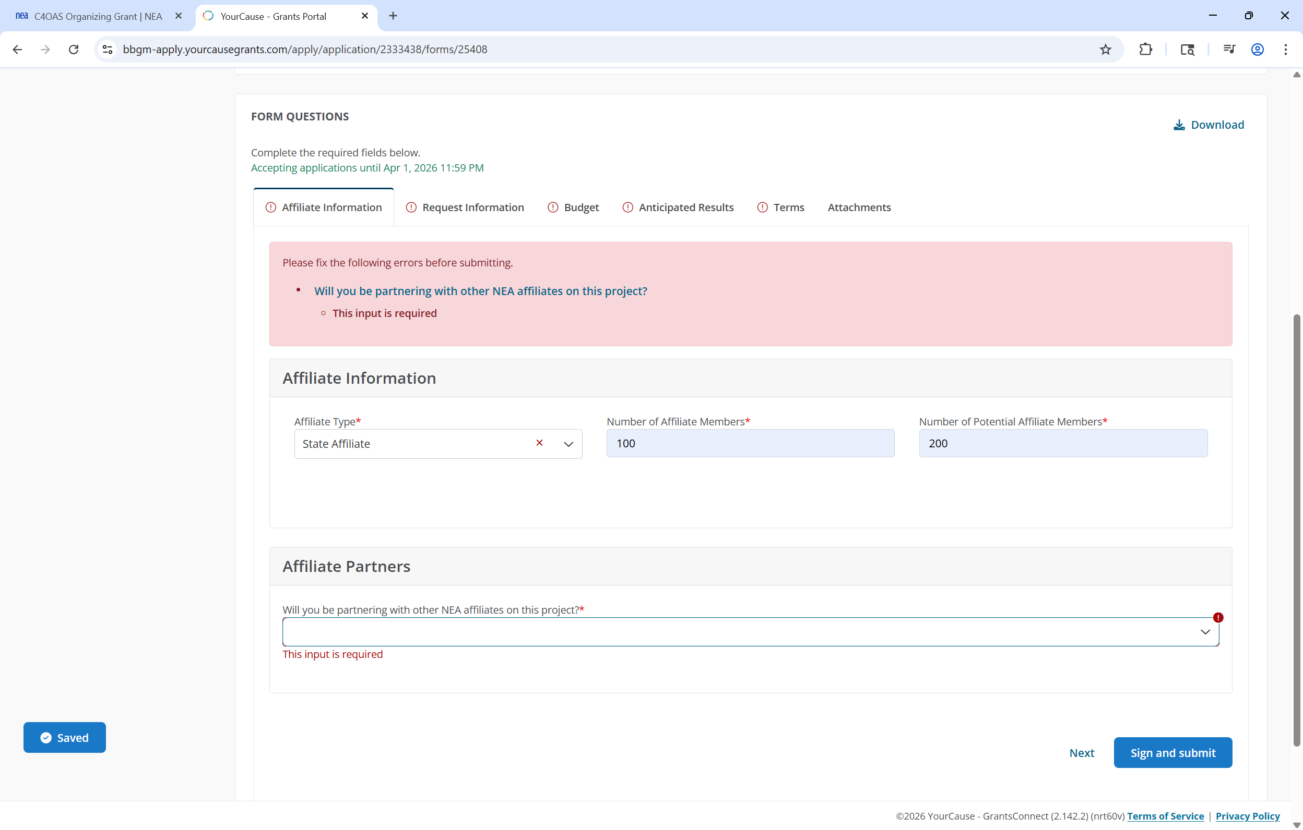
Field Validations
Notes:
CLICK
If you leave required fields blank, the application will flag and message those fields
CLICK
You will not be able to submit your application until all required information is provided

Slide 31
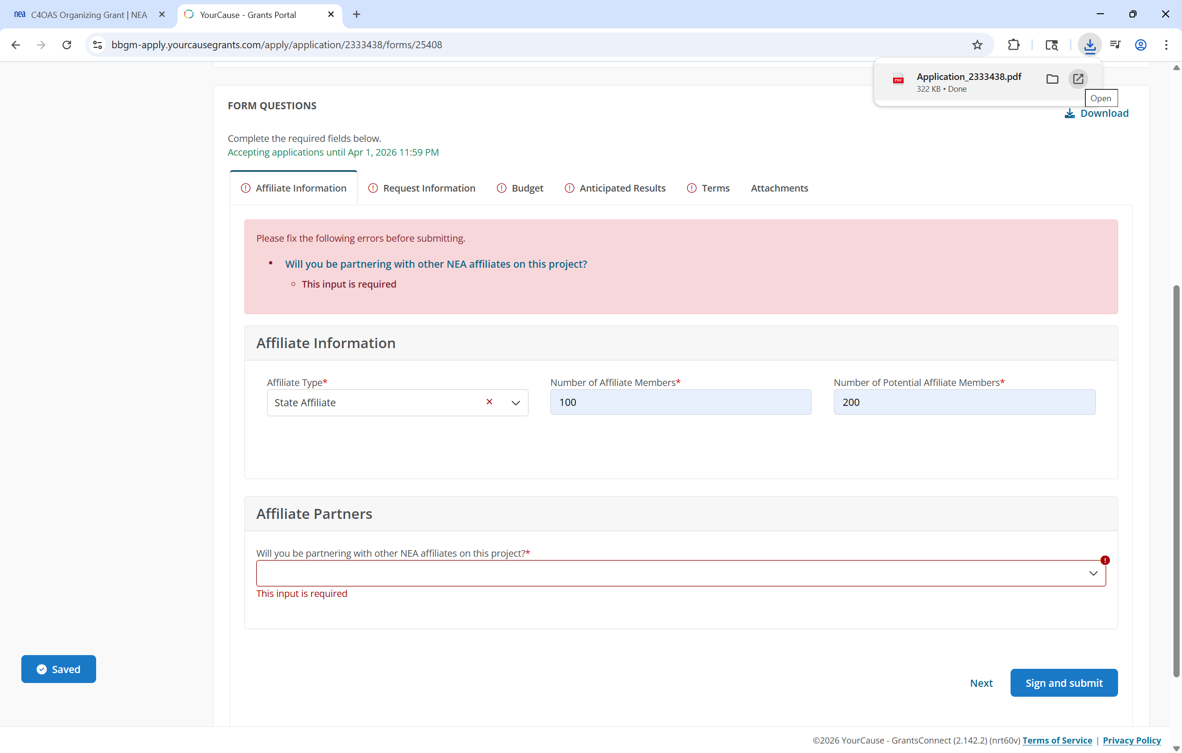
Download Application
Notes:
To download a .PDF copy of your application
CLICK
Click the download button
CLICK
To open the download, click the file name

Slide 32
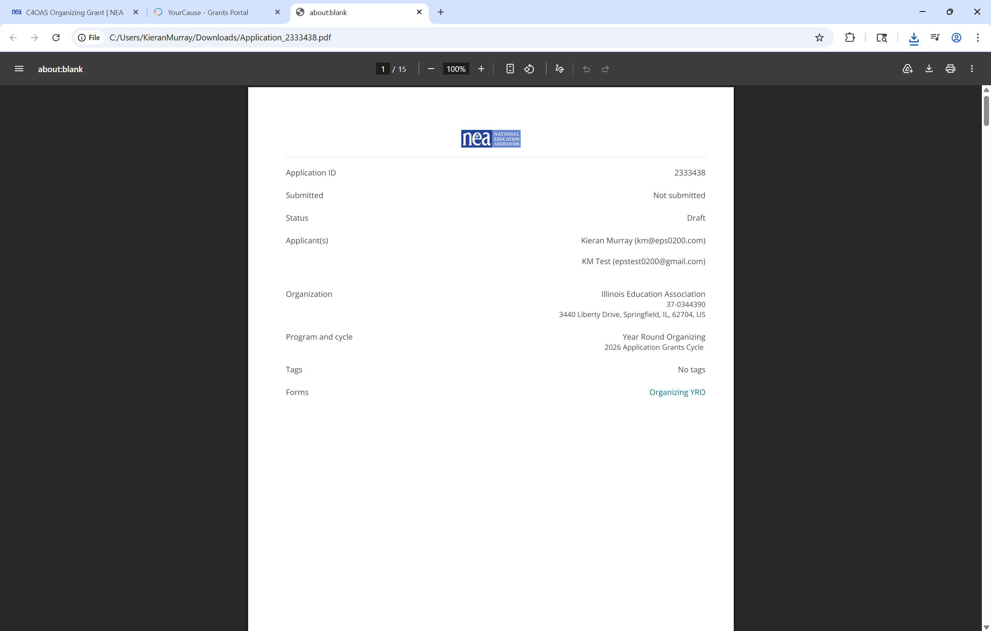
Downloaded Application Cover Page
Notes:
Your downloaded application will begin with a cover page
CLICK
Providing your application status summary information
CLICK
As well as Applicant summary information

Slide 33
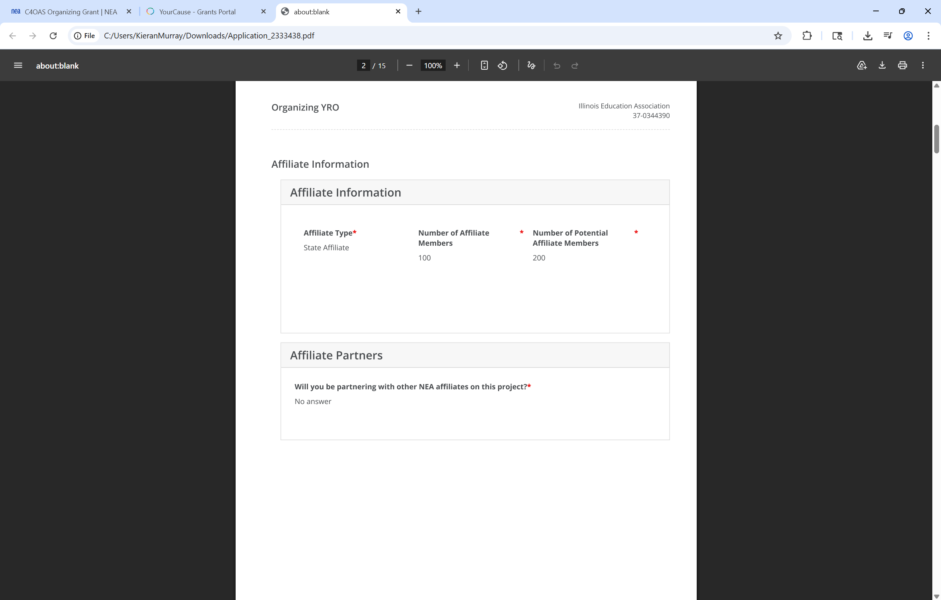
Downloaded Application Content
Notes:
The application will follow
CLICK
Showing fields you completed
CLICK
As well as incomplete fields

Slide 34
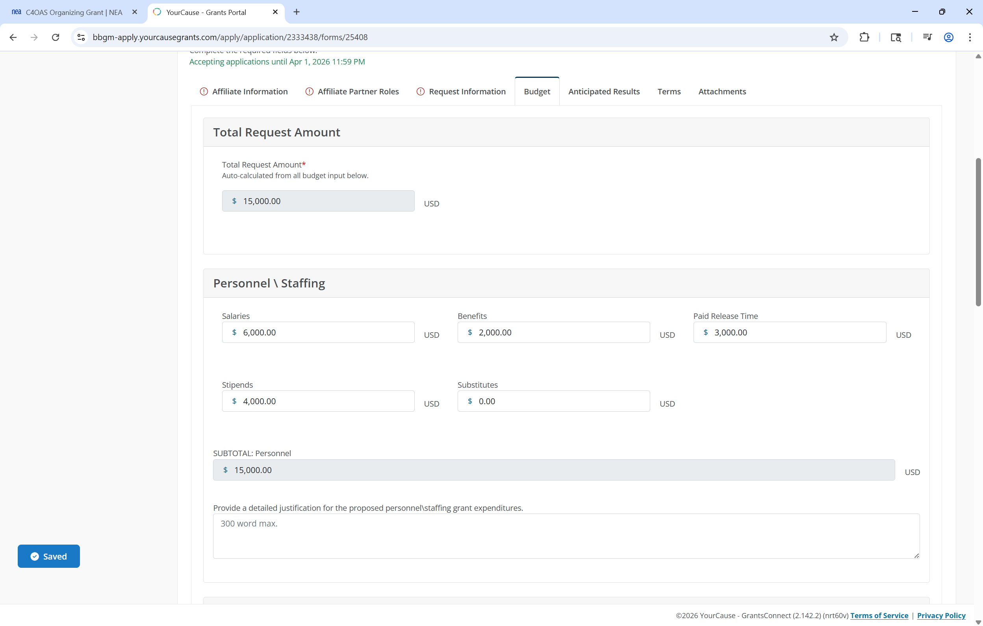
Auto Calculated Fields
Notes:
CLICK
The application contains auto calculated fields to ensure data accuracy and integrity
CLICK
These fields will appear greyed out and are not editable

Slide 35
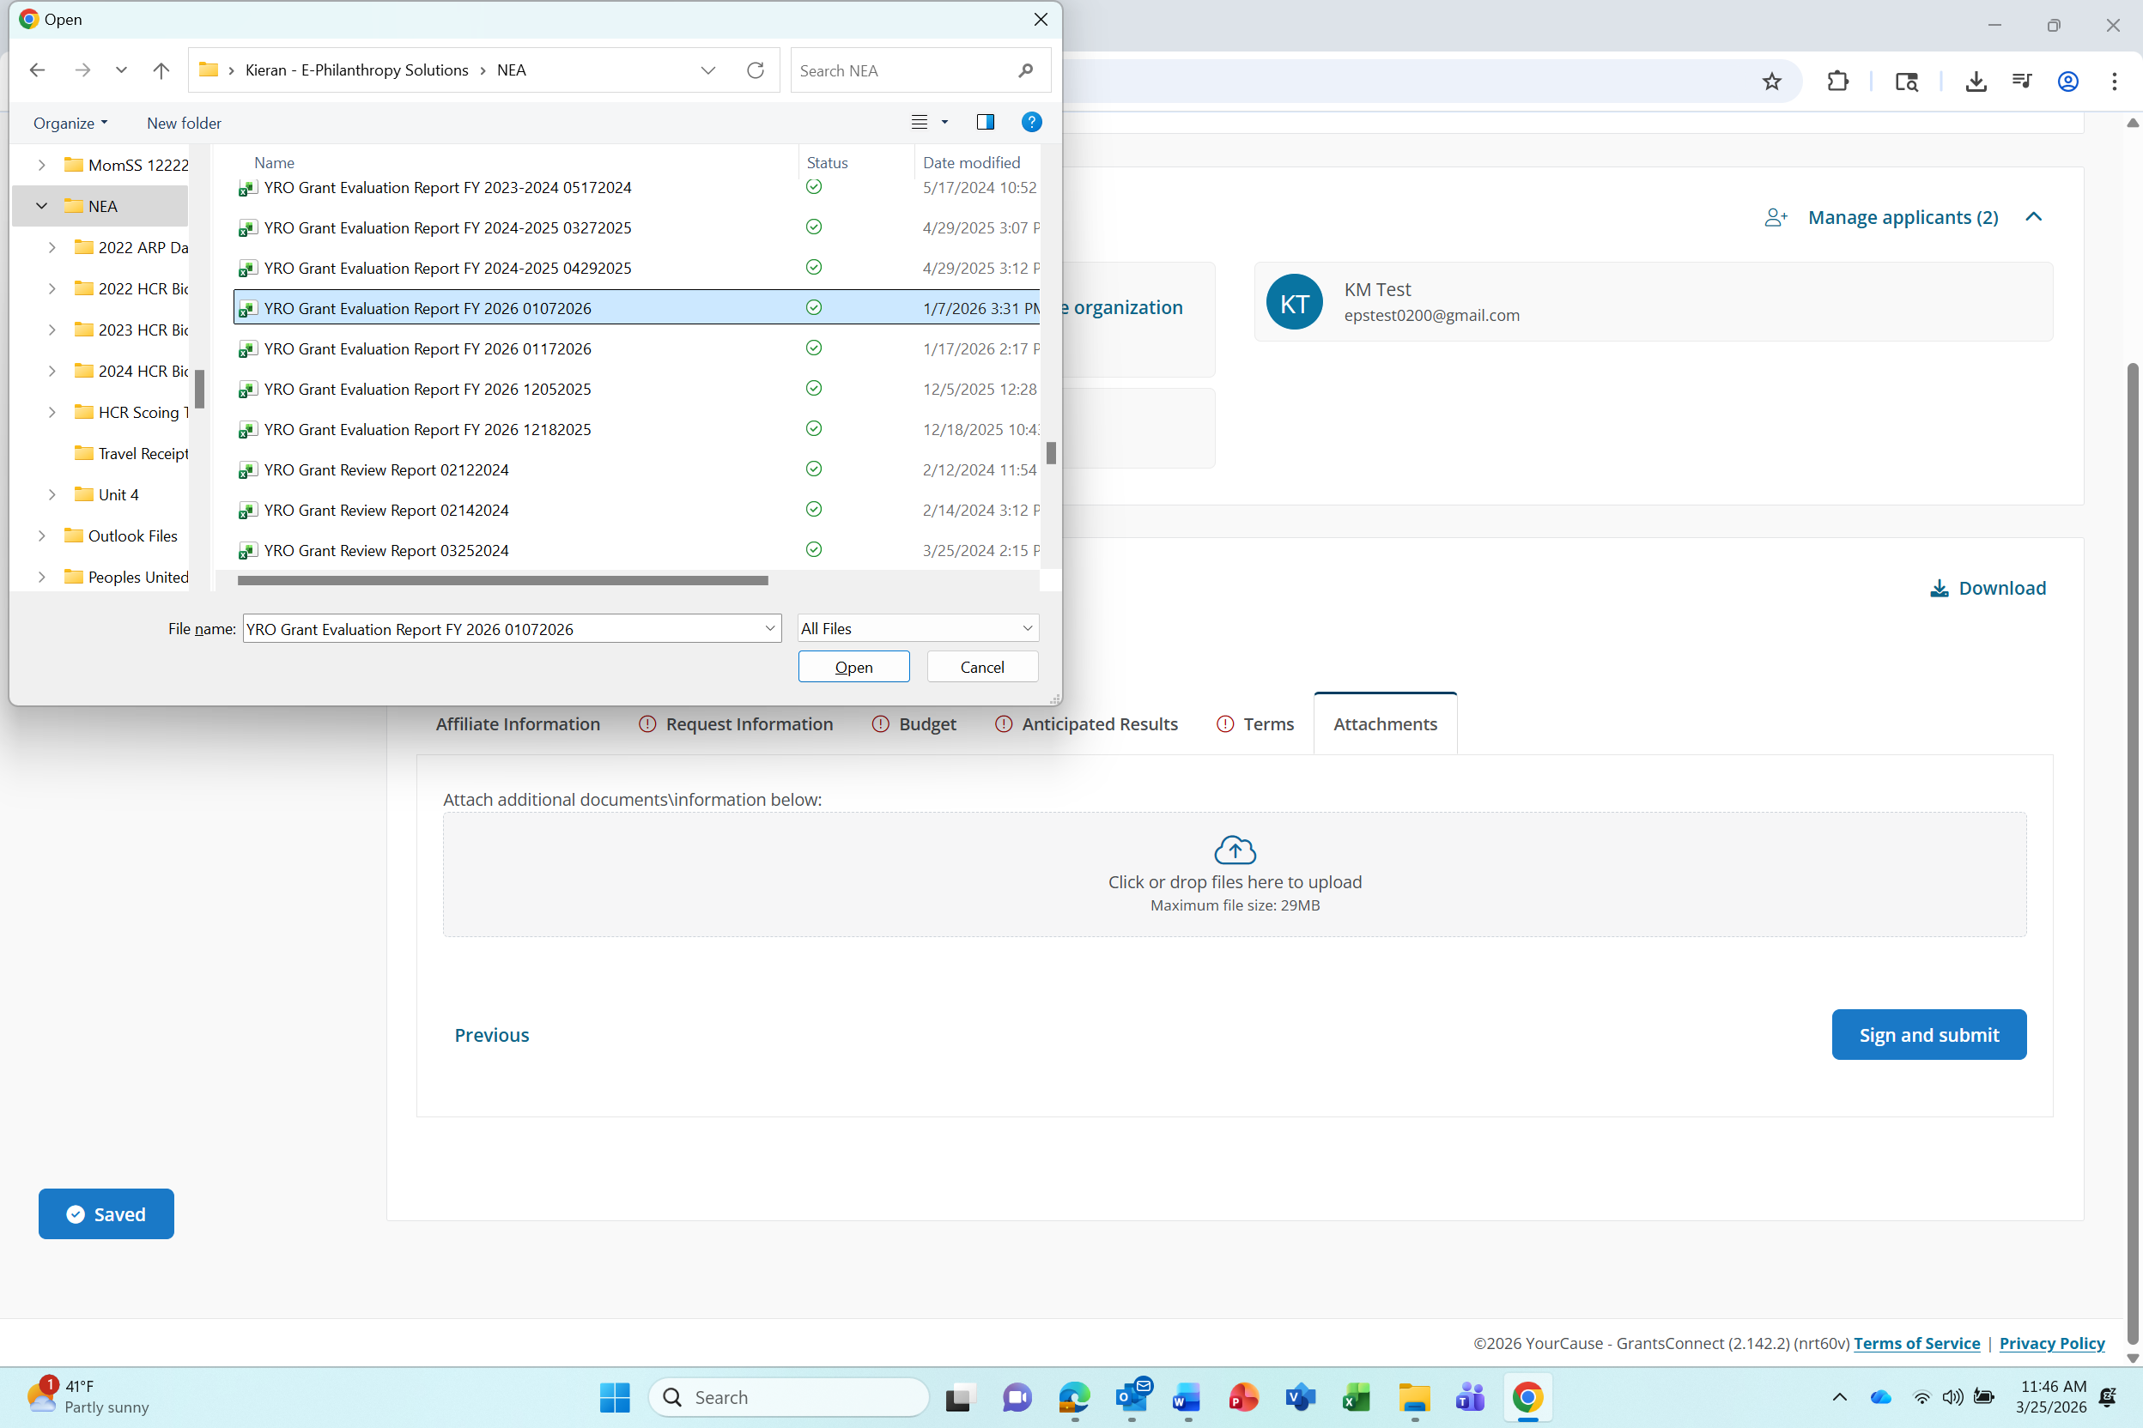
Upload Application Attachments
Notes:
On the Attachments page
CLICK
Click here to begin uploading an attachment file to your application
CLICK
A file explorer window will open. Select the file you want to upload
CLICK
Then click the Open button

Slide 36
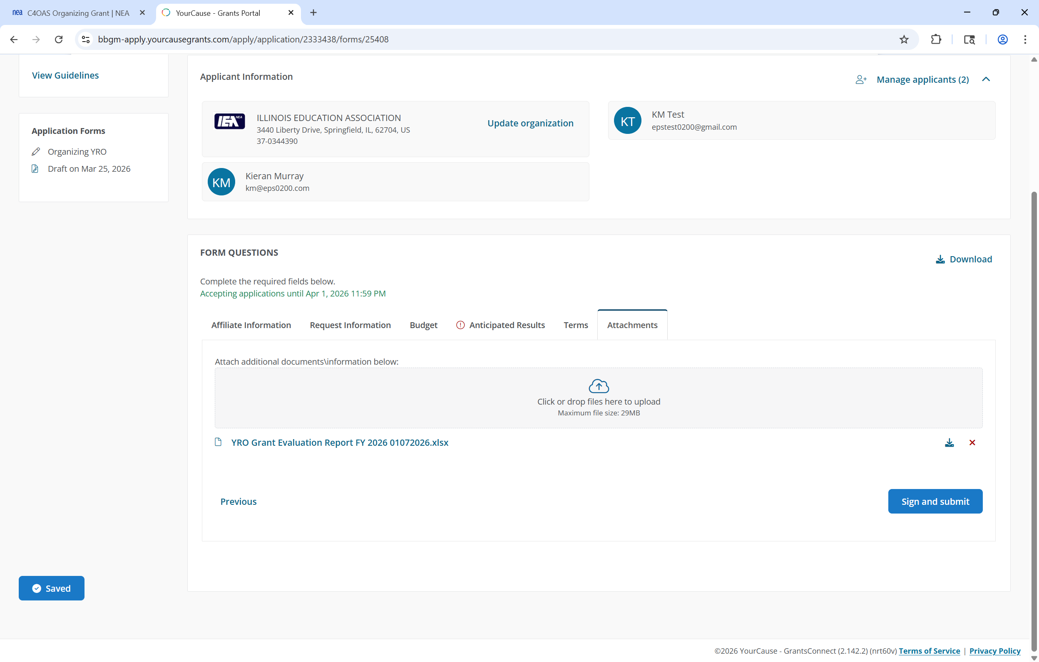
Submit Application
Notes:
CLICK
Your uploaded attachment file will appear here
CLICK
Once your application is complete, Click the Sign and Submit button

Slide 37
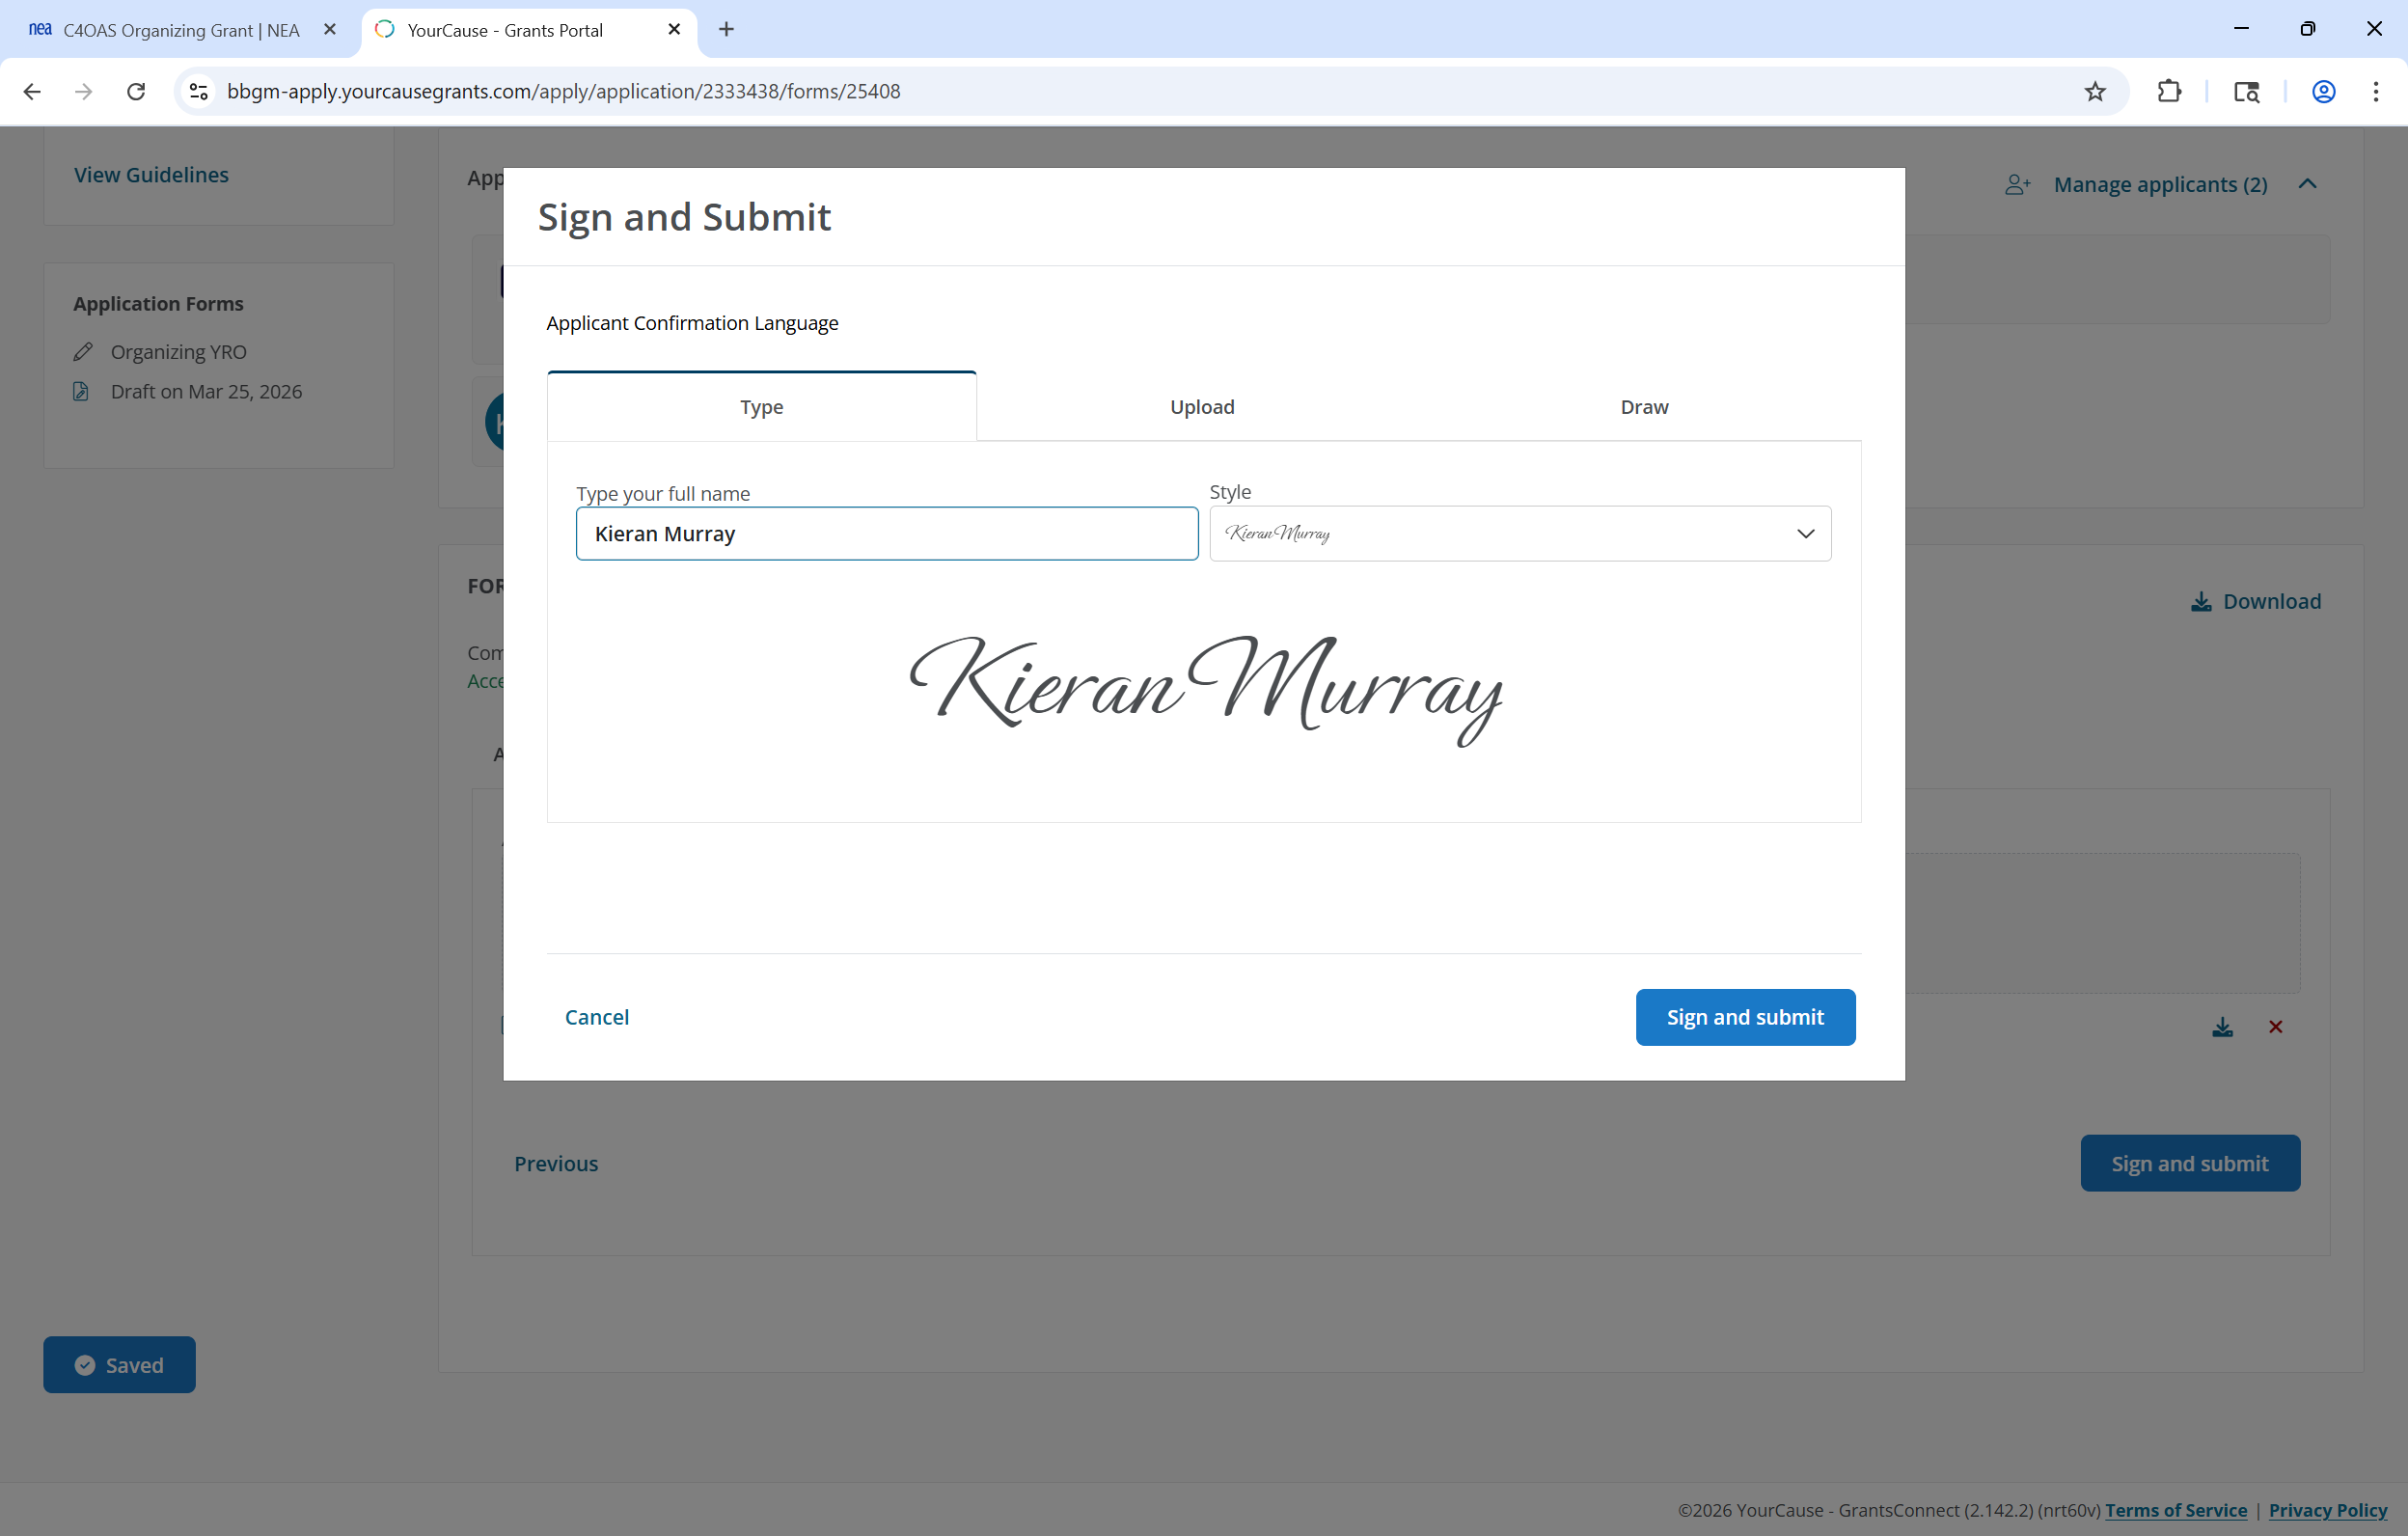
Sign and Submit Application
Notes:
CLICK
Type, upload or draw your signature
CLICK
Then click the Sign and Submit button

Slide 38
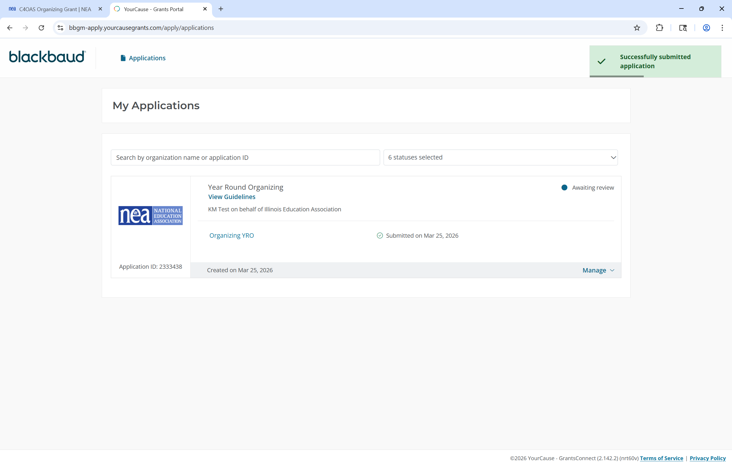
Submitted Application
Notes:
CLICK
You will receive an Application Successfully Submitted message
CLICK
And your submitted application will be added to your applicant portal for future access

Slide 39
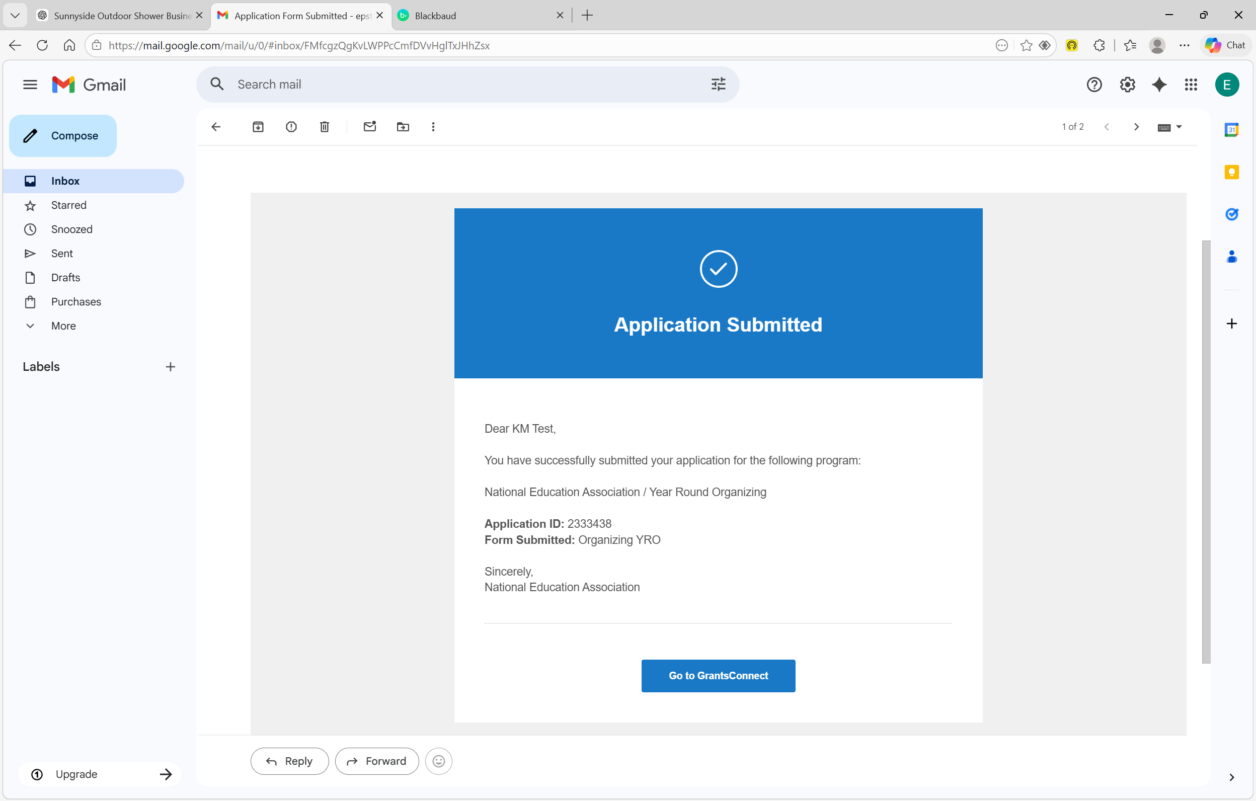
Application Submission Confirmation Email
Notes:
CLICK
You will also receive a confirmation email
CLICK
You can use the Go To GrantsConnect button to log back into your NEA Applicant Account Portal if necessary

Slide 40
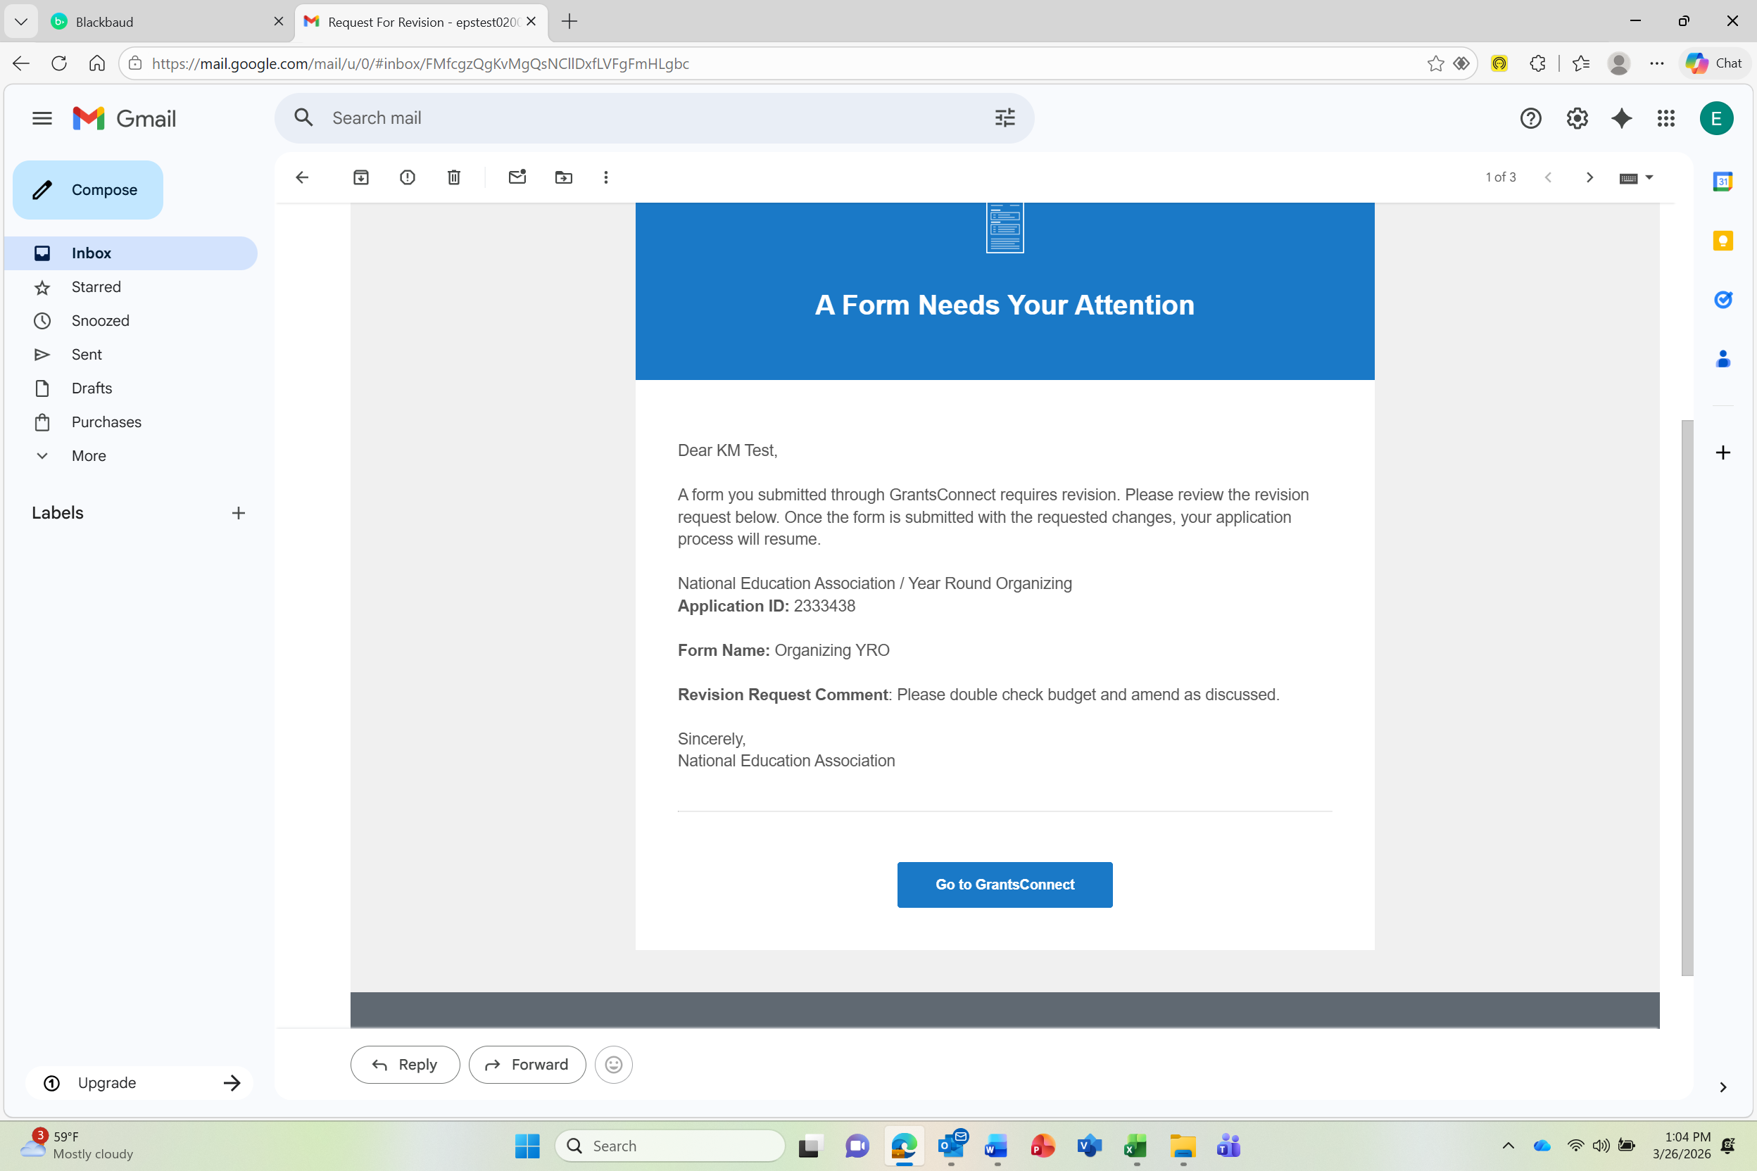
Application Resubmission Request Email
Notes:
If the NEA Program Manager wants you to make revisions to your application, they will send it back for revision via the Applicant Portal. You will receive a Resubmission Requested notification email
CLICK
The email will contain revision instructions
CLICK
Use the Go To GrantsConnect button to begin the resubmission process

Slide 41
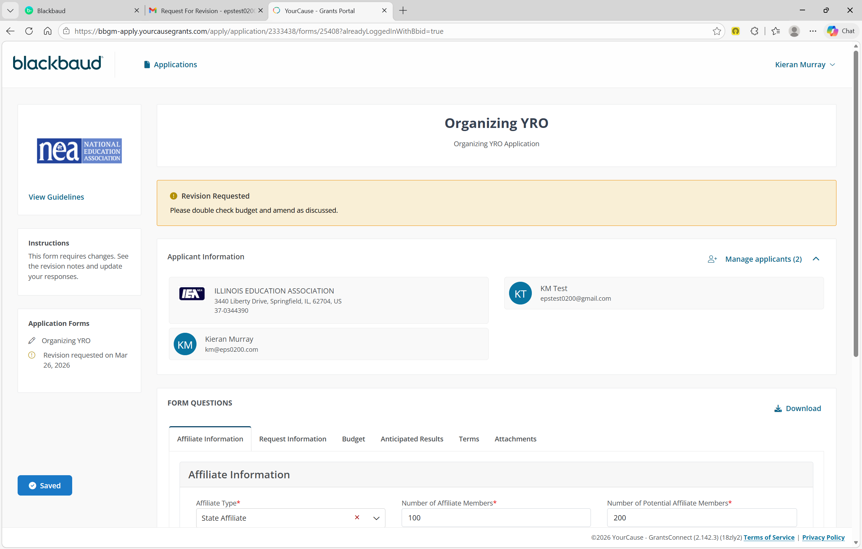
Revision Request Instructions
Notes:
The Revision Request will be highlighted at the top of your Applicant Portal homepage
CLICK
Application revision instructions will appear here
CLICK

Slide 42
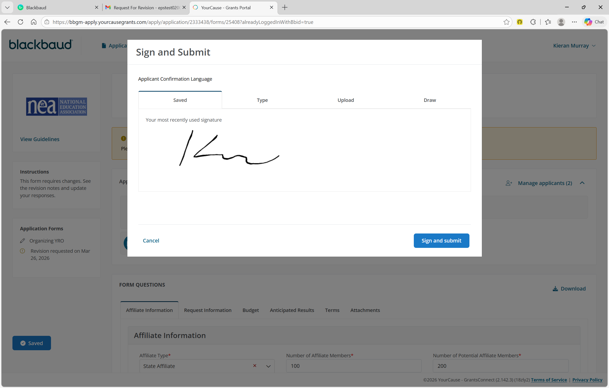
Resubmit Application
Notes:
Once you have revised your application, Sign it
CLICK
Then click the Sign and Submit button.

Slide 43
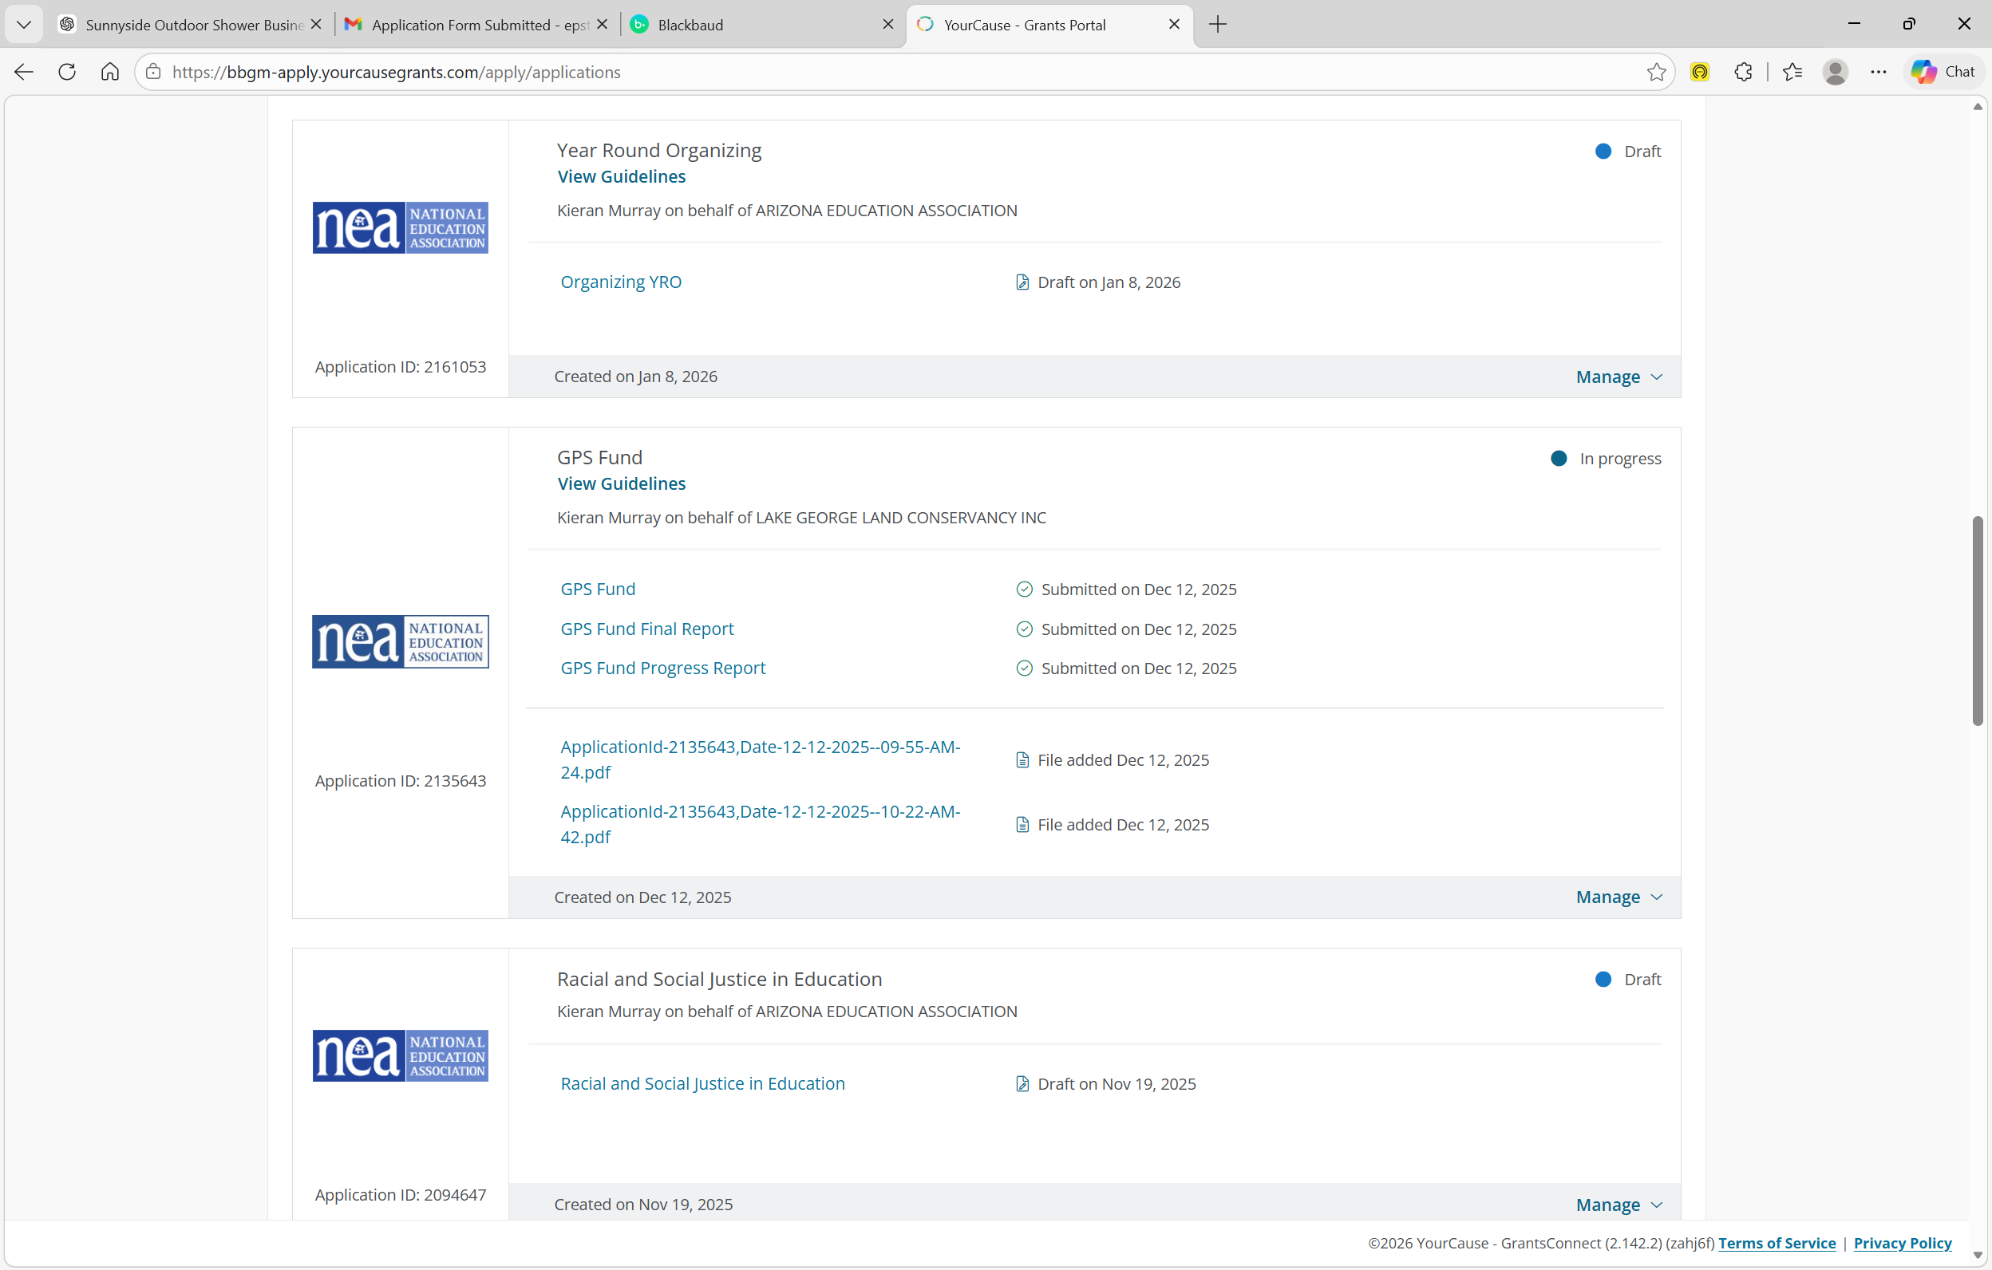
Progress and Final Reports
Notes:
CLICK
Progress and Final Reports will also be completed and accessible via the Applicant Portal
CLICK
In addition, to all attached documents you uploaded during the application and report submission processes

Slide 44
Thank You!
End of Training Video
Notes:
Thank You! This marks the end of the training video.

